Slide 2
Legal Historical Sources on the Internet
Workshop, Paris 7-10 February 2023
Kacper Górski (Jagiellonian University in Kraków)
E-mail: kacper.gorski@uj.edu.pl

Slide 3
Contents
Internet bases:
Digital libraries
Digital archives
Other tools:
AI-powered text transcription
On-line Latin dictionaries and glossaries
Latin grammar tools

Slide 4
Digital Libraries
Google Books - https://books.google.com
Internet Archive - https://archive.org
HathiTrust - https://www.hathitrust.org
Europeana - https://www.europeana.eu
Gallica - https://gallica.bnf.fr
German Digital Library (Deutsche Digitale Bibliothek) - https://www.deutsche-digitale-bibliothek.de
Federacja Bibliotek Cyfrowych (Federation of Digital Libraries) - https://fbc.pionier.net.pl

Slide 10
Digital Collections of Legal Sources
The Avalon Project - https://avalon.law.yale.edu
Monumenta Germaniae Historica - https://www.dmgh.de
Collection of Swiss Law Sources (Sammlung Schweizerischer Rechtsquellen) - https://editio.ssrq-online.ch/
IURA. Sources of Law from the Past (IURA. Źródła prawa dawnego) - https://www.iura.uj.edu.pl/

Slide 14
Digital Archives
Search the Archives (Szukajwarchiwach) - https://www.szukajwarchiwach.gov.pl
Virtual Manuscript Library of Switzerland - https://www.e-codices.unifr.ch
e-manuscripta - https://www.e-manuscripta.ch
Archivportal - https://www.archivportal-d.de
The National Archives - https://www.nationalarchives.gov.uk

Slide 15
Digital Archives
6. France Archives - https://francearchives.gouv.fr
7. Vatican Digital Library - https://digi.vatlib.it
8. Italian National Archive System - https://san.beniculturali.it Inventories: https://inventari.san.beniculturali.it/inventari
9. Archives Portal Europe - https://www.archivesportaleurope.net

Slide 26
Transkribus – Text Transcription and Text Recognition
Layout Analysis – automatic segmenting of text (printed or handwritten) – lines and regions (paragraphs) → manual transcription (free)
Handwritten Text Recognition (HTR) – automatic recognition of text (printed or handwritten) based on ready or self-trained model of recognition (behind the paywall)

Slide 27
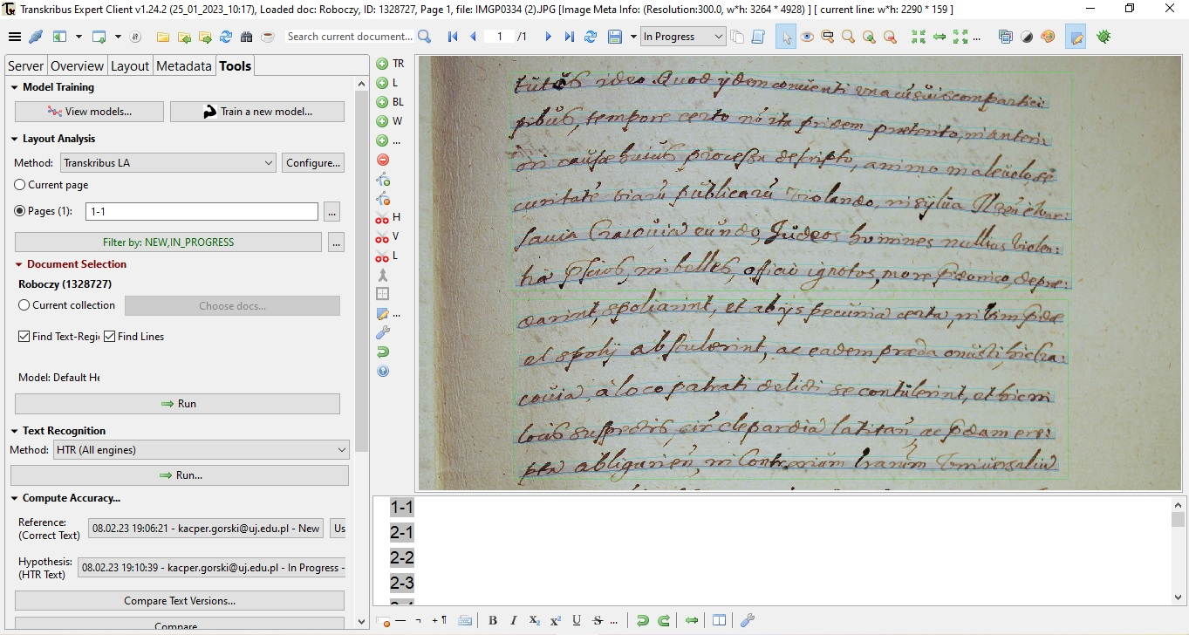

Slide 28
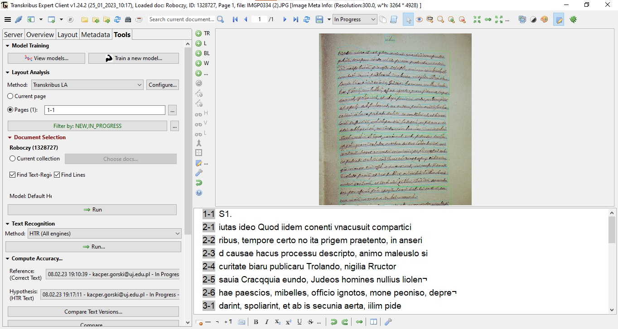

Slide 29
TRANSCRIPTION BY TRANSKRIBUS:
iutas ideo Quod iidem conenti vnacusuit compartici
ribus, tempore certo no ita prigem praetento, in anseri
d causae hacus processu descripto, animo maleuslo si
curitate biaru publicaru Trolando, nigilia Rructor
sauia Cracqquia eundo, Judeos homines nullius liolen¬
hae paescios, mibelles, officio ignotos, mone peoniso, depre¬
darint, spoliarint, et ab is secunia aerta, iilim pide
et spolii abstulerint, ac eadem praedi onusti sic lra¬
Source: own photography of MS Castrensia Cracoviensia 1101, p. 51 (National Archives in Kraków)
CORRECT TRANSCRIPTION:
[...]tutos ideo, Quod iidem conuenti vna cu[m] suis compartici:
pibus, tempore certo no[n] ita pridem praeterito, in anteri:
ori causae huius procesu descripto, animo maleuolo se:
curitate[m] viaru[m] publicaru[m] violando, in sylua Ilzen[si] e War:
sauia Cracouiam eundo, Judeos homines nullius violen:
tiae p[rae]scios, imbelles, officio ignotos, more p[rae]donico, deprae:
darint, spoliarint, et ab iis pecuniam certam, in vim p[rae]dae
et spolii abstulerint, ac eadem praeda onusti, hic Cra:[...]

Slide 30
Online Latin Dictionaries and Glossaries (General, Ancient)
Lexicon Totius Latinitatis by Egidio Forcellini - http://www.lexica.linguax.com/forc.php
A Latin Dictionary by Ch. Lewis and Ch. Short - https://artflsrv03.uchicago.edu/philologic4/LewisShort521
Dictionnaire Illustré Latin-Français by Félix Gaffiot - https://gaffiot.fr
Thesaurus Linguae Latinae - https://publikationen.badw.de/de/thesaurus/lemmata

Slide 35
Online Latin Dictionaries and Glossaries (Medieval and Early Modern)
Glossarium ad scriptores mediae et infimae latinitatis by Ch. du Fresne, sieur du Cange (DuCange) - http://ducange.enc.sorbonne.fr
Dictionary of Medieval Latin from British Sources (DMLBS) - http://www.dmlbs.ox.ac.uk
Lexicon Mediae et Infimae Latinitatis Polonorum (Słownik łaciny średniowiecznej w Polsce) - https://elexicon.scriptores.pl/pl
Latinititatis Medii Aevi Lexicon Bohemorum - http://lb.ics.cas.cz/#cs
Mittellateinische Wörterbuch (MLW) - https://mlw.badw.de/en/mlw-digital/mlw-open-access.html
Latinitatis italicae medii aevi lexicon
Novum Glossarium Mediae Latinitatis (NGML) - https://glossaria.eu/ngml

Slide 41
Online Latin Meta-Dictionaries
Logeion (ΛΟΓΕΙΟΝ) – https://logeion.uchicago.edu contains:
A Latin Dictionary by Lewis and Short (L&S);
Dictionary of Medieval Latin from British Sources (DMLBS);
Glossarium ad scriptores mediae et infimae latinitatis by du Cange (DuCange);
Dictionnaire Illustré Latin-Français by Gaffiot (Le Gaffiot);
Woordenboek Latijn/Nederlands edited by Harm Pinkster (LaNe).

Slide 43
Online Latin Meta-Dictionaries
Database of Latin Dictionaries (DLD) – through Brepols contains:
concerning classical Latin: Forcellini’s Lexicon Totius Latinitatis, Lewis and Short Latin Dictionary, Le Gaffiot;
concerning patristic age: Dictionnaire latin-français des auteurs chrétiens by Albert Blaise, A Glossary of Later Latin to 600 A.D. by Alexander Souter;
concerning medieval and early modern Latin: Lexicon latinitatis medii aeui by Albert Blaise, Du Canges’ Glossarium mediae et infimae latinitatis, national dictionaries of medieval Latin from 20th century: Italian Latinitatis italicae medii aevi lexicon, Hungarian Glossarium mediae et infimae Latinitatis regni Hungariae by Antonius Bartal (1901) , Spanish Lexicon Latinitatis Medii Aevi Regni Legionis (s. VIII-1230) imperfectum (2010) , British Dictionary of Medieval Latin from British Sources (see above) and Czech Latinitatis medii aevi Lexicon Bohemorum (see above);
many others thematic and medieval dictionaries.

Slide 45
Grammar Tool
Whitaker’s WORDS – a Latin translation software
more than 39 000 entries
offers grammatical analysis of a typed word in terms of part of speech, gender, case, number, comparison, numeral sort, tense, number of conjugation, voice, mood, pronoun type.
Legible Latin – user-friendly Whitaker’s WORDS
downloadable from https://www.softpedia.com/get/Others/Home-Education/Legible-Latin.shtml#sgal_4

Slide 48
Thank you for your attention!
Workshop, Paris 7-10 February 2023
Kacper Górski (Jagiellonian University in Kraków)
E-mail: kacper.gorski@uj.edu.pl
© — 2023 — Jagiellonian University. All rights reserved. Licensed to the European Union under conditions.
CC 4.0 BY NC

