Slide 2
Beatrice Pasciuta Guido Rossi (Università di Palermo)
Typologie des sources juridiques
Paris, 8 Février

Slide 3
Juridical Sources
Normative sources (top-down regulation)
Doctrinal sources (interpretation and reflection)
Practical sources (concrete application)

Slide 4
The top-dawn regulation sources
normative sources "inherited from the past"
"new" normative sources
Universal normative sources
Particular normative sources
From the past - Justinian Law
New - Decretals and canons; Law of the kingdoms; Statutes etc.
Universality - Justinian Corpus Juris; Decretals and canons
Particularism - Law of the kingdoms; Statutes etc.

Slide 5
Justinian's Corpus Iuris
Codex repetitae praelectionis
(534)
Digestum (533)
Institutiones (533)
Novellae
Constitutiones, edicta, rescripta; 12 books
Iura; 50 books
4 books
Authenticum
Epitome Iuliani

Slide 6
Quotation
D. (or Dig.), book, title and fragment
C. (or Cod.), book, title, law or pr. (principium)
I. (or Inst.), book, title, paragraphs.

Slide 7
CODEX: C. 1.1.1

Slide 8
https://droitromain.univ-grenoble-alpes.fr/corpjurciv.htm

Slide 10
Libri Legales
Digestum Vetus (D. 1.1 – D.24.2)
Digestum Novum (D. 39.1 – D.50.17)
Digestum Infortiatum (D. 28.3 – D. 38.17)
Codex (C. 1-9)
Authenticum (C. 10-12; Institutiones; Novellae)

Slide 11
http://manuscripts.rg.mpg.de/search/

Slide 12
Digestum Vetus (Vat. Lat. 1406) https://digi.vatlib.it/view/MSS_Vat.lat.1406

Slide 13
Pal. Lat 734, ff. 3v-4r

Slide 14
Digestum Vetus, s.l., 1513 ff.XIV r-v (D. 1.5.9) https://www.google.it/books/edition/Corpus_iuris_civilis/GfRgAAAAcAAJ?hl=it&gbpv=1&dq=digestum+vetus&printsec=frontcover

Slide 15
Medieval sistem of quotations
Codex - C. followed by the first words of the title and the first words of the law and possibly the first words of the paragraph.
(C. de prescrip. lon. temp. l. fi. = book 7, tit. de praescriptione longi temporis, final law (C. 7.33.12).
Digest - ff. followed by the first words of the book, title and fragment, and possibly the paragraph.
(ff. de tributo. l. Quod in herede §eligere = book XIV, title de tributoria actione,l.quod in herede dicimus, par. eligere = (D. 14.4.9, 1)
Institutiones - Inst., followed by the first words of the book, title and paragraph

Slide 16
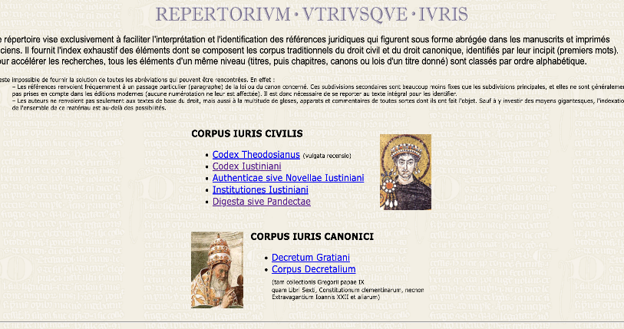
http://www.palaeographia.org/utriusque/repertorium.htm

