Slide 1


Slide 2

Generi dialettici: quaestiones, distinctiones, brocardica
David De Concilio
Università di Padova

Slide 3

Why «dialectical» genres?
12th c.: birth of several new genres in the legal schools
Connected to the ways of transferring knowledge in all the fields
Scholastic method = method of inquiry to reach knowledge
Use of the liberal arts = rhetoric and logic (dialectic)
Rediscovery of Aristotle
Dialectic as a tool for knowledge bu also as a simulation of the forensic activity

Slide 4
Legal literary genres: essential bibliography
Coing, H. (cur.). Handbuch der Quellen und Literatur der neueren europäischen Privatrechtsgeschichte. München, 1973-1988.
Colli, V. Termini del diritto civile. In Id., «Giuristi medievali e produzione libraria». Goldbach, 2005, pp. 127-138.
Kuttner, S. Repertorium der Kanonistik (1140-1234). Prodromus corporis glossarum. Città del Vaticano, 1937.

Slide 5
1. Distinctiones

Slide 6
What a distinctio is
Method:
  Separation of a concept into logical parts to specify their various fields of application (exegetical technique of the divisio)
  Subdivision according to a binary logic
  Hierarchical classification from general to particular (genus/species)
  Emphasis on analogies and differences
  «Methodological passepartout» in schools (both legal anon non-legal)
  Used as a method in all the legal literary genres
Genre:
  Collections of distinctiones which circulate autonomously

Slide 7
Example of a distinctio
Sciendum est quod ignorantia alia est pena alia culpa. Ignorantia que est culpa nocet et de ea dicitur «qui ignorat ignorabitur» et noluit intelligere ut bene ageret, et iusta neminem excusat, ut Infra c. Quia ea (C.3 q.2 c.9). Ignorantia que est pena quemlibet excusat. Ignorantia pena aliter iuris aliter facti. Illa que est iuris, aliter est naturalis, aliter iuris civilis, aliter canonici. Ignorantia iuris naturalis nullum adultum excusat. Ignorantia iuris civilis aliquos excusat, ut rusticos, milites et mulieres. Ignorantia iuris canonici clericos non excusat. Ignorantia facti aliter probabilis alia crassa et supina. Illa que est probabilis quandoque excusat, ut i. q. i. Si qui a simoniacis (C.1 q.1 c.108)., et ix. q. i. Ordinationes (C.9 q.1 c.5), et xxxiv. q. ultima In lectum (C.34 q.1–2 c.6). Illa que est crassa et supina non excusat, ut xvi. D. Quod dicitis (D.16 c.14) et xii. q. ii. Qui et humanis (C.12 q.2 c.24).
One should know that ignorance is either pain or guilt. Ignorance that is guilt harms, and of it is said «he who is ignorant will be ignored» (1 Corinthians 14:38 and he did not want to understand how to act well, and this does not exonerate anybody from what is due […]. Ignorance which is pain excused anybody. Ignorance that is pain is either ignorance of law or of fact. That of law is either of natural law, or of civil law, or of canon law. Ignorance of natural law does not excuse any adult person. Ignorance of civil law excuses some, like peasants, soldiers, and women. Ignorance of canon law does not excuse clerics. Ignorance of fact is either probable or gross and sheer. Probable ignorance can sometimes excuse […] That which is gross and sheer does not excuse […]
Munich, BSB, Clm. 7622, fol. 51rb

Slide 8
Example of a distinctio
Naturalis
Nullum adultum excusat
Iuris
Civilis
Aliquos excusat
Canonici
Clericos non excusat
Pena
Quemlibet excusat
Ignorantia
Probabilis
Quandoque excusat
Facti
Crassa et supina
Non excusat
Culpa
Neminem excusat

Slide 9
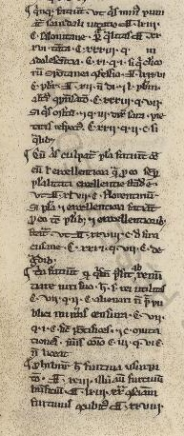
Quinque faciunt ut quis minus puniatur: scandali vitatio, D. lxiii. c. Salonitane (D. 63 c. 24); personae qualitas, D. xxxvi. Tanta (D. 86 c. 24), C. xxxiii. q. In adolescentia (C. 33 q. 2 c. 14), C. xi. q. i. Si qui clericorum (C. 11 q. 1 c. 25); spontanea confessio, D. lxxxvi. c. Presbiter (?), D. 12 Non di. (D. 12 c. 1) et l. Presbiterum (D. 50 c. 3); alterius conpensatio, C. xxxiii. q. vii. Si quis multum (?) et q. iii. Dixit Sara (C. 32 q. 4 c. 3); pietatis respectus, C. xxii. q. ii. c. Si qualibet (C. 22 q. 2 c. 20).
Incipit highlighted by a paragraph mark §
Simple text
Vatican, Biblioteca Apostolica Vaticana, Borgh. 287, fol. 9ra (Distinctiones “Hec sunt que suadent”)

Slide 10
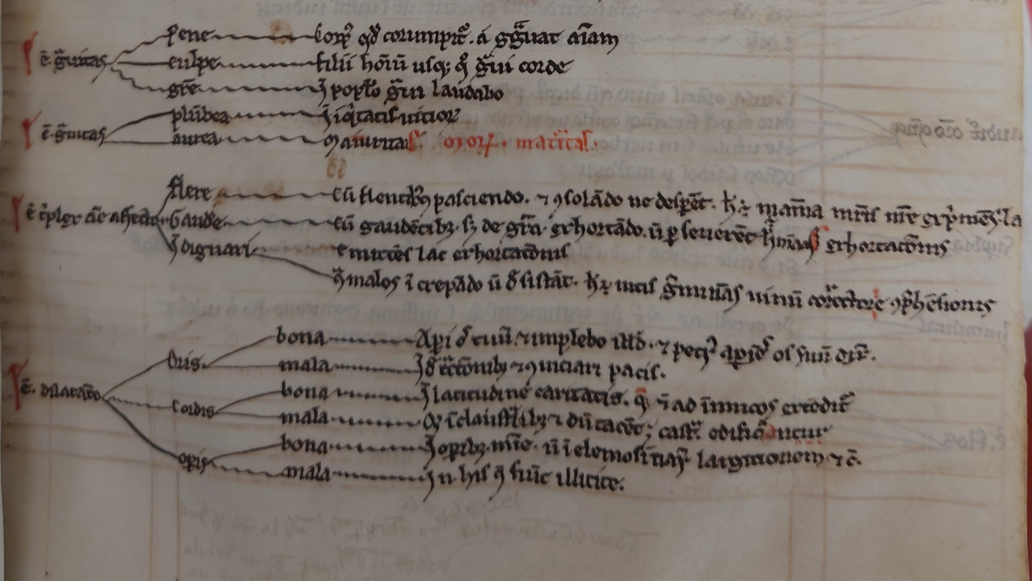
Diagrams
Cambridge, Pembroke College, 101 fol. 27r (Distinctiones)

Slide 11
Distinctiones: essential bibliography
Meyer, C. Die Distinktionstechnik in der Kanonistik des 12. Jahrhunderts. Ein Beitrag zur Wissenschaftsgeschichte des Hochmittelalters. Leuven, 2000.
Seckel, E. Distinctiones glossatorum. Studien zur Distinktionen-Literatur der romanistischen Glossatorenschule. Graz, 1956.
Genzmer, E. Vorbilder für die Distinctionen der Glossatoren, in Acta Congressus Iuridici Internationalis VII saeculo a decretalibus Gregorii IX et XIV a Codice Iustiniano promulgatis, vol. 2. Rome, 1935, pp. 345-58.

Slide 12
2. Quaestiones

Slide 13
What a quaestio is
It implies a quaerere, i.e., a question regarding a problem
It is both a method and a genre
  Teaching method: application of dialectics to solve the contrast between diverging opinions
  Literary genre: collective term to indicate various scholastic genres characterised by the use of this method
Non only in legal schools: theological and medical quaestiones
Legal schools examine the quaestio iuris: the legal characterisation of a fact
Pro and contra
Solutio: the antinomy is only apparent (distinctio)

Slide 14
Types of quaestiones
Quaestiones legitimae
  They solve contradictions between norms
  Systematic purpose
  Parts of the lesson of the master
Quaestiones disputatae
  Casuistic purpose: simulation of a court case
  Class exercises by students
  Initially collected by students (q. reportatae), then by the masters (q. redactae)
  Initially fictitious cases (q. de facto), then taken from practice (q. ex facto emergentes)

Slide 15
Example of quaestio 1/2
Cum Romana ecclesia persecutione quorundam fere pateretur naufragium, vocavit summus pontifex imperatorem Romanum ut liberaret sponsam Dei ab incursione hostium. Tandem venit imperator in Italiam. Pepigit apostolicus cum cardinalibus et cum imperatore quod nullum fedus inirent cum rege Siculo absque imperatoris concilio. Procedente autem tempore, cum imperator tardaret, item investivit dominus apostolicus regem Siculum de Apulia, et postquam audivit imperator, nimium turbatus conqueritur de pacti fracta fide, subtrahit obsequium Romane curie, vult eligere iudices ut cognoscant suam et domini apostolici rationem. Papa vero non vult se submittere iudicio cuiuslibet. In hoc themate ii. formantur questiones: prima est an tali facto debeat imperator subtrahere suum servitium. Secunda est an ratione possit convenire Romanum pontificem. Solutio: non potest eum convenire nec debet ei subtrahere obedientiam.
When the Roman Church was nearly shipwrecked by the persecution of certain people, the supreme pontiff called upon the Roman emperor to liberate the bride of God from the onslaught of enemies. Finally, the emperor came to Italy. The pope, with the cardinals and the emperor, negotiated that he would enter into no treaty with the king of Sicily without the emperor’s consultation. However, as time passed and since the emperor delayed, the also invested the king of Sicily with Apulia. Upon hearing this, the emperor was greatly troubled and complained about the breach of the pact; he withdrew obedience from the Roman Curia and wanted to choose judges to hear his and the pope’s case. However, the Pope refused to submit to the judgment of anyone. In this matter, two questions arise: the first is whether the emperor should withdraw his allegiance due to such a fact. The second is whether he can sue the Roman pontiff in court. Solution: he cannot sue him, nor should he withdraw obedience from him."
Edition in G. Fransen, Canones et quaestiones, vol. 1.2, pp. 341-42

Slide 16
Example of quaestio 2/2
Q. i. ex parte imperatoris
C. xi. q. iii. Non semper malum (C.11 q.3 c.92)
C. e. Si dominus (C.11 q.3 c.93)
et c. Qui iustus (C.11 q.3 c.90)
C. xi. q. iii. C. Plurumque (C.11 q.3 c.88)
et c. Nemo clericorum (C.11 q.3 c.81)
D. xxi. c. Nolite (D.21 c.5)
Q. ii. Ex parte imperatoris
C. ii. q. vii. c. Nos si com. (C.2 q.7 c.41)
D. lxiii. c. Agatho (D.63 c.21)
et c. Adrianus (D.63 c.22)
et c. Quia sancta (D.63 c.28)
C. ii. q. iiii. c. Mandasti (C.2 q.5 c.10)
C. ii. q. iiii. C. Auditum est fratres (C.2 q.5 c.18)
C. xii. q. ii. Non liceat (C.12 q.2 c.3)
D. xcvi. c. Cum ad verum (D.96 c.6)
D. xc. Quoniam (D.100 c.1)
C. vi. q. i. c. Oves (C.6 q.1 c.9)
e. C. e. q. Sacerdos (C.6 q.1 c.8)
C. viiii. q. i. Quam sit separabile (C.7 q.1 c.9)
C. viii. q. i. c. Sciendum Summopere (C.8 q.1 c.10)
C. viii. q. iiii. Nonne (C.8 q.4 c.un.)
D. vii. Huic (D.17 c.3)
C. xxiii. q. Si dicat (C.33 q.5 c.1)
C. xi. q. i. c. Quia reus (C.11 q.1 c.50)
C. ix. q. iii. Quid ergo mirum (C.9 q.3 c.99)
C. viiii. q. iii. c. Nemo (C. 9 q.3 c.13)
C. e. q. e. c. Aliorum hominum (C.9 q.3 c.14)
et c. Facta (C.9 q.3 c.15)
et c. Cuncta per (C.9 q.3 c.17)
et c. Fratres (C.9 q.3 c.19)
C. viiii. q. iii. C. Patet (C.9 q.3 c.10)
C. xvii. q. iiii. Neminem (C.17 q.4 c.30)
D. xxi. c. Nunc autem (D.21 c.7)
D. lxxiii. § Verum quia imperatores (D.63 p.c.28)
D. xcvi. c. In scripturis (D.96 c.8)
Edition in G. Fransen, Canones et quaestiones, vol. 1.2, pp. 341-42

Slide 17
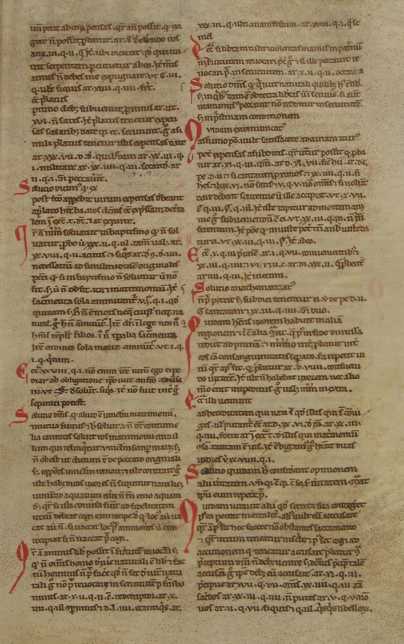
2 columns
Simple text
Rubricated initial letter
Quaestio with
allegations
Contra
Solutions
Barcelona, Archivo de la Corona de Aragón, Sant Cugat 55, fol. 100r (Quaestiones “Barcinonenses VIII”)

Slide 18
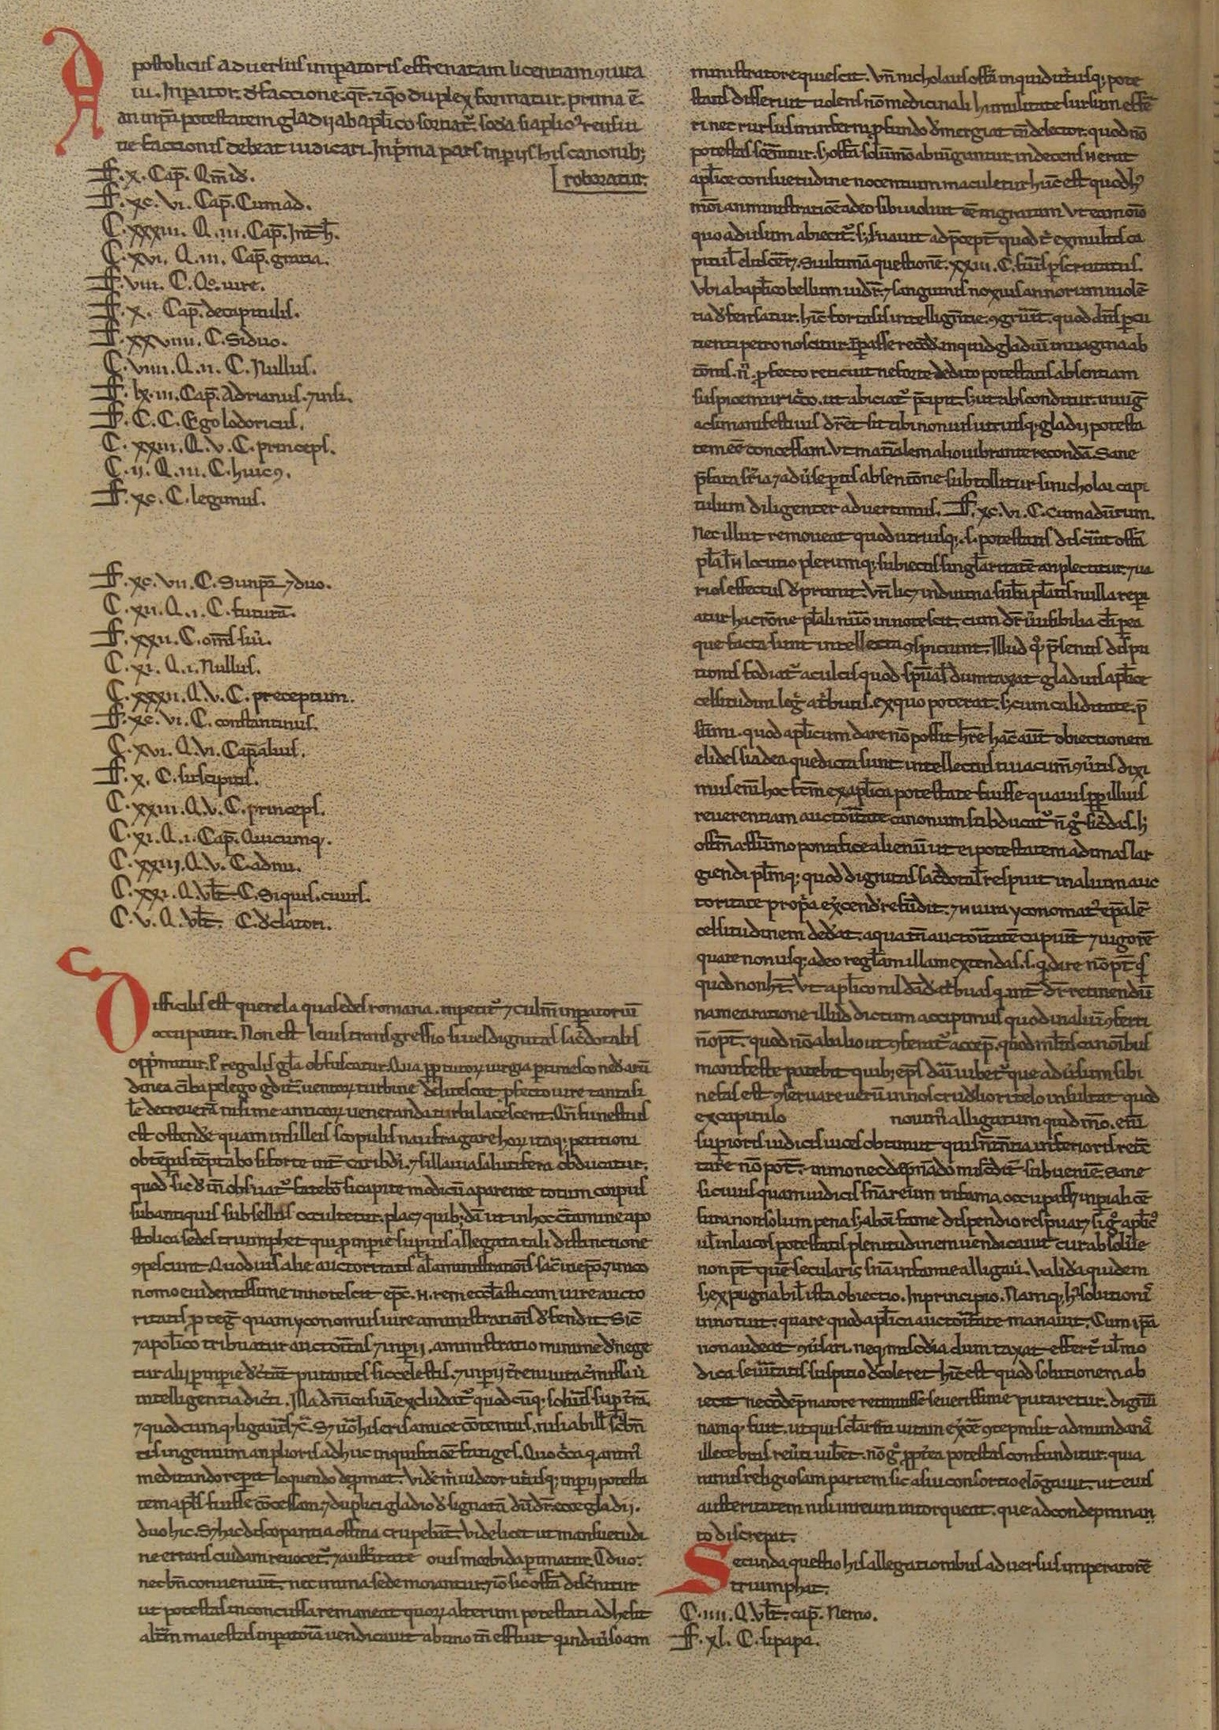
2 columns
Bigger text and smaller allegations
Barcelona, Archivo de la Corona de Aragón, Sant Cugat 55, fol. 62v (Quaestiones decretales “Barcinonenses VI”)
Incipit (Rubricated intial letter)
Allegations pro
Allegations contra
Solution

Slide 19
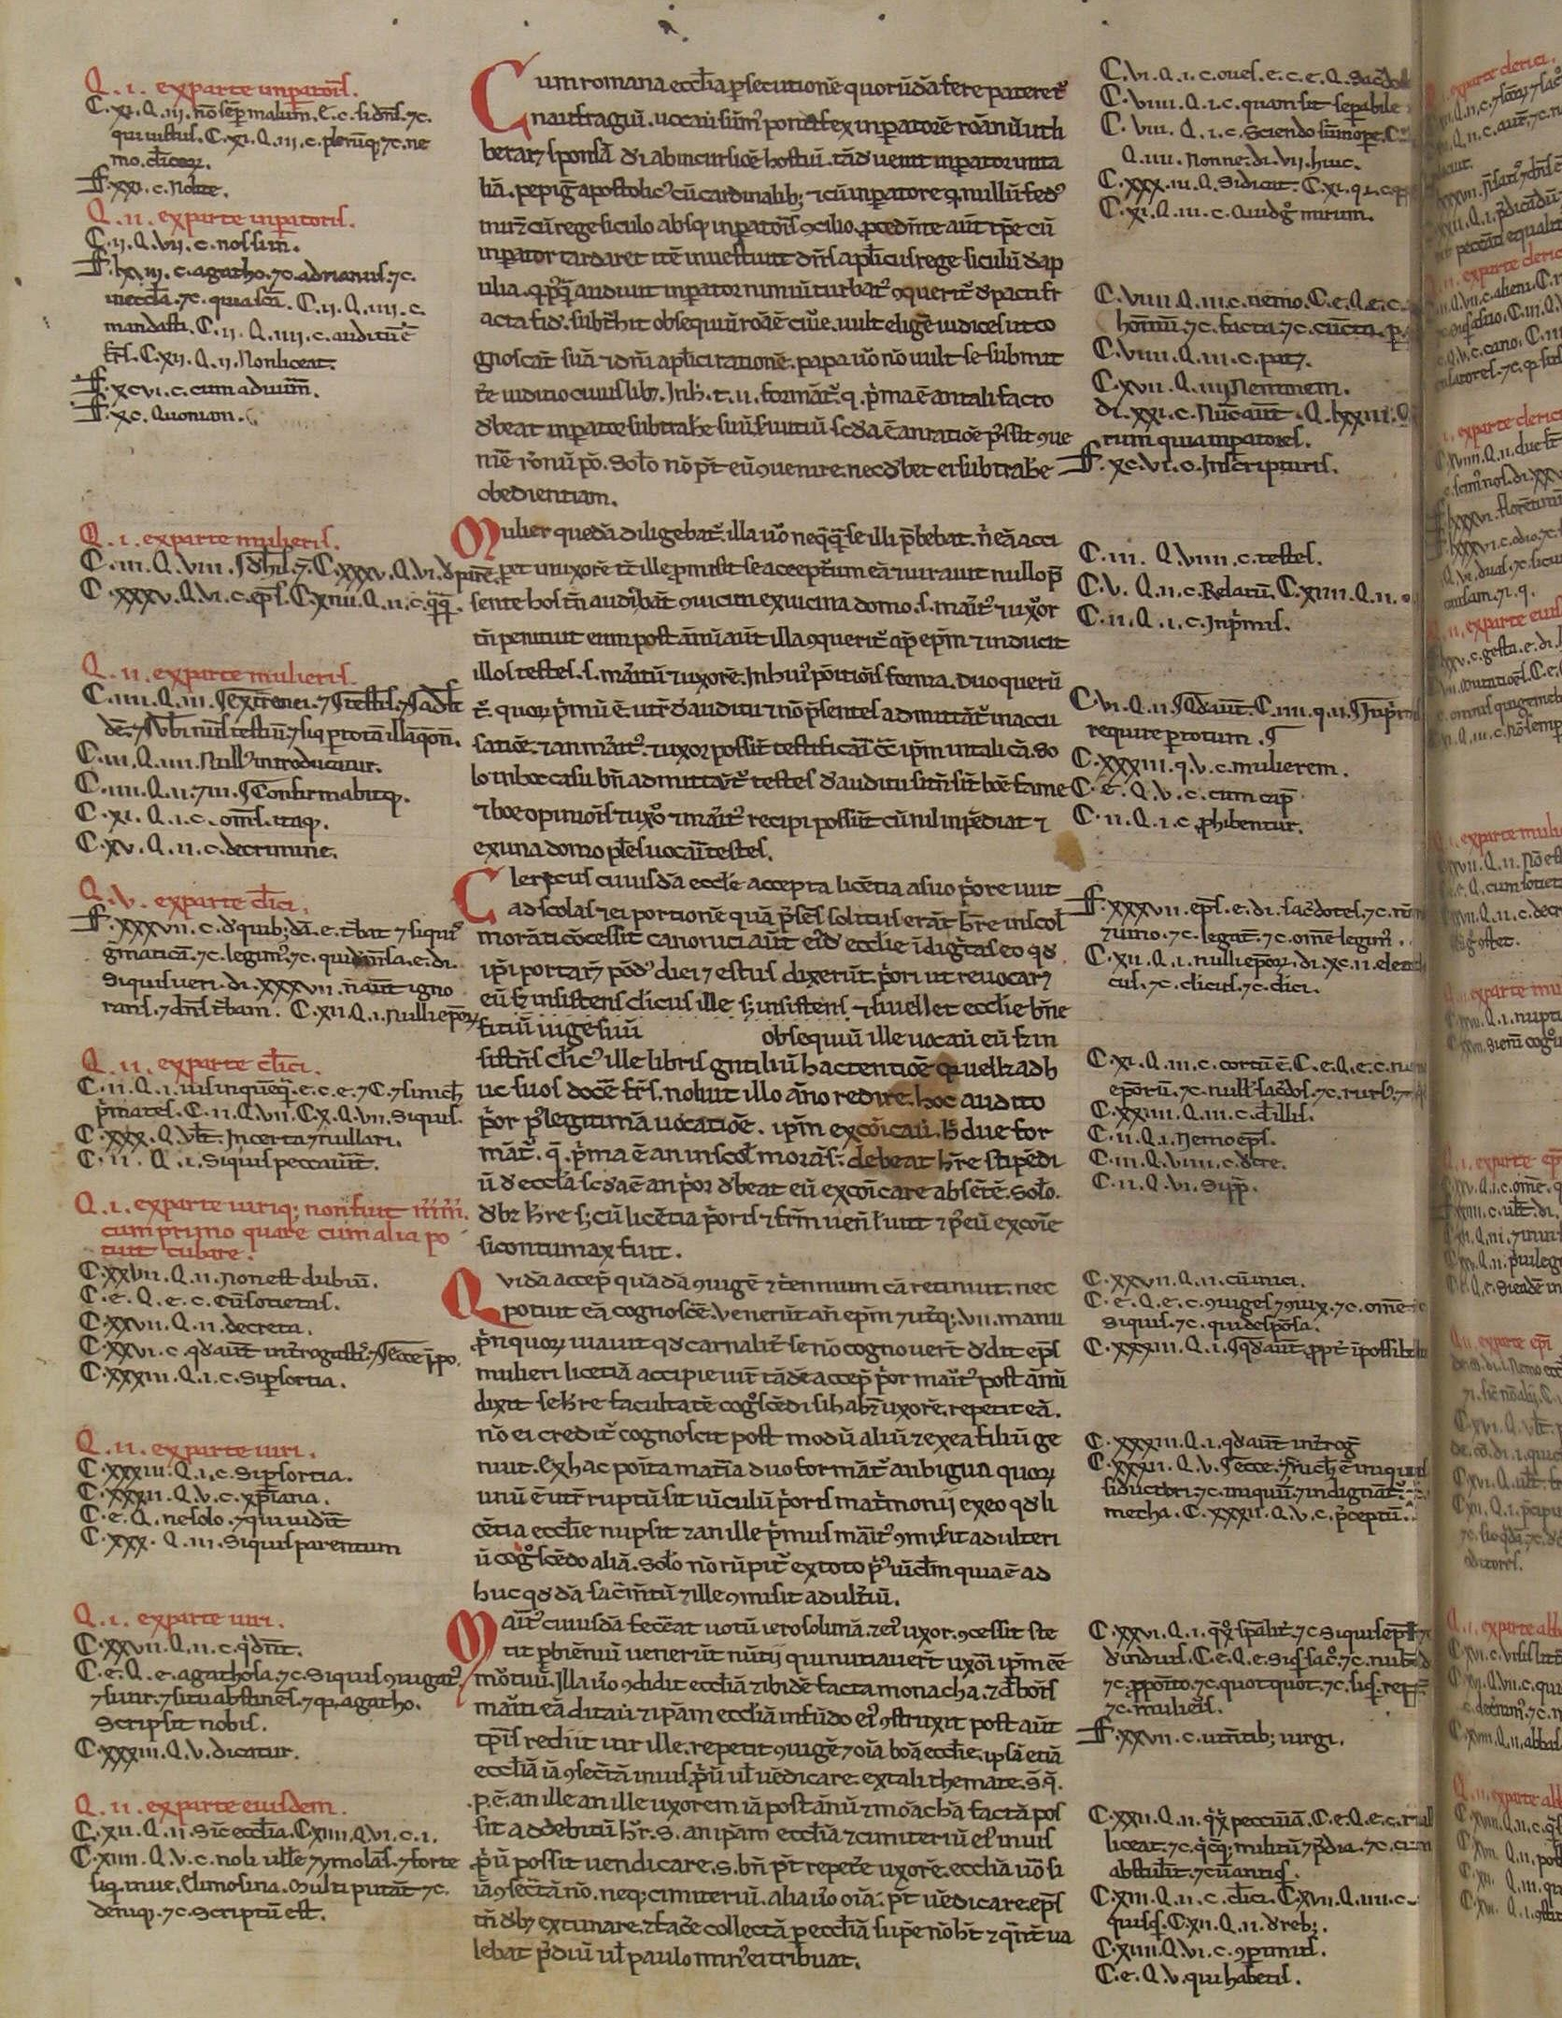
3 columns
Text in the middle and allegations on both sides
Barcelona, Archivo de la Corona de Aragón, Sant Cugat 55, fol. 59v (Quaestiones Barcinonenses breves)

Slide 20
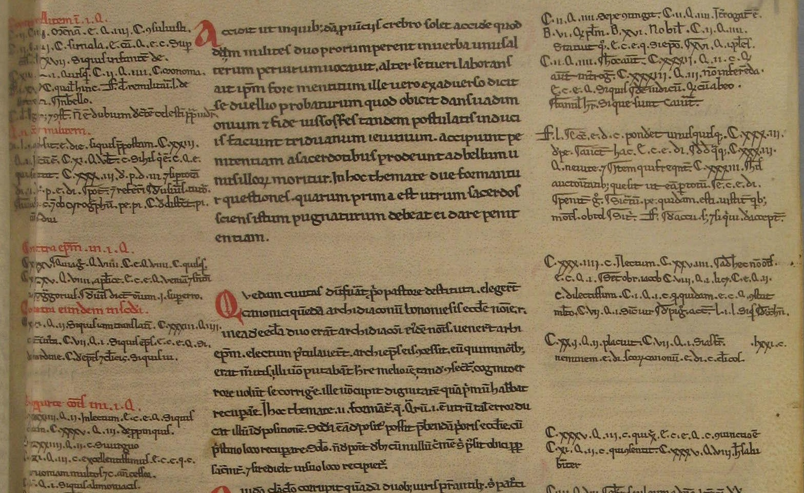
Allegations in one sense: contra militem in prima questione
Allegations
in the other sense: for the soldier
The first solution of each question is rubricated
Distinctio
within the quaestio
Edition in G. Fransen, Canones et quaestiones, vol. 1.2, pp. 338-40
Solutio
Barcelona, Archivo de la Corona de Aragón, Sant Cugat 55, fol. 59r (Quaestiones Barcinonenses breves)

Slide 21
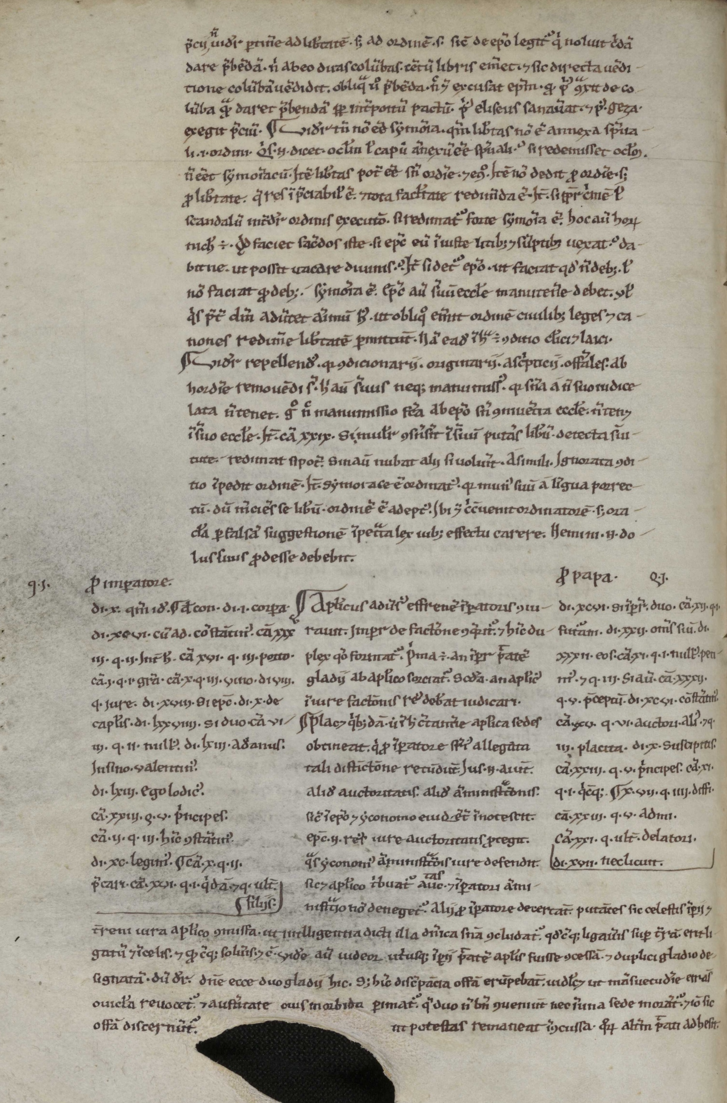
Leipzig, UB, Rep.II 4° 117, fol. 21v (Quaestiones Lipsienses IV.1)
Body text
of the previous quaestio
Incipit of the quaestio (paragraph mark §)
Allegations
in one sense: pro imperatore
Allegations
in the other sense: pro papa
Body text
of the quaestio

Slide 22
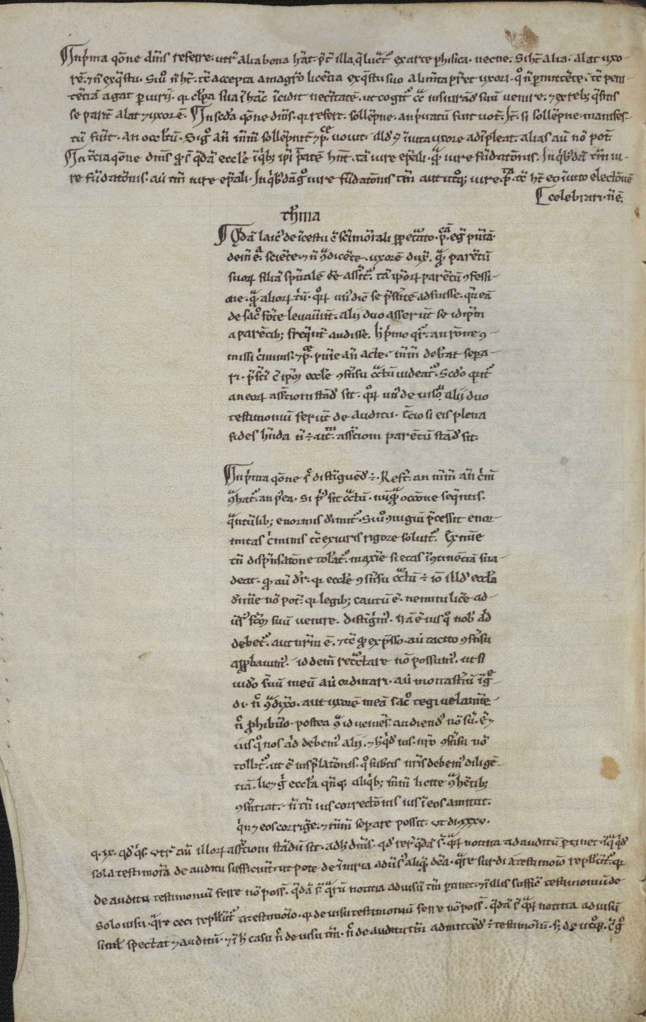
Leipzig, UB, Rep.II 4° 117, fol. 28v (Quaestiones Lipsienses IV.1)
}
3 quaestiones in the topic
Distinctio
within the quaestio
Room for the allegations
Room for the allegations

Slide 23
Quaestiones: essential bibliography
Bazàn, B. et al. (eds.). Les questions disputées et les questions quodlibétiques dans les facultés de Théologie, de Droit et de Médecine. Turnhout, 1985.
Bellomo, M. Quaestiones in iure civili disputatae. Didattica e prassi colta nel sistema del diritto comune fra Duecento e Trecento. Rome, 2008.
Belloni, A. Le questioni civilistiche del secolo XII. Da Bulgaro a Pillio da Medicina e Azzone. Frankfurt, 1989.
Fransen, G. Canones et quaestiones. Évolution des doctrines et système du droit canonique. Goldbach, 2002.
Kantorowicz, H. The Quaestiones Disputatae of the Glossators, in Id., Rechtshistorische Schriften. Karlsruhe, 1970, pp. 137-185.

Slide 24
3. Brocardica

Slide 25
What a brocard is
A legal maxim that concisely enunciates a legal principle
followed a list of norms for and against
and by a solution that solves the antinomy

Slide 26
Example of brocard
The same measure or currency that existed at the time of the contract is due.
The supervening one, whether major or minor, is due.
Eadem mensura vel moneta debetur, que erat tempore contractus.
In Decreto I q. I Principatus (c. 25 C. I q. 1).
In Authentico Ut cum de appellatione cognoscitur (Nov. 115) § I.
ff. si quis cautionibus Si quis quam (D. 2.11.11) et l. Qui autem § illud (D. 2.11.12.1).
ff. de edendo Ubi (D. 2.13.8) § I.
C. de legibus et constitutionibus Leges et constitutiones (C. 1.14.7).
ff. si certum petatur (D. 12.1) l. III, in fine.
ff. de evictionibus Bonitatis (D. 21.2.13).
ff. de legatis II Lucius Titius (D. 31.1.22).
ff. de legatis III Nomen debitoris § I (D. 32.1.34.1).
ff. de legatis III l. Uxorem et filium § testamento (32.1.41.4). [….]
Superveniens debetur, sive maior sive minor sit.
In Decreto XXIII, q. IIII Si Ecclesia (C. 23. q. 4 c. 42).
ff. de conditionibus et demonstrationibus Filie (D. 35.1.28) § ultimo.
ff. de liberis et posthumis Placet (D. 28.2.4).
ff. de legatis II Imperator (D. 31.1.70), § ultimo.
ff. si certum petatur Vinum (D. 12.1.22).
ff. de pignoribus Cum tabernam (D. 20.1.34), rubrica I.
ff. de furtis Infitiando § infans (D. 47.2.68.2).
ff. de fideiussoribus Si quis (D. 46.1.56) § si nummos.
ff. de operis libertorum (D. 38.1) l. I.
ff. de verborum obligationibus Inter stipulantem (D. 45.1.83) § ultimo.
ff. quorum legatorum Diversum (D. 43.3.2).
Edition in D. De Concilio, Moneta e cultura giuridica. Un brocardo di Azzone nella costruzione del diritto pecuniario medievale, «TVR», 87 (2019), pp. 384-426

Slide 27
Example of brocard
Solutio. Eadem mensura debet prestari, et eadem moneta: vel, si alia prestetur, habeatur ratio dampni. Statuta post contractum facta, futuris contractibus dant formam, non preteritis, ut C. de legibus et constitutionibus Leges (C. 1.14.7). Nec obstat quod legitur ff. de legatis II Imperator § ultimo (D. 31.70.3), et de pignoribus l. Cum tabernam (D. 20.1.34), et de furtis Infitiando § infans (D. 47.2.78.2), quia in his legibus non prohibetur, quin possint peti ea, que tempore testamenti vel contractus erant in hereditate, vel in bonis debitoris et in taberna, vel quin petatur utilitas, que erat tempore delicti: sed dicit, etiam in plus agi posse, vel dicitur, quod in primis duabus legibus facit illud tenor verborum testatoris; sicut et in ff. de conditionibus et demonstrationibus, Filie § ultimo (D. 35.1.28). […] . Nec obstat, quod legitur in ff. de rebus creditis l. Vinum (D. 12.1.22), quia ibi non loquitur in alia mensura, sed in eadem. Queritur autem de extimatione rei, quo tempore sit spectanda. Alie leges contrarie non videntur esse digne responsione.
Solution: The same measure must be returned, and the same currency; or, if a different one is given, the damage must be accounted for. Statutes made after the contract regulate future contracts, not past ones: C. 1.14.7. What is read in D. 31.70.3, D. 20.1.34 e D. 47.2.78.2 does not prevent this, because these laws do not forbid to claim those things that, at the time of the will or contract, were in the inheritance or in the debtor’s estate and shop, or to claim the damages that existed at the time of the illicit. Rather, it is said that it is also possible to act in excess, or it is said that the tenor of the testator's words in the first two laws allows it, just as in D. 35.1.28. […] It is not a hindrance what is read in D. 12.1.22, because it does not speak there of a different measure, but of the same. However, there is a question about the estimation of the thing, at what time it should be considered. Other laws that contradict it do not seem to be worthy of a response.
Edition in D. De Concilio, Moneta e cultura giuridica. Un brocardo di Azzone nella costruzione del diritto pecuniario medievale, «TVR», 87 (2019), pp. 384-426

Slide 28
Historical transformation of brocards
Brocards have not always been like this
Initially, they were only maxims that described the content of the following allegations
  Without contrarium and without solutio
Later, they are organised in a pro-contra form
At the end, solutiones are added

Slide 29
Example of a brocard without solutio
On will, works, and intention. The spirit, not works, has be considered, rewarded, punished.
De voluntate, opere et intentione. Animum, non opus, spectandum, remunerandum, puniendum.
C. xi. q. iii. Quod predecessor (C.11 q.3 c.105) “spiritualiter servasse.”
C. xxiii. q. viii. Occidit (C.23 q.8 c.14).
C. xxii. q. ii. Homines (C.22 q.2 c.3) “sed putat non pluisse,” “nisi rea mens.”
Q. eadem Is autem (C.22 q.2 c.4) “ille mentitur, qui dicit verum” et c. Beatus (C.22 q.2 c.5).
D. l. Presbiteros (D.50 c.32) “extra delictum”
et c. Quia te (D.50 c.38) et c. Eum qui (D.50 c.46).[….]
Contra.
D. l. Studeat (D.50 c.39) “voluntatem occidendi.”
D. eadem c. Eos (D.50 c.42) et c. Si qua (D.50 c.43) “si casu” et Si quis voluntarie (D.50 c.44) “si autem” et Qui saccum (D.50 c.45) “quamvis.”
D. eadem Quod factum (D.50 c.32) et c. Sepe (D.50 c.50) “vel negligentia.”
C. xxxi. q. iii. Si qui (C.31 q.3 c.un.) “excusati.” C. xxxiii. q. iii. D. i. Cogitatio (D.1 de pen. c.20).
C. xxxiii. q. iii. Hec autem verba (D.1 de pen. c.17) in i. pagina.
Edition in D. De Concilio, Via Brocardica, 2:171.

Slide 30
Munich, BSB, Clm. 7622, fol. 50va
(Perpendiculum)
Locus argumentorum
{
Rubric of the
brocard
Allegations
Other brocard
{
Rubric
(Argumentum)
Generale
Allegations pro
Contrarium
Allegations contra

Slide 31
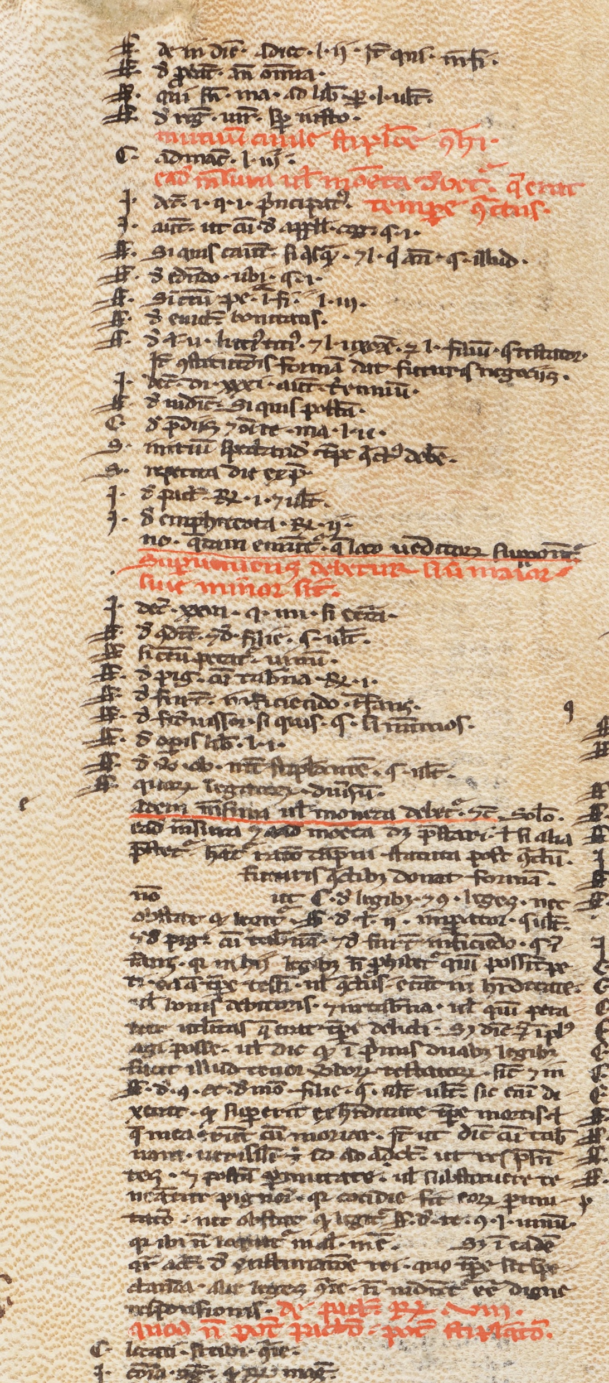
Azo, Brocardica, ms. Sion, Archives du Chapitre, 83, fol. 296va
Rubric
{
Allegations pro
Regula
iuris
Contrarium
Allegations contra
Solutio

Slide 32
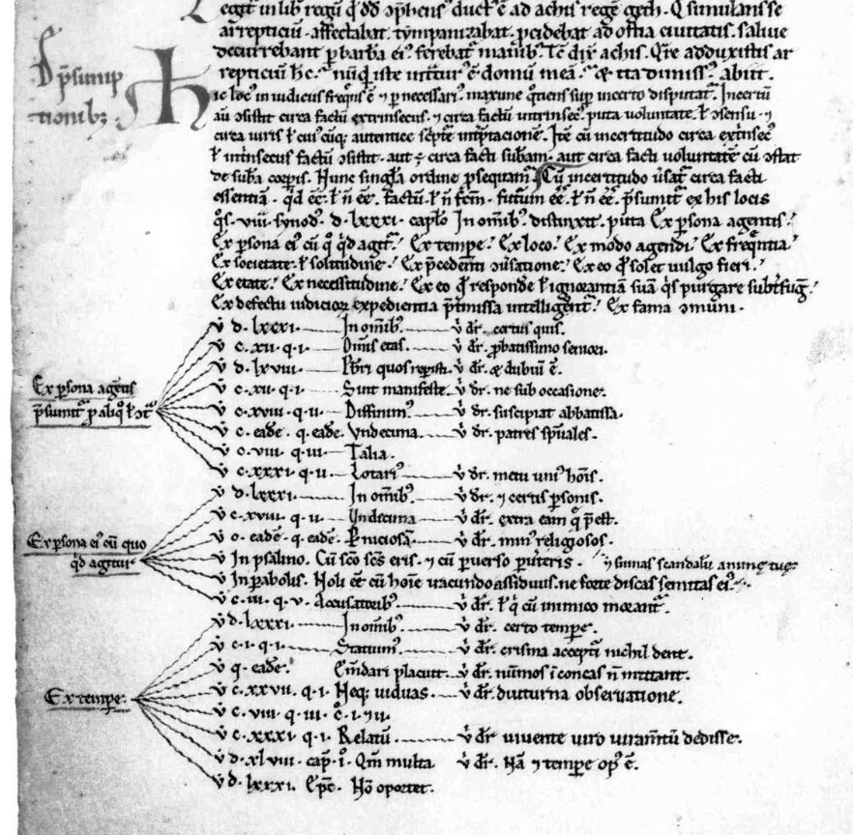
Diagrams
Munich, BSB, Clm. 8013, fol. 11v (Perpendiculum)
}
Rubric
Allegations

Slide 33
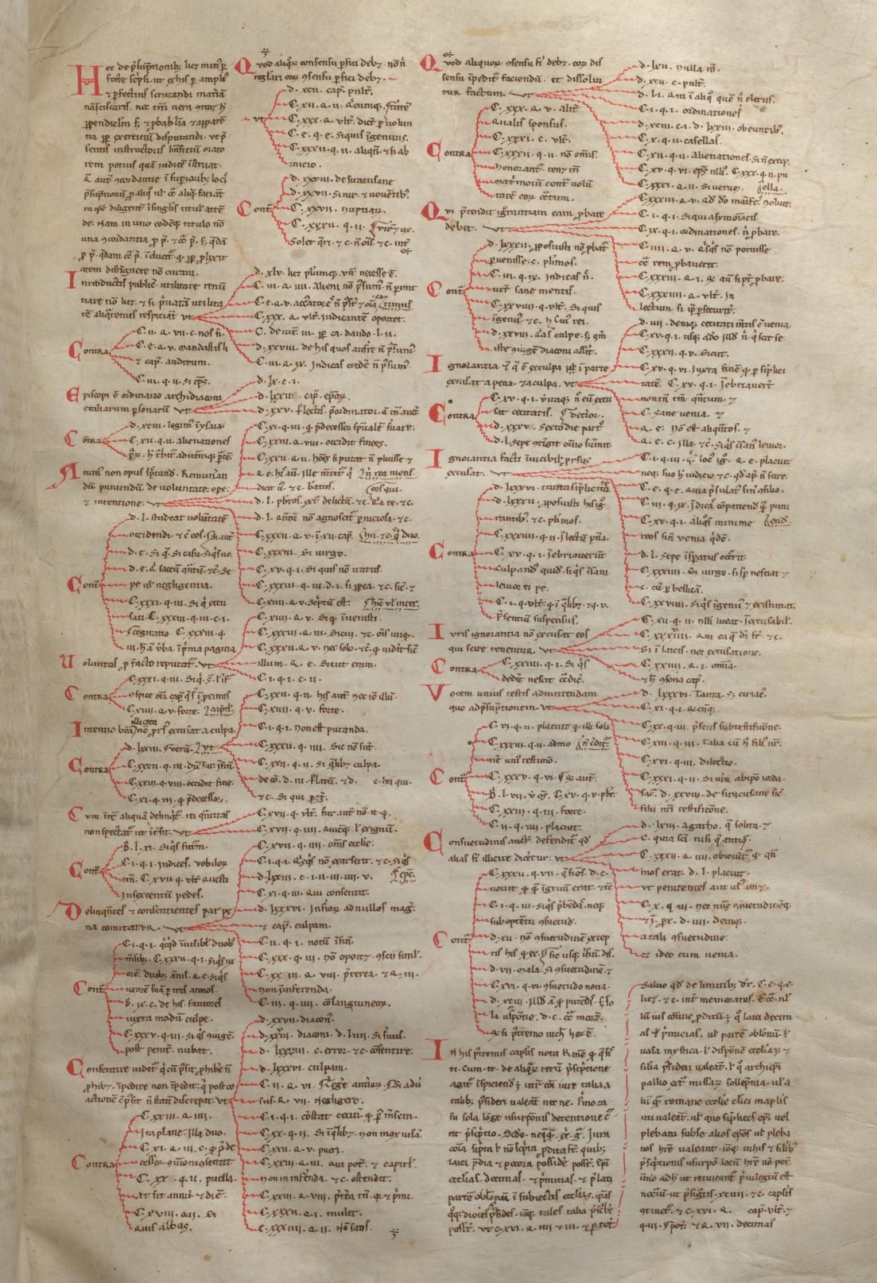
Fulda, Landesbibliothek, D. 10, fol. 80ra
(Perpendiculum)
}
Allegations
Rubric
Contrarium

Slide 34
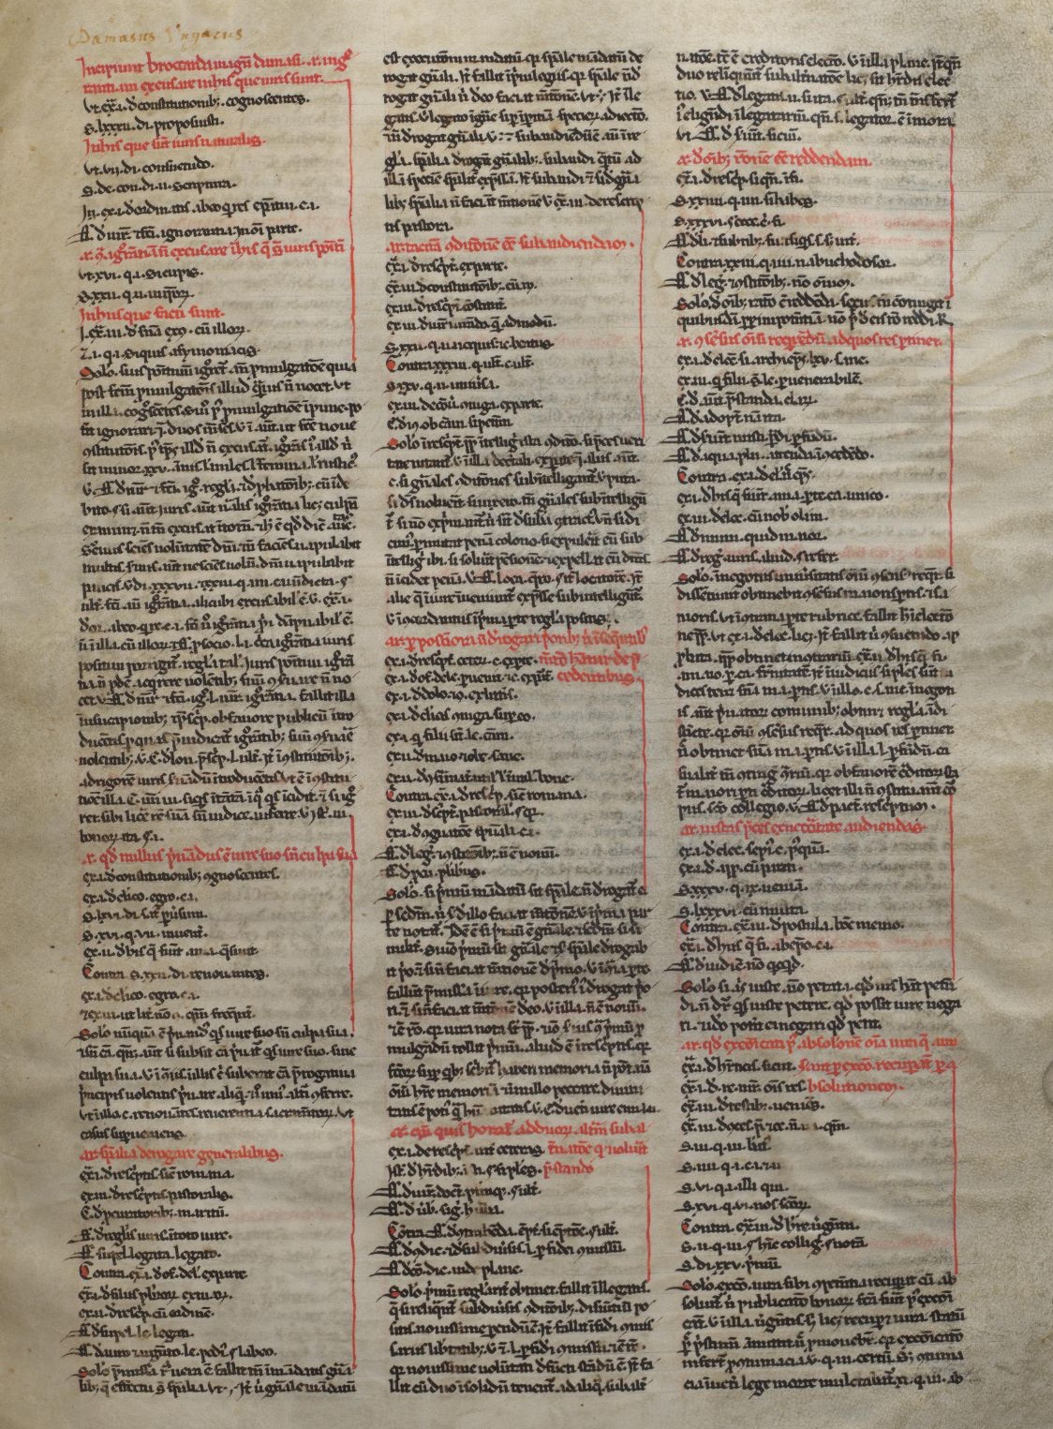
Fulda, Landesbibliothek, D. 10, fol. 80ra
(Perpendiculum)
Rubric
Diagram
Contrarium
Third maxim
Solutio

Slide 35
Brocardica: essential bibliography
De Concilio, D. Via Brocardica. The Development of Brocards and the Western European Legal Tradition (c. 1160 - c. 1215). PhD Thesis, University of St Andrews, 2022.
Kuttner, S. Réflexions sur les brocards des glossateurs. In Id., Gratian and the Schools of Law. 1140-1234. London, 1983, n° IX, pp. 767-792.
Schwaibold, M. Brocardica ‘Dolum per subsequentia purgari’. Eine englische Sammlung von Argumenten des römischen Rechts aus dem 12. Jahrhundert. Frankfurt am Main, 1985.
Schwaibold, M. Wer sucht, der findet, «Rechtshistorisches Journal», 4 (1985), pp. 202-214.
van de Wouw, H. Brocardica Dunelmensia, «ZRG Rom.Abt.», 108 (1991), pp. 234-278.
Weimar, P. Argumenta brocardica, «Studia Gratiana», 14 (1967), pp. 91-123.

Slide 36
What is it that distinguishes quaestiones and brocardica?

Slide 37
What is it that distinguishes quaestiones and brocardica?
Quaestiones legitimae:
  same function and structure of brocards
  but only in their final form, and q. are more refined (dialogical form)
Quaestiones disputatae:
  Different subject: abstract legal principle (generale) vs court case (casus)
  Different reasoning of the solutio: in the q., prevalence of a specific argument in a specific case; in b., the antinomy is only apparent (distinctio)

