Slide 1


Slide 2

Intoduction to medieval codicology
(legal manuscripts)
Joanna Frońska
Institut de recherche et d’histoire des textes
CNRS, Paris-Aubervilliers

Slide 3
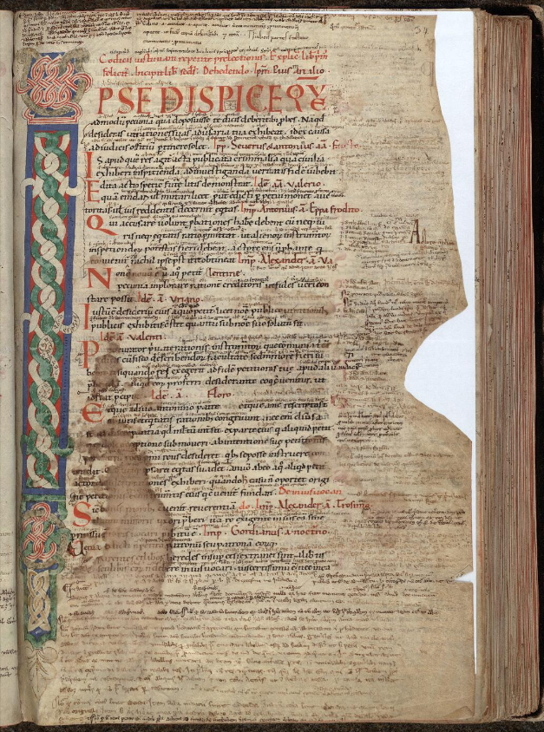
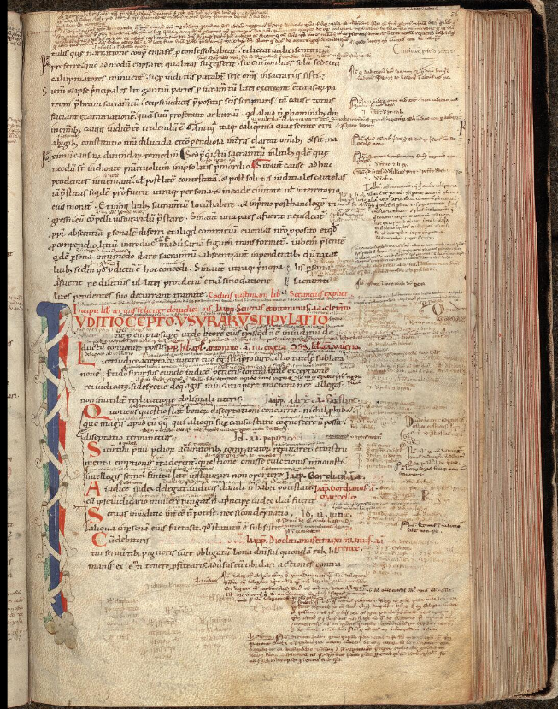

Single-column layout
Justinianus, Codex,
Montpellier, BU Médecine, H 82
Central Italy, Late 11th c.

Slide 4
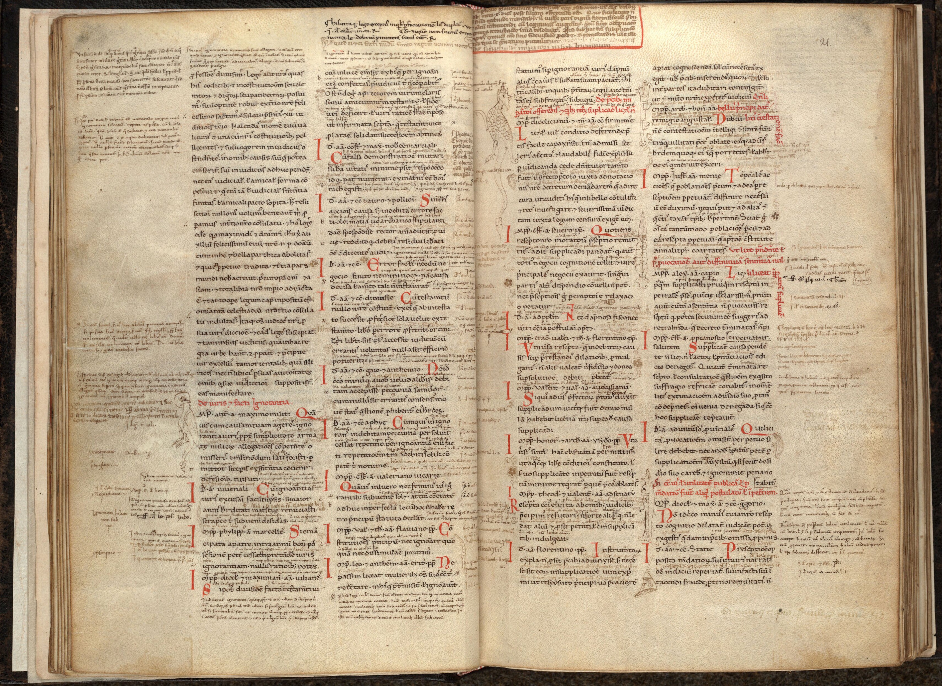
Double-column layout
Justinianus, Codex
Montpellier, BU Médecine, H 83,
Italy, 12th c. (1st half)

Slide 5

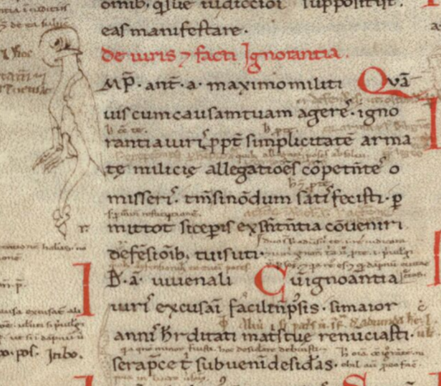
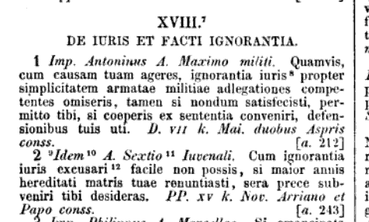
Inscriptions (Roman Law)
Montpellier, BU Médecine, H 83,
Italy, 12th c. (1st half)

Slide 6
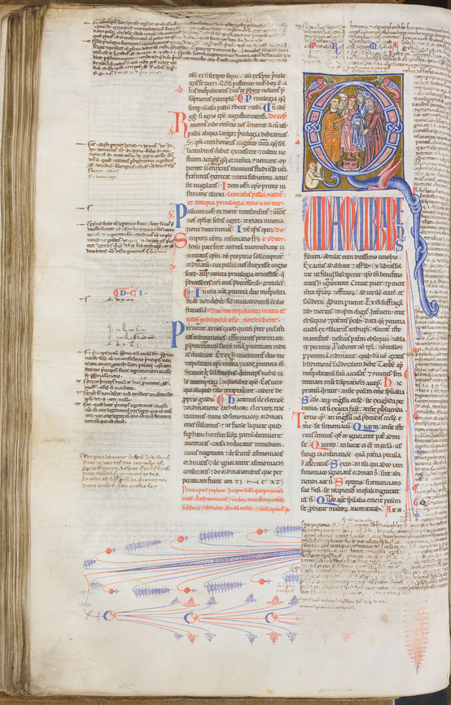
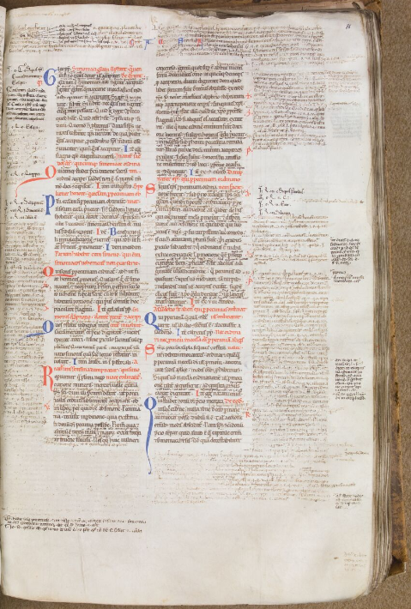
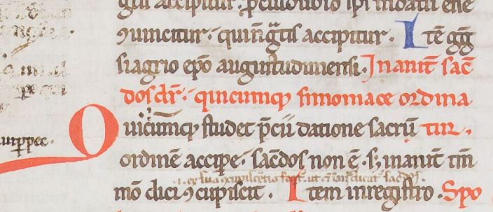
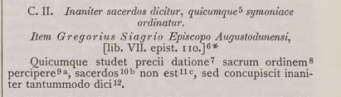
Canon Law
Causa I, Cap. 2
Decretum Gratiani
Saint-Omer, BASO, 454, f. 85v-86
Bologna, c. 1170-1180

Slide 7
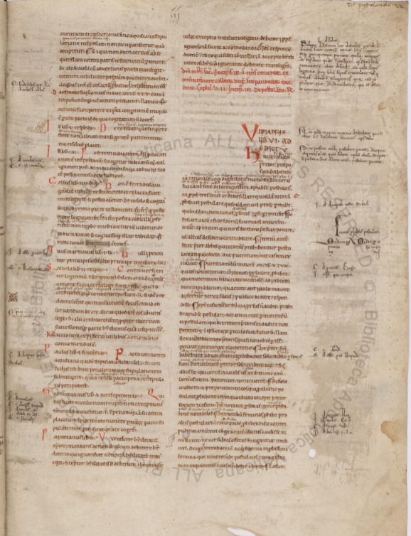
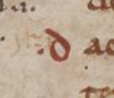
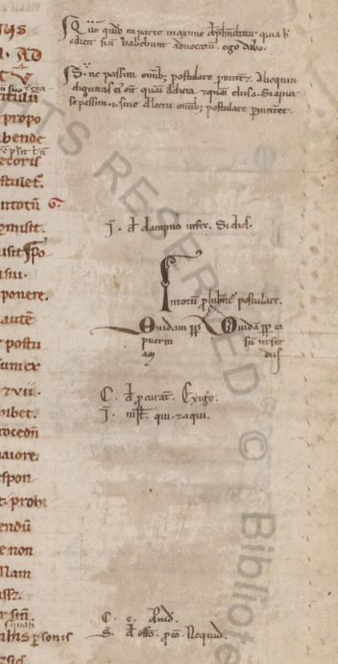
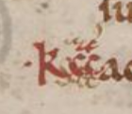
« red signes »
Layout of glosses (12th c.-13th c. in.)
notablie
allegations
Digestum vetus, Vat. lat. 1405
Italy, 12th c.

Slide 8
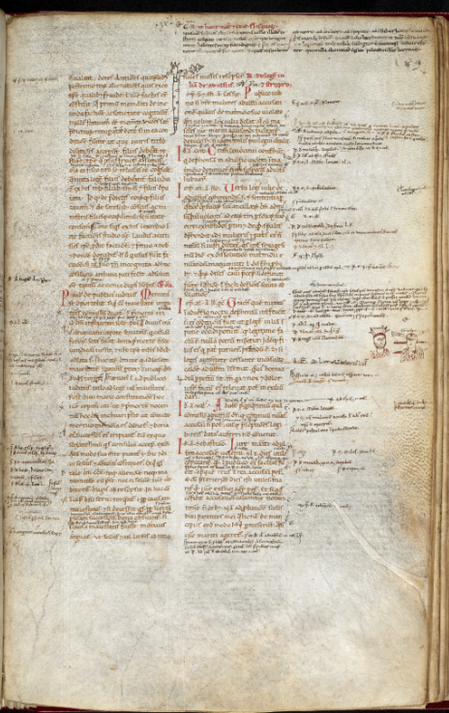
Lawful homicide case (C. 9.9.4, pr.): Numerius (the betrayed husband, with horns sticking out of his head) and Gracchus, his victim, pierced with several knives and spears.
London, British Library, Harley MS 5117, Codex
Italy, 12th c.
Drawings.

Slide 9
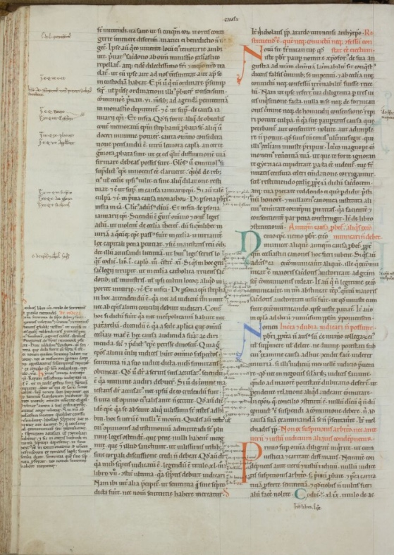
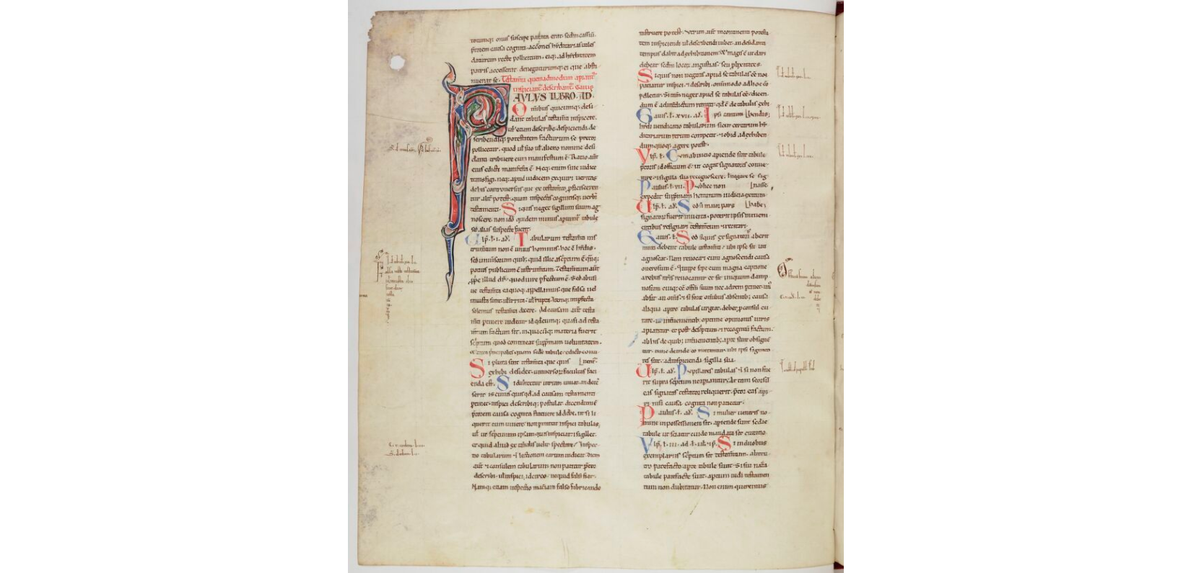
French ‘imitation’ of an Italian layout
Paris BNF, Latin 4454, f. 39v
12th c. (3rd quarter, Sens)
SAINT-OMER, BASO, 453, f. 89v, Decretum Gratiani, St-Bertin, 1164-1178

Slide 10
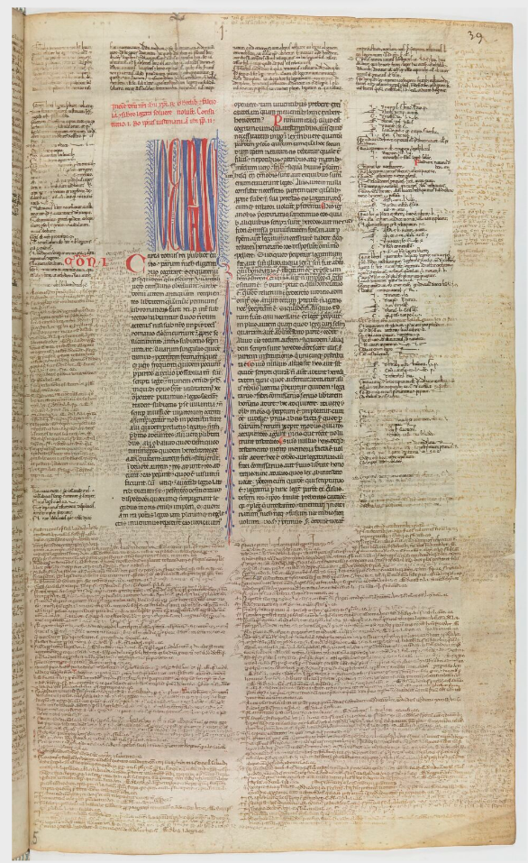
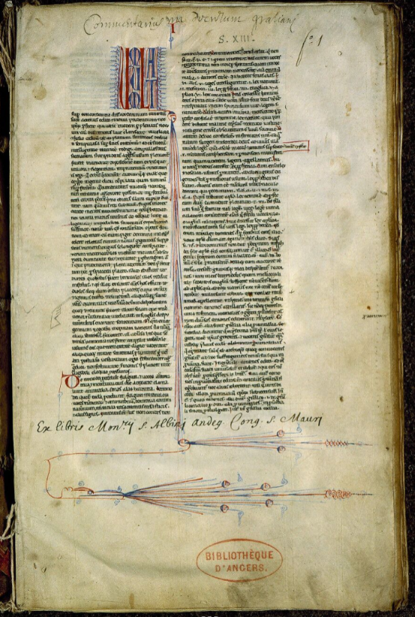
Paris, BNF Lat. 4429, f. 39
Authenticum
(part of the Volumen parvum)
Bologna, 13th c. (1st half)
Saint-Omer, BASO, 454
Decretum Gratiani, Bologna, c. 1170-1180
Angers, BM 370
Johannes Faventinus, Summa in Decretum Gratiani

Slide 11
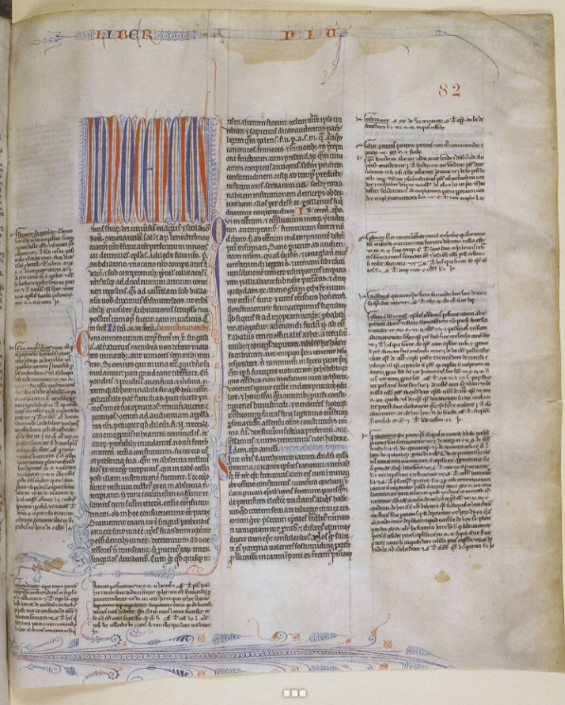
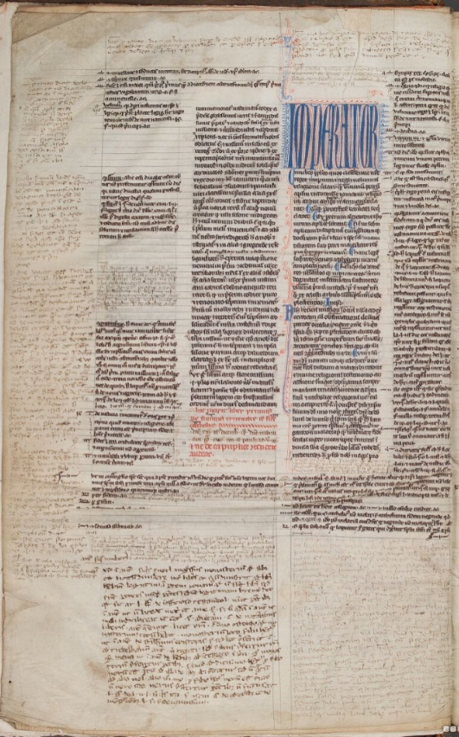
Lyon, BU, 6, f. 82, France, 1230s
Petrus Beneventanus, Compilatio tertia,
gloss: Johannes Teutonicus
Saint-Omer, BM 477, f. 2v
Codex, England, c. 1240-1250

Slide 12

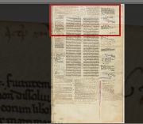
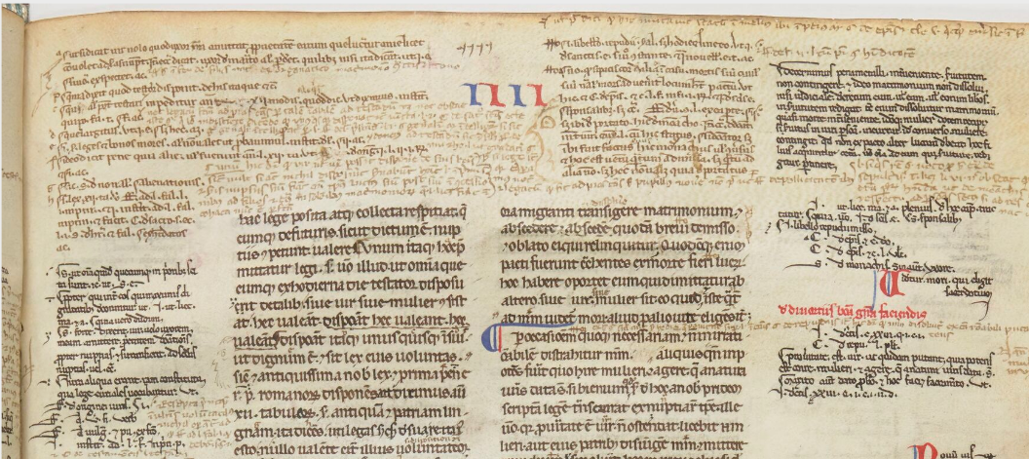
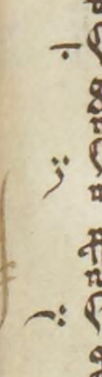
First apparatus of glosses and their physical aspects
Paris, BNF, Lat. 4429, f. 62
Authenticum (part of the Volumen)

Slide 13
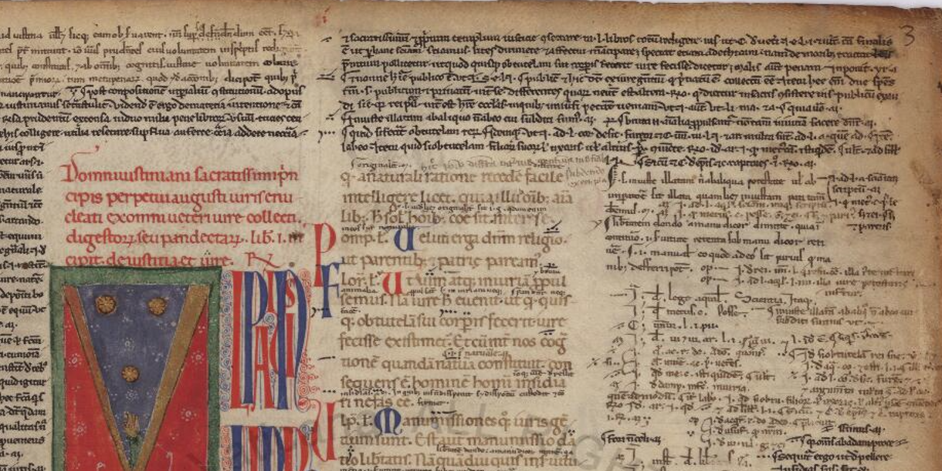
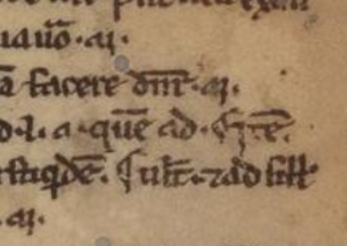
Digestum vetus, Vat. lat. 1408
Apparatus by Azo

Slide 14
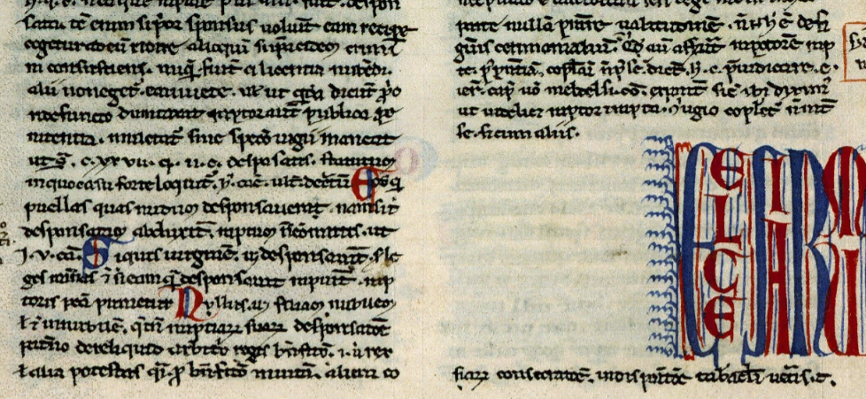
Angers, BM, 370, f. 151v
Johannes Faventinus, Summa in Decretum Gratiani

Slide 15
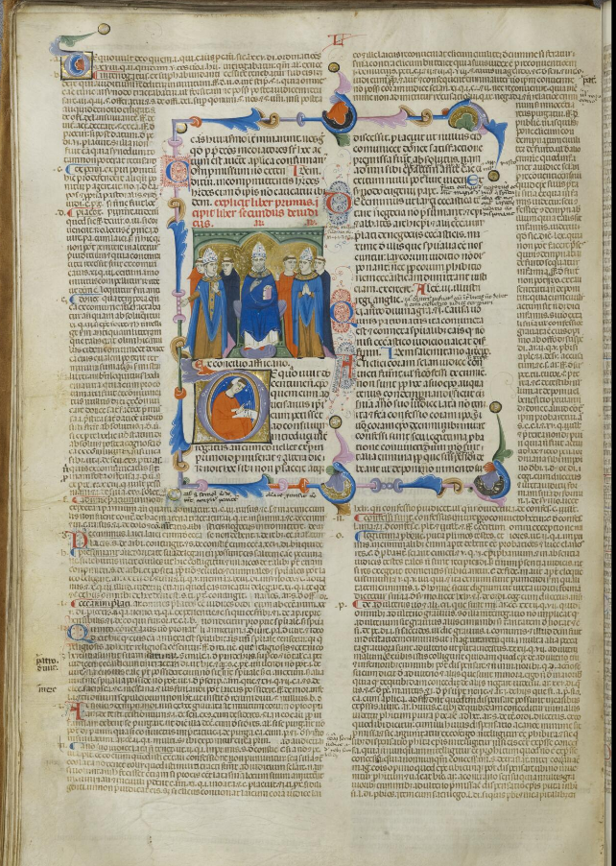
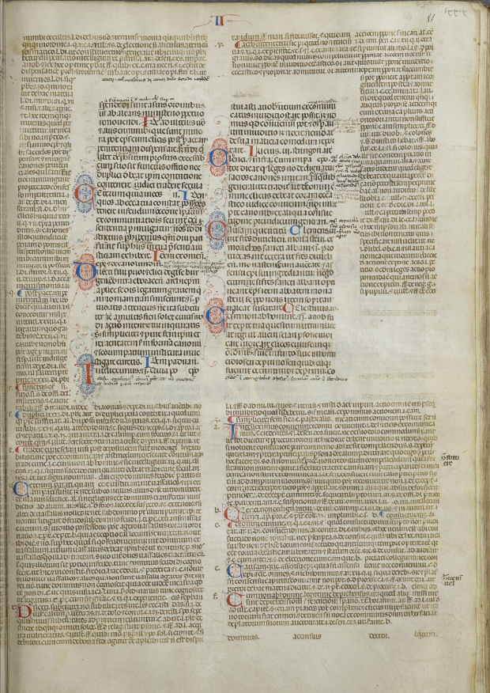
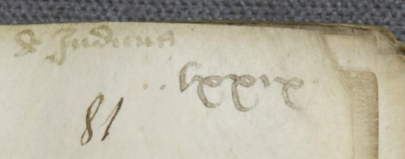
Running title and
old foliation:
L = liber
‘de iudicis’
lxxix
II = book II
Gregorius IX, Decretales,
Arras, BM 11 (6), Bologna c. 1300

