Slide 1
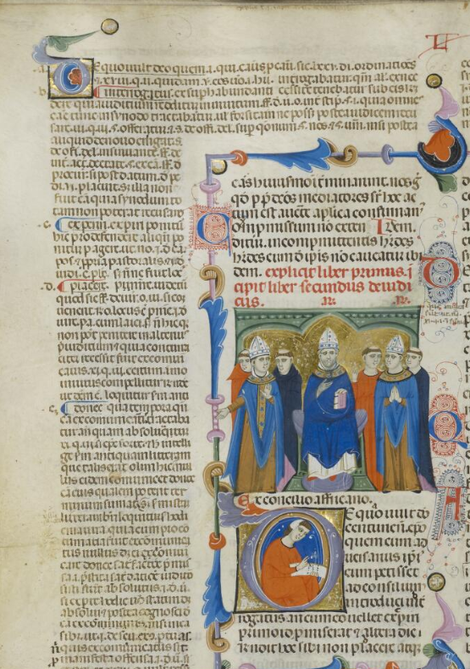
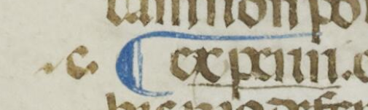
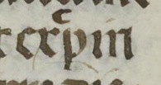

Hierarchy and architecture of the page
Rubric and miniature (beginning of the book)
Initials in the text correspond with those in the gloss
Each gloss begins with a paragraph sign
lemmata are underligned in red
A letter of alphabet tags the gloss and a commented term

Slide 2
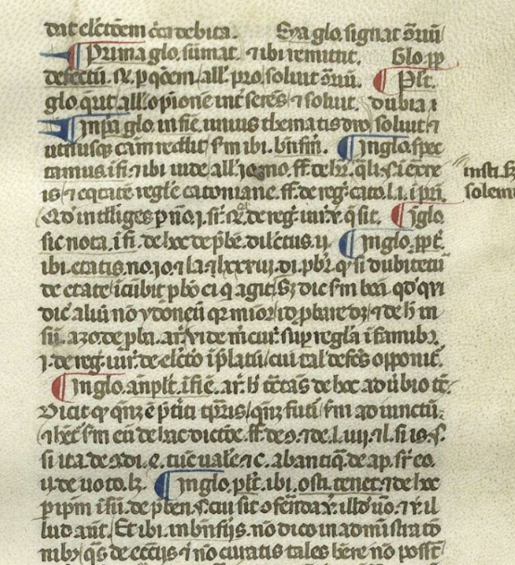
Paraph: casus summari,
paraph with a single spike : divisio
paraph with two spikes : literalis prosecutio
Johannes Andreae, Novella in Sextum
Cambrai, BM, 620, f. 8

Slide 3
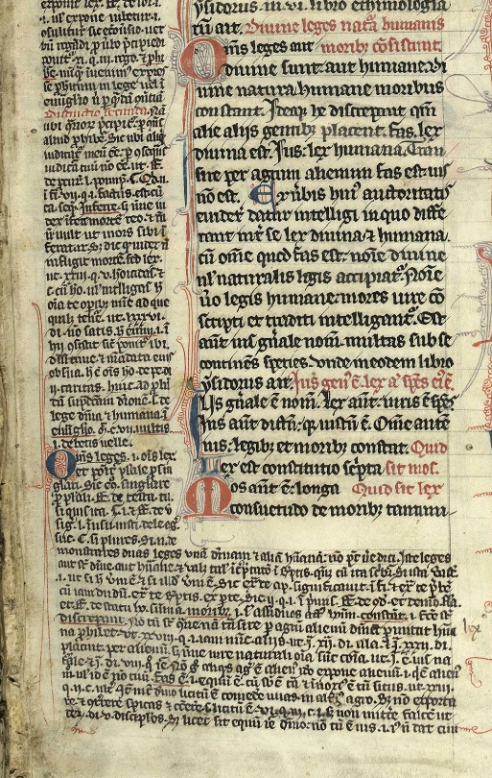
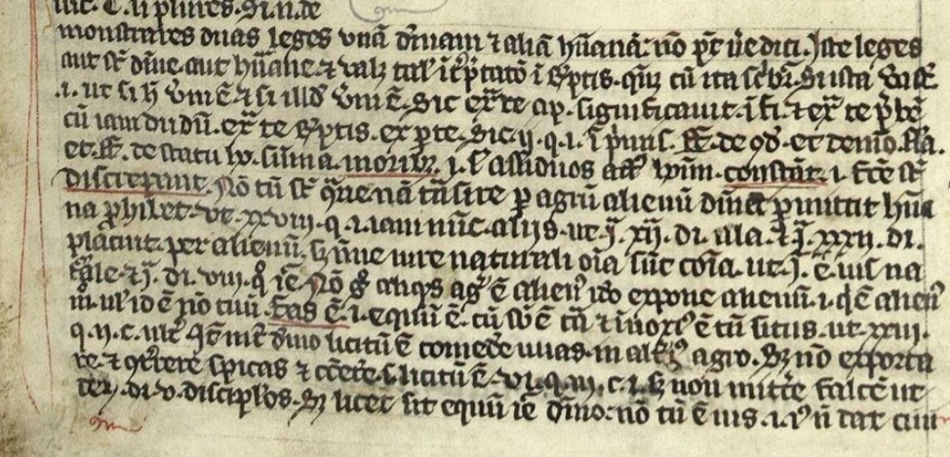
Glosses: ‘French’ layout
underlined lemmas
often no reference sign
Initial O
Decretum Gratiani, northern France, late 13th c.
Cambrai, BM, 606 (564), f. 1,

Slide 4
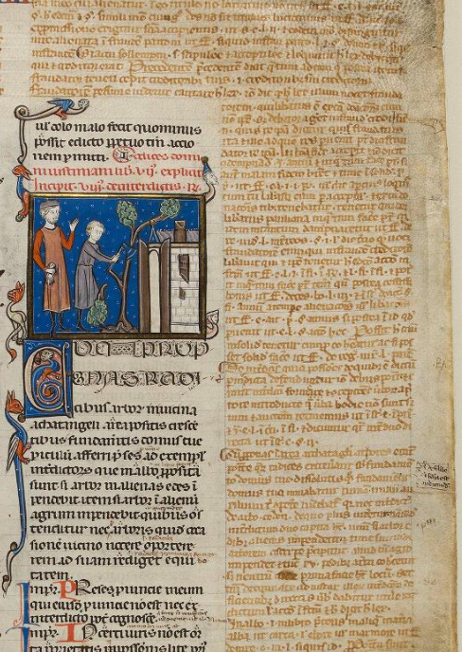
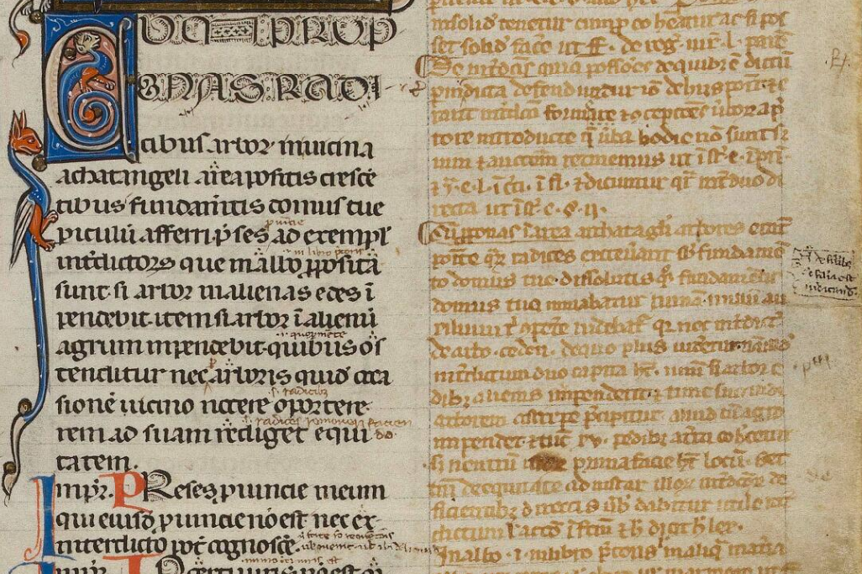
Glosses: ‘French layout’
underlined lemmas
often no reference sign
C. 8. 1, 1: Cum proponas radicibus arborum in vicina agathangeli area positis crescentibus fundamentis domus tuae periculum adferri…. in albo proposita habet…
Justinianus , Codex, Paris; Mus. Cluny cl. 22717b
Orléans, 3rd quarter and Late 13th. c.

Slide 5
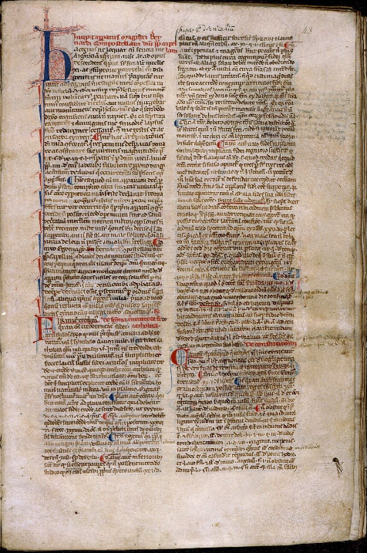
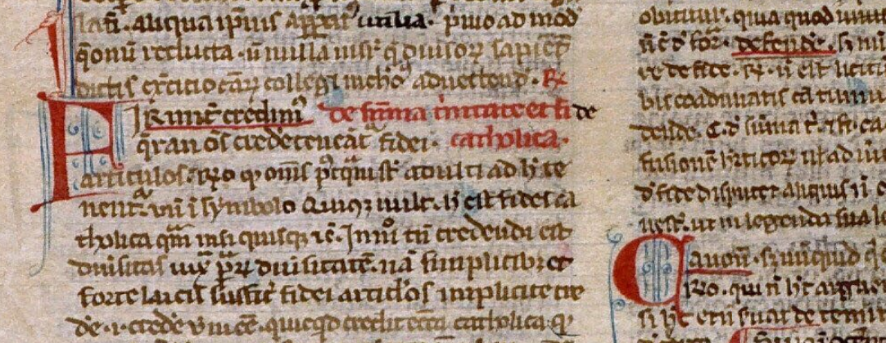
Commentary - layout
Angers, BM, 381, f. 43
Bernardus Compostellanus junior, Casus Decretalium
southern France, 13th c. (last quarter)

Slide 6
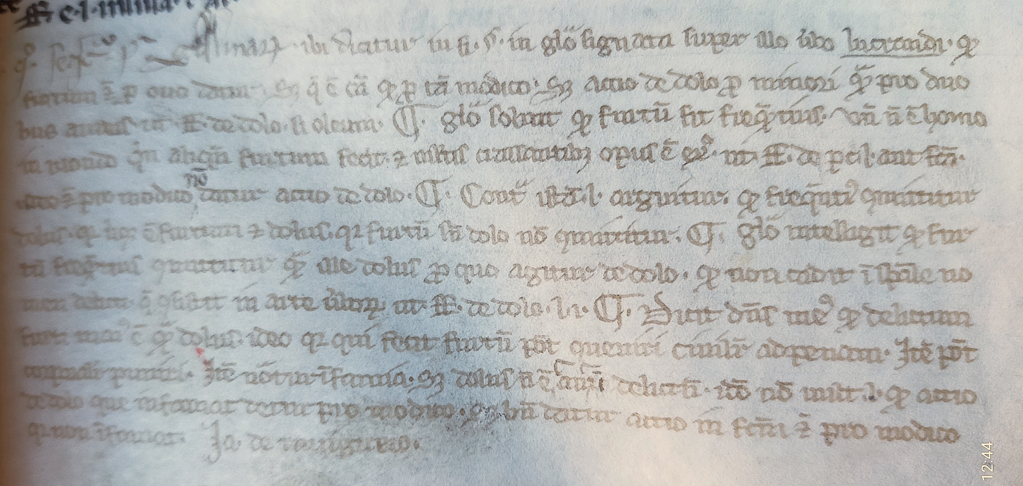
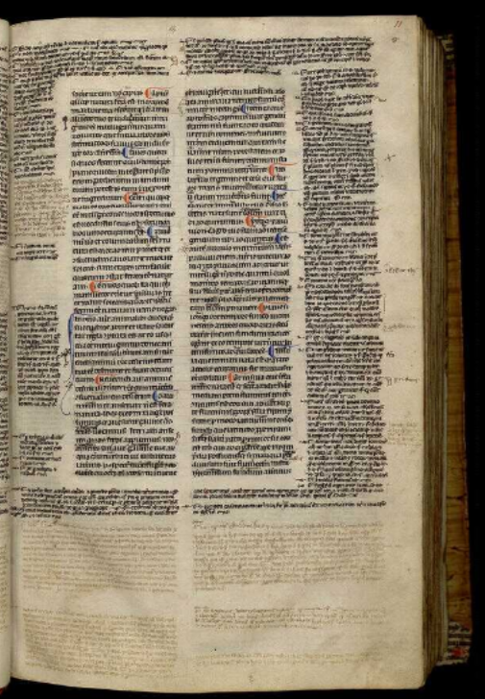
Additiones
Troyes, BM, 171, Volumen, Orléans, 13th c. (3rd quarter)
‘Ja de Ravignaco’ = Jacques de Révigny, master at the University of Orléans, between 1263 and 1280

Slide 7
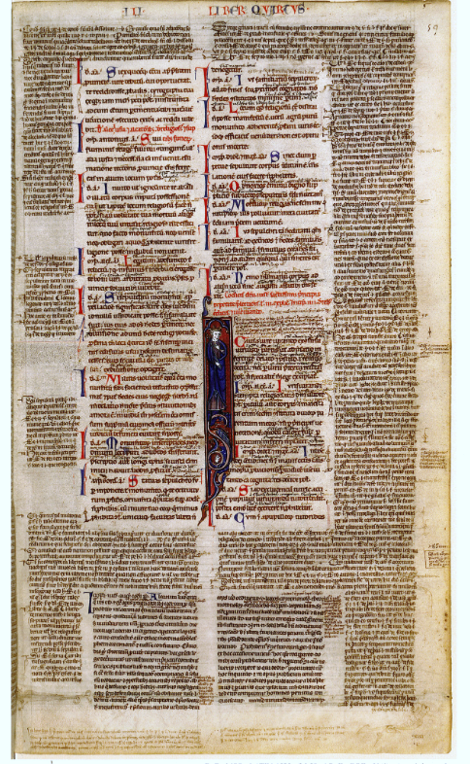
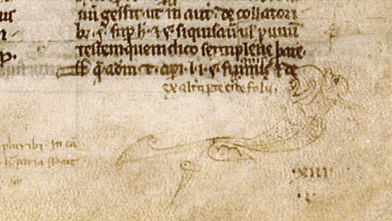
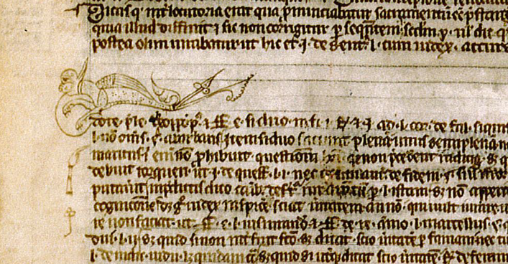
‘Ex altera parte eiusdem folii’
Paris, BNF, ms. lat 4523, f. 59 and 59v

Slide 8
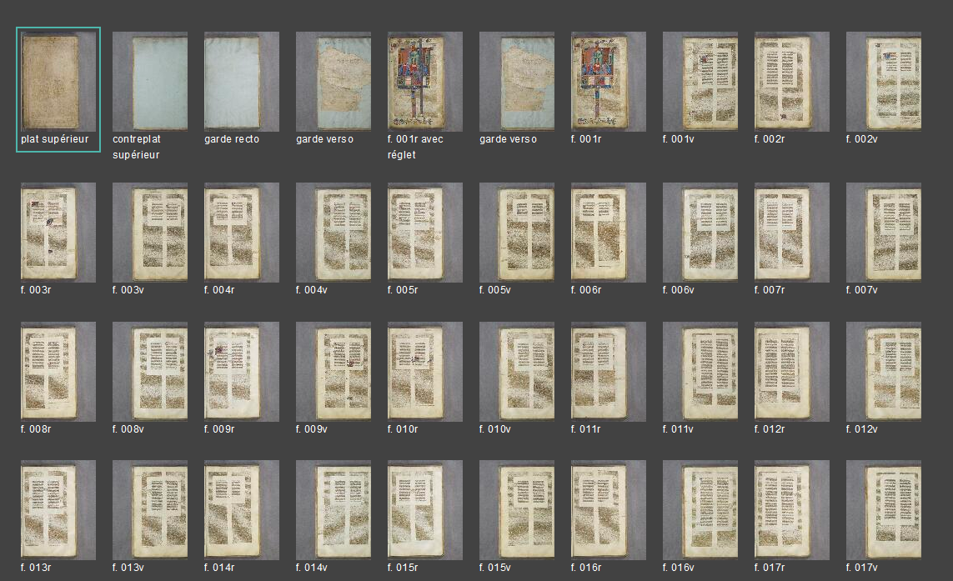
France, Arras, Médiathèque de l'Abbaye Saint-Vaast (Bibliothèque municipale) - 260 (CGM 14)
Liber sextus Decretalium
Bologna, c. 1320-1340
‘adjustable’ layout

Slide 9
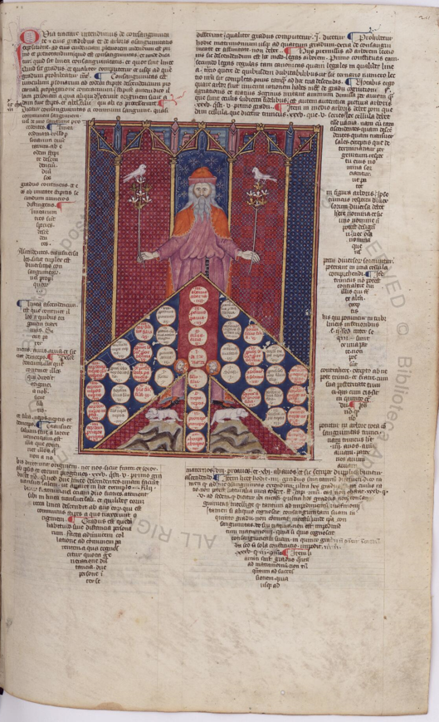
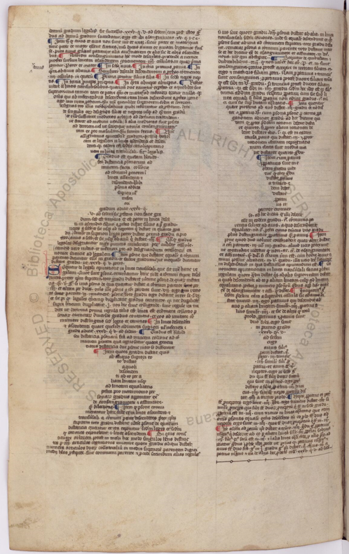
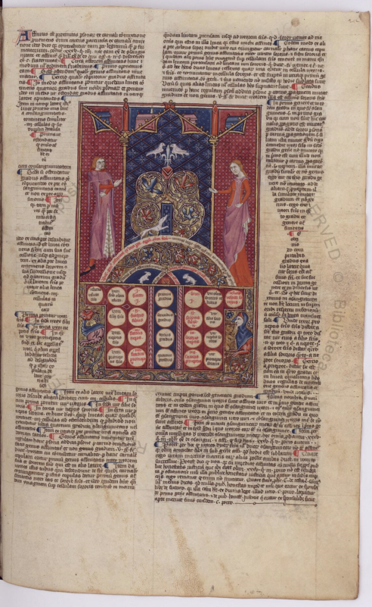
Gregorius IX, Decretales
Vat.lat.1390

Slide 10
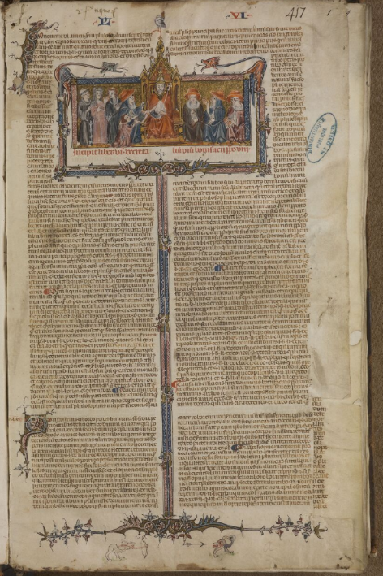
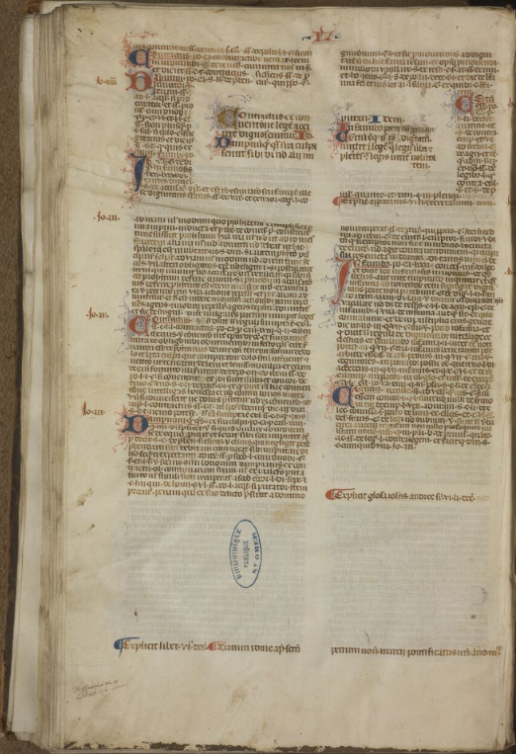
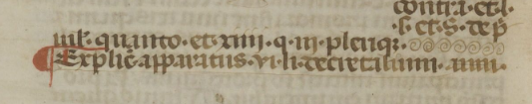

SAINT-OMER, BM, 456, Liber Sextus, with a ‘double’ apparatus by Johannes Monachus and Johannes Andreae

Slide 11
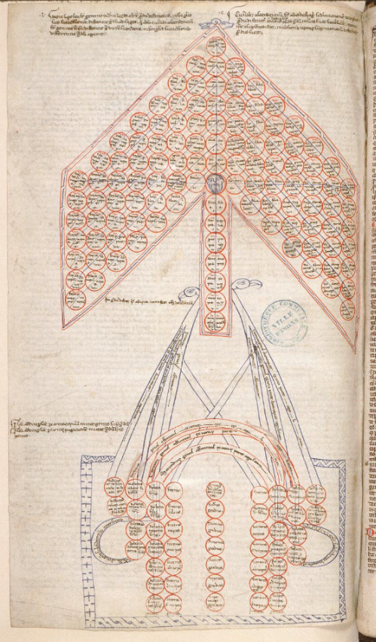
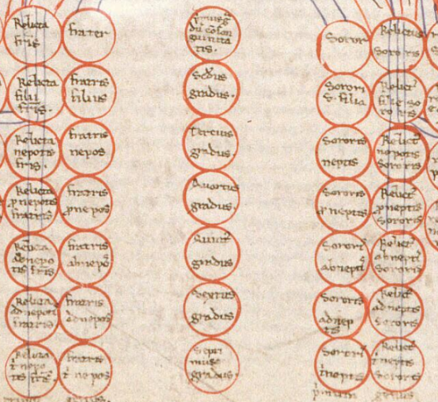
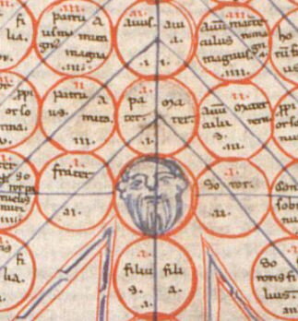
Legal diagrams:
Tree of consanguinity
Tree of affinity
Decretum Gratiani, Amiens 354, f. 257, late 12th c. Italy (addition)

Slide 12
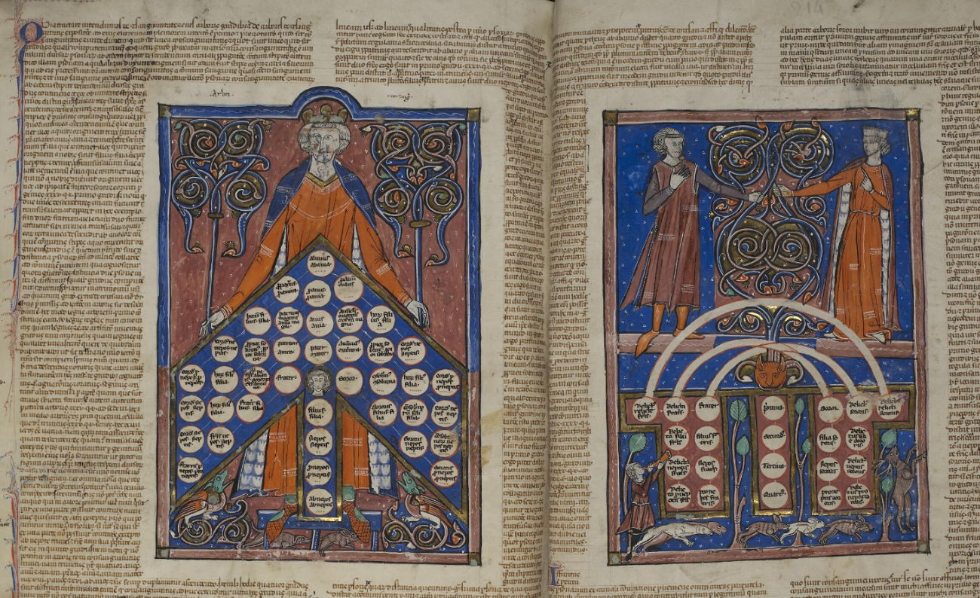
Gregorius IX, Decretales, book IV
France du nord, late 13th c. Arras, BM, 816

Slide 13
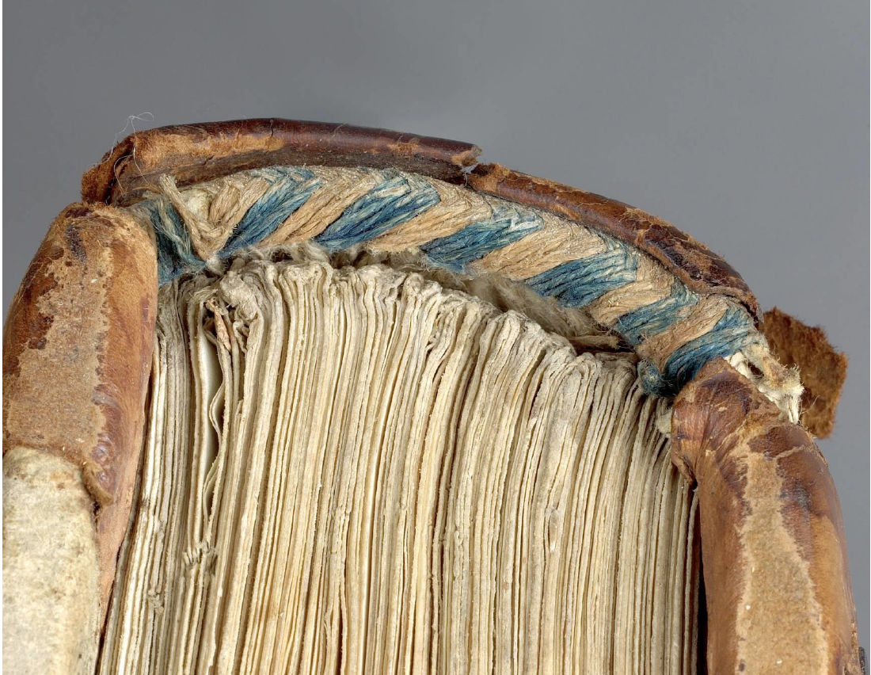
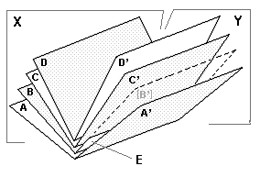
Physical structure of the book
quire
Quires of 8 = standard until c. mid-XIIIth century
Italian manuscripts : quires of 10 folios
French manuscripts : quires of 12 folios
Headband of the spine with attached quires

Slide 14
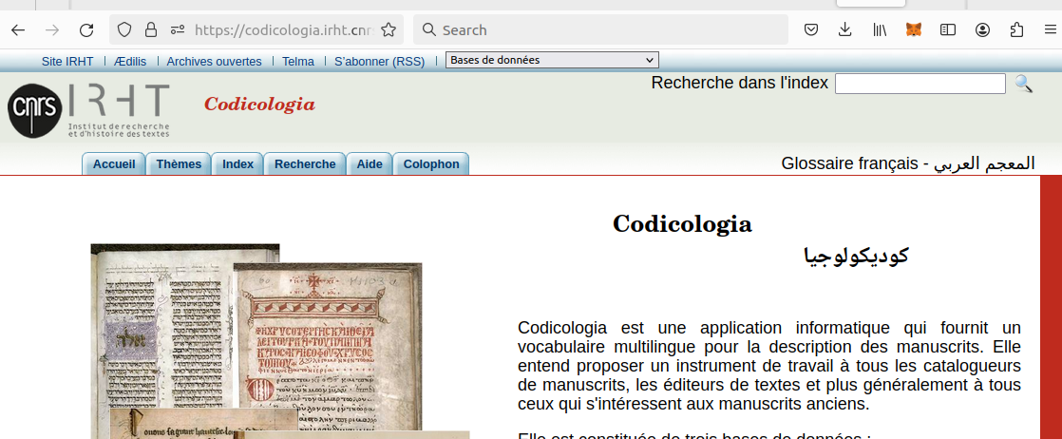
Codicological vocabulary
with indexes in Italian, English , Spanish and Arabic
MUZERELLE (Denis). Vocabulaire codicologique : répertoire méthodique des termes français relatifs aux manuscrits. Paris : Editions CEMI, 1985.
MANIACI (Marilena). Terminologia del libro manuscritto. Roma : Istituto per la patologia del libro ; Editrice Bibliografica, 1997.
Bibliography :
MANIACI (Marilena). Archeologia del manoscritto. Metodi, problemi, bibliografia recente. Con contributi di C. Federici e E. Ornato. Roma : Viella, 2002

Slide 15
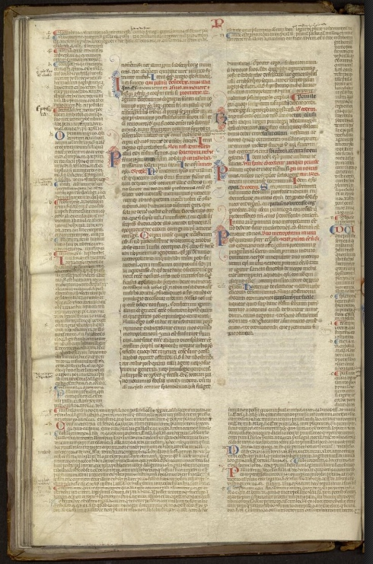
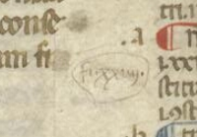
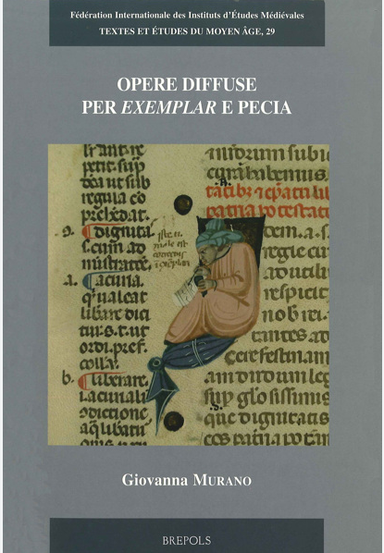
Peciae
Exemple: Decretum Gratiani (canon law: textus ordinarius)
3 series of peciae correspond to 3 parts:
Distinctiones – 28 (+3?)
Cause - 54
De Consecratione 19
fi. xxviiii
Saint-Omer, BASO, 452
Bologa, late 13th c.

Slide 16
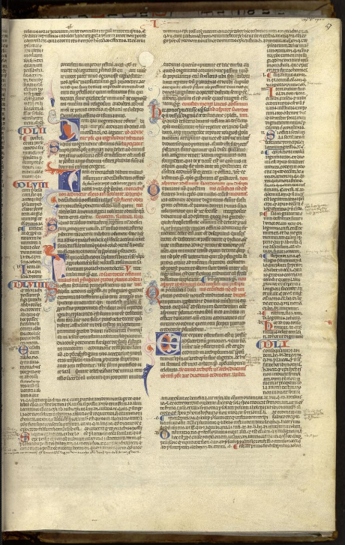
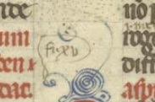
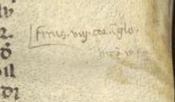
Peciae :
Separate series for the gloss:
Johannes Teutonicus revised by Bartholomeus Brixensis
Glossa ordinaria
‘fi. Xv’
'finis viii cor. in glo. Incip. ix pe.'
Saint-Omer, BASO, 452
Bologa, late 13th c

Slide 17
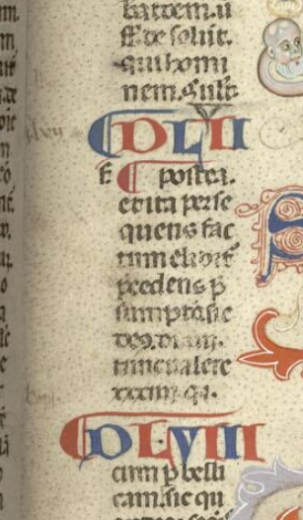
Attention: not every number in the margin is a pecia sign
dlvii
dlvii
Saint-Omer, BASO, 452
Bologa, late 13th c

Slide 18
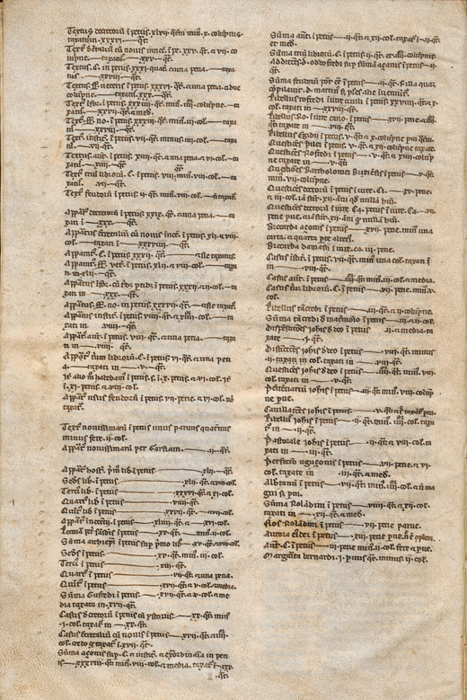
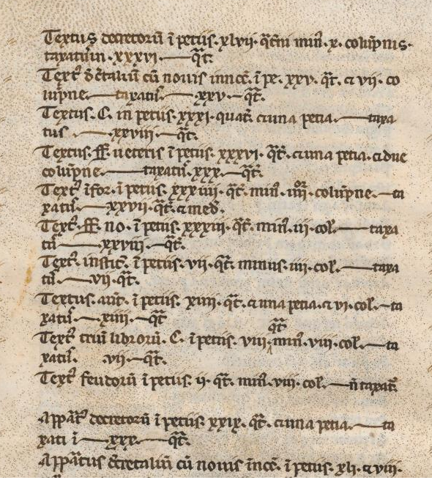
List of examplars from the university of Bologna, late 13th century
Montpellier, BU Médecine, H 9, f. 3v

Slide 19

Bibliography
-Glosses:
G. DOLEZALEK ,"Research on manuscripts of the Corpus Iuris with glosses written during the 12th and early 13th centuries: state of affairs.” In El dret comú i Catalunya. Barcelona, 1991, pp. 17-45.
G. DOLEZALEK, Glosses and the Juridical Genre "Apparatus glossarum" in the Middle Ages, Rivista internazionale di diritto comune vol. 32 (2021) p. 9-54
-Red signes: G. DOLEZALEK, R. WEIGAND 1983: Gero Dolezalek, Rudolf Weigand. “Das Geheimnis der roten Zeichen. Ein Beitrag zur Paläographie juristischer Handschriften des zwölften Jahrhunderts.” Zeitschrift der Savigny-Stiftung für Rechtsgeschichte. Kanonistische Abteilung 69 (1983): 143–99.
-production
F. Soetermeer, Utrumque ius in peciis: aspetti della produzione libraria a Bologna fra Due e Trecento, Milano, 1997
Between Codicology and Legal History: Pecia Manuscripts of Legal Texts, Manuscripta 49, no. 2 (2005): 247–67
Juristische Buchproduktion im Mittelalter, ed. Vincenzo Colli (Frankfurt am Main, 2002)
Layout:
S. L’Engle, R. Gibbs, Illuminating the Law, London 2001 (Exhibition at the Fitzwilliam Museum)

Slide 20
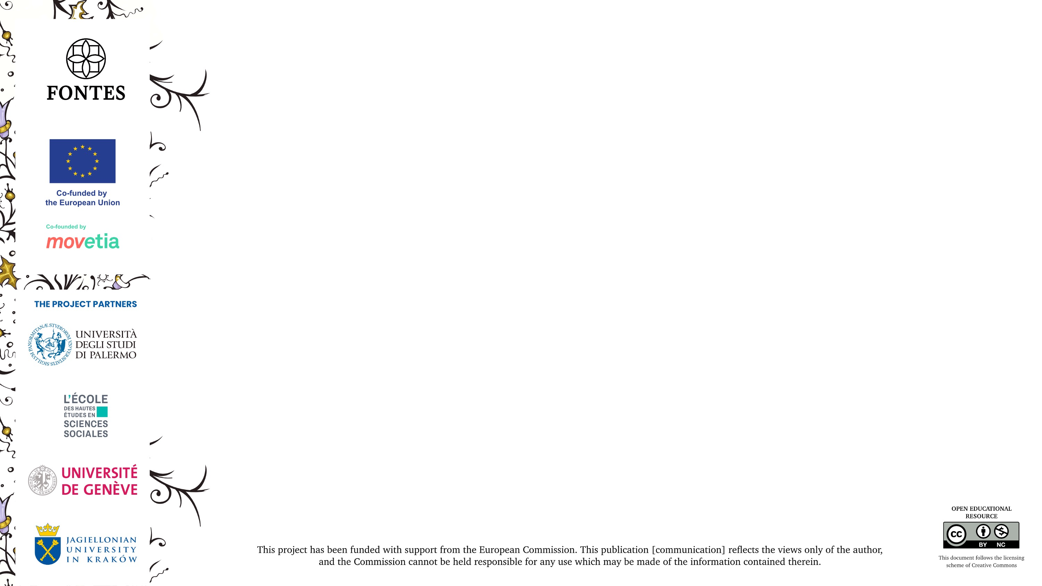


GRAZIE!
Joanna.fronska@irht.cnrs.fr
CAMPUS CONDORCET - 14 COURS DES HUMANITES - 93322 AUBERVILLIERS CEDEX

