Slide 1

Statutory sources in late medieval and early-modern central Europe (the case of the Kingdom of Poland)

Slide 2

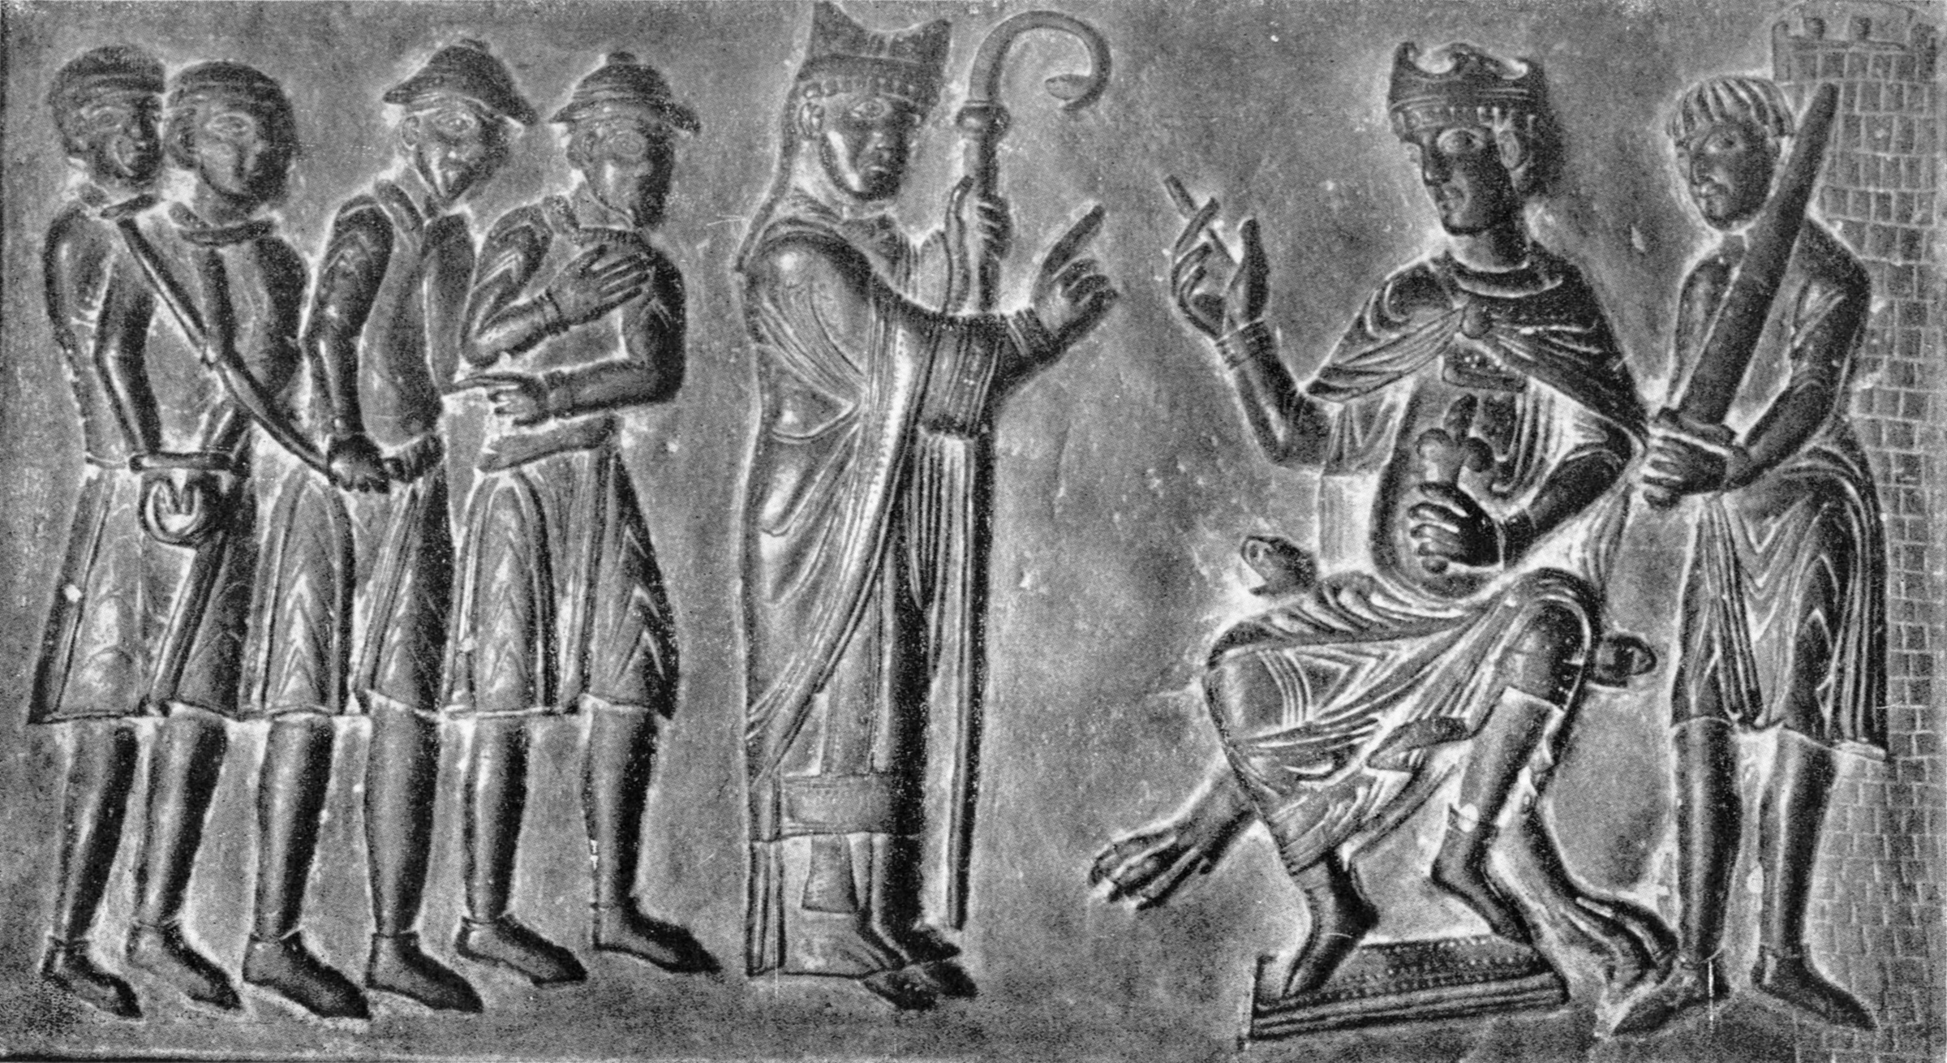
“The younger Europe”
The three kingdoms: baptism
925 (Bohemia)
966 (Poland)
974 (Hungary)
Autorstwa Nieznany fotograf - &quot;Drzwi Gnieźnieńskie&quot; Zakład Imienia Ossolińskich Wrocław, Poland, 1956, Domena publiczna, https://commons.wikimedia.org/w/index.php?curid=10143368

Slide 3
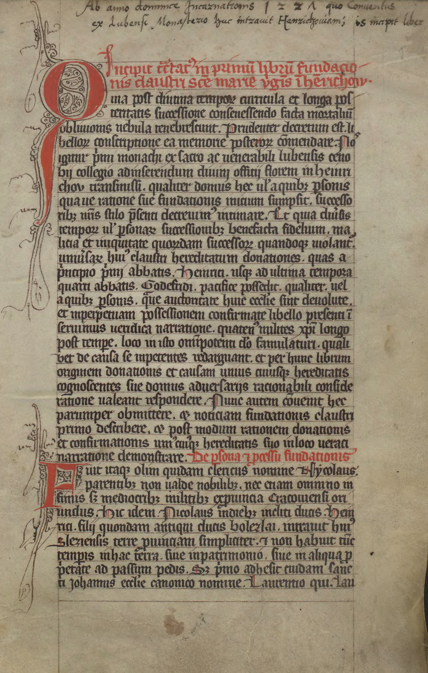
Features of legal culture (Poland)
1. Huge importance of customary law and slow development of statutory law
a. Knowledge of law often from non-normative sources, e.g. the Book of Henryków Abbey, 13th C.
b. First written collection of customary law the Book of Elbląg, 13th/14th C. in German
c. Individual privileges through their accumulation radically change the legal order, general privileges for knighthood and clergy appeared in 13th C.
d. Legislation in the form of statutes developed more strongly from the 14th century onwards
Autorstwa Nieznany fotograf - &quot;Drzwi Gnieźnieńskie&quot; Zakład Imienia Ossolińskich Wrocław, Poland, 1956, Domena publiczna, https://commons.wikimedia.org/w/index.php?curid=10143368

Slide 4
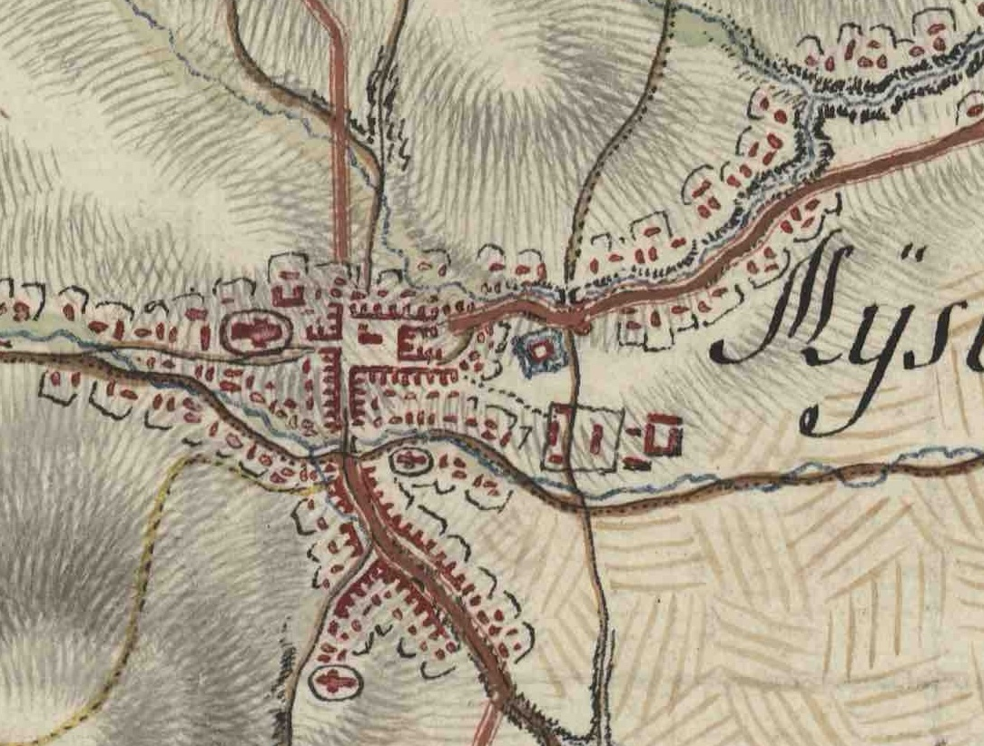
Features of legal culture
2. Impact of Magdeburg law: town and village locations [FONTES online lecture Krzysztof Fokt]
a. adaptation of this law, development by local legislation [FONTES online lecture Maciej Mikuła]
b. common denominator for many factors, for example an urban layout (central market square)
Myślenice on Mieg’s map, reprinted after: Galicja na józefińskiej mapie topograficznej 1770–1783, t. 1, cz. B, eds. W. Bukowski, B. Dybaś, Z. Noga, Kraków 2012, section 205 (citation rights).

Slide 5
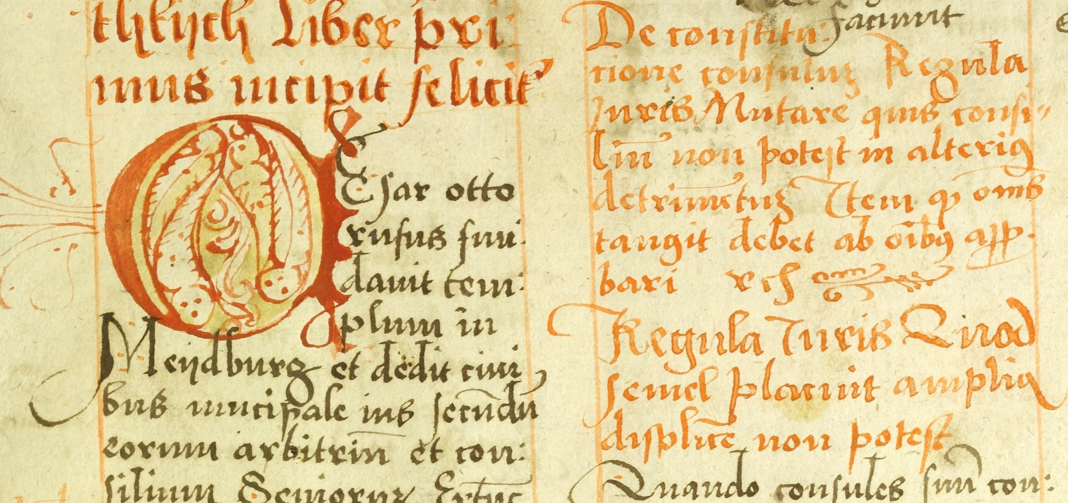
Features of legal culture
3. Influences of canon law, slight direct influence of Roman law
a. Educated elite, university teaching, Krakow (established 1364) teaching of canon law from ca. 1400, Roman law from 1533
b. Example of influence: regulae iuris in manuscripts of ius proprium
Magdeburg Weichbildrecht, Ms. National Library BN 3068 III, public domain, https://polona.pl/item/miscellanea-iuridica,NjA3MzgxNw/42/#info:metadata

Slide 6
Features of legal culture
3. Influences of canon law, slight direct influence of Roman law
c. Examples of influence: Roman-canon procedure in 16th C. legislation
    Formula processus of 1523 [FONTES online lecture Kacper Górski]
    Correctura iurium of 1532
    Kraków project of 1544
d. Basically no direct influence of Roman law until the early 16th century
1st, 2nd, 3rd Lithuanian Statutes [FONTES online lecture Łukasz Marzec]
4. Significance of Diet legislation

Slide 7
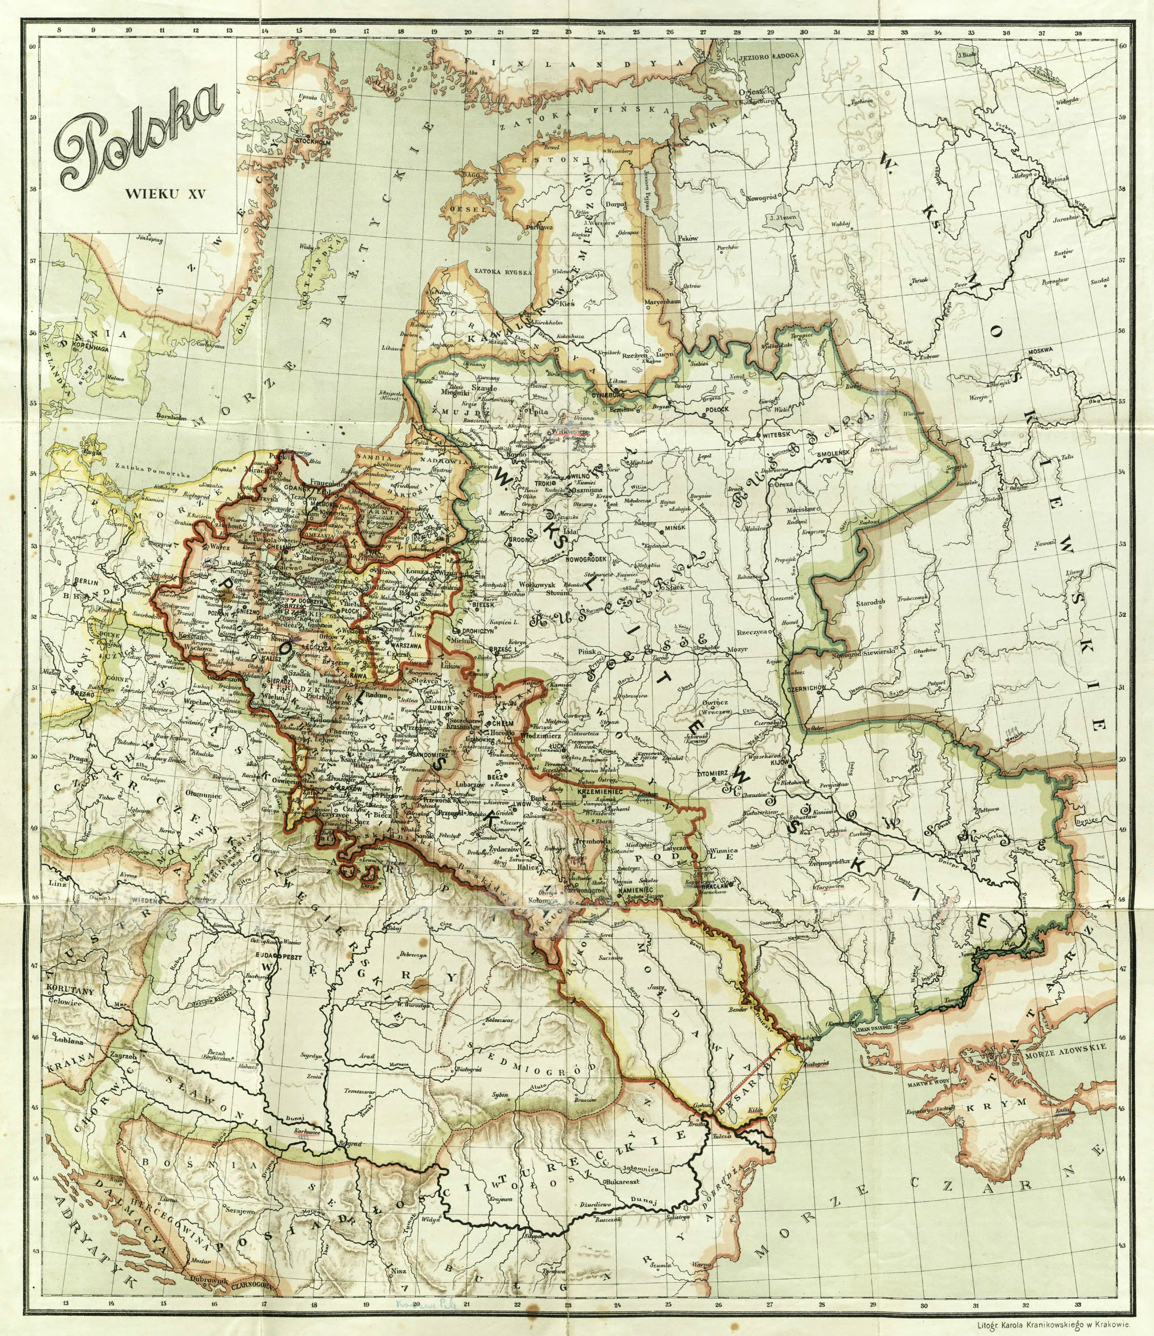
Origins of Polish parliamentarism
Casimir IV Jagiellon
(1447-1492)
53 general assemblies
20 times taxes passed
1468 – first modern Sejm (general Diet)
still a sovereign
Source [PD]: https://rcin.org.pl/igipz/dlibra/publication/44117/edition/27720/content
(Babirecki, Jan. Trzy mapy Polski: wiek XV, wiek XVII, rok 1815. Warszawa, ca. 1918).

Slide 8
Characteristics
Sejm (Diet)
Chamber of deputies
Royal council (Senate)
Bishops
High land officials
Ministers
deputies from sejmiks (dietines)
King (sovereign)
superior to the Sejm,
summons the Sejm,
proposes the agenda,
approves the bill,
but is bound by the law.
= Sejming estates

Slide 9
Source [PD]: https://pl.wikipedia.org/wiki/Statut_Łaskiego#/media/Plik:Commune_incliti_Poloniae_Regni_priuilegium_constitutionum_et_indultuum_publicitus_decretorum_approbatorumque_1506_(3742766)_(cropped).jpg
(Statute of Łaski [1506])

Slide 10
Consensus
Nihil Novi Act (1505):
  Quod omnes tangit,
  ab omnibus approbetur.
  (in practice = majority rule).
  Since mid-16th century:
  required unanimity
  (nemine contradicente)
  Since mid-17th century:
  literally interpreted principle quod omnes tangit… led to the emergence of liberum veto.
King
Deputies
Senators
Act of Sejm
Vota (or speeches, opinions) concluded by the king
Deliberations, ’grinding out’ the discussed matter

Slide 11
Evolution
(Noble) Estate representative body
(15th century)
Legislative body
(upon Nihil Novi Act [1505])
Chief body
of the Commonwealth
(last quarter of 16th century)
1569
Poland
Poland-Lithuania
(P-L Commonwealth)
Embodiment of new sovereign – the noble estate

Slide 12
Materials

Slide 13

1A. Diet in Piotrków in 1496
[69]. [De civibus et plebeis oppida at bona alia in iure terrestri non possessuris].
Item statuimus, quod civibus et plebeis undecumque existentibus, op[p]ida, villas, praedia et bona alia iure terrestri supposita emere, tenere, possidereque perpetuo vel obligatorio modo liceat minime ex eo, quod in profectionibus bellicis et aciebus ordinatis, locum inter nobiles competentem non haberent, quodque illi bonis talibus habitis, occasiones querere consueverunt se a bellicis expeditionibus liberandi, […] Et quod illi qui iam in effectu bona terrestria usurparunt illa hinc ad decursum temporis, quo commode istud facere possent vendere teneantur, sub poenis quas ex illis secus facientibus, iuxta arbitrium nostrum, et palatini terrae, in quo illa consistunt, exacturi sumus irremissibiliter.
[69]. [Regarding citizens and peasants so that they do not dare to possess towns and other properties under terrestrial law].
Similarly, we decree that citizens and peasants from wherever they may be, may not buy, hold, and possess towns, villages, estates, and other properties subject to terrestrial law perpetually or in an obligatory manner, not least because they did not have a suitable place among the nobles in military expeditions and ordered battles, but because they have been accustomed to seeking opportunities to exempt themselves from military expeditions by holding such properties. […] Moreover, those who have already effectively appropriated terrestrial properties shall be obliged to sell them within a reasonable period from the time they could conveniently do so, under penalties which we shall rigorously exact from those who act contrary to this, according to our discretion and that of the palatine of the land in which they reside.
https://iura.uj.edu.pl/dlibra/publication/3119/edition/2358/content?ref=struct

Slide 14
1B. Diet in Piotrków in 1496
[47]. [De fugitivis kmethonibus].
Pro fugitivis tamen tametsi videatur satis superque diffinitum in statuto Magni Kazimiri quod teneri decernimus, tamen quia non videtur quidquam descriptum esse qualiter in citando procedendum esset. I[d]circo statuimus ut pro kmethonibus fugientibus a die date p[raesen]tium in futurum citentur, qui citandi sunt ad iudicia terrarum; […]
[47]. [Regarding runaway peasants].
However, concerning runaways, although it may seem to be sufficiently and abundantly defined in the statute of King Kazimierz the Great, which we decree to be binding, yet because it does not seem that anything is described regarding how proceedings should be conducted in summoning them, therefore, we decree that for peasants fleeing from the day of the present document onwards, those who are to be summoned to the courts of the land shall be summoned. […]
https://iura.uj.edu.pl/dlibra/publication/3119/edition/2358/content?ref=struct

Slide 15

2A. Diet in Kraków in 1507
23. Item providere volentes indemnitati oppidorum et eorum subditorum, in quorum praeiudicium mercata in villis fieri consueverunt, statuimus et decernimus, ut capitanei locorum mercata in villis per publicas proclamationes exerceri prohibeant, et maxime, ne in villis et ceteris locis, quibus fora ex privilegio non sunt concessa, ulnis et talento fiat rerum venditio. Secus facientes per rerum venditioniafexpositarum receptionem puniantur, exceptis frumento, pecoribus pecudibusque. Ipsi etiam capitanei prohibituri sunt negotiatoribus, quod nonnisi viis consuetis et publicis stratis, thelonea et publica loca non declinando, vadant sub rerum, quas per obliquas vias vexerint, privatione.
23. Also, desiring to provide for the indemnity of towns and their subjects, in whose detriment markets are accustomed to be held in villages, we decree and determine that the captain of the places shall prohibit the holding of markets in villages through public proclamations, especially ensuring that no sale of goods by weight and measure takes place in villages and other places where markets have not been granted by privilege. Those who act otherwise shall be punished for receiving goods offered for sale, excepting wheat, livestock, and cattle. The captain themselves shall also forbid merchants from deviating from customary and public roads, avoiding tolls and public places, under the penalty of forfeiture for goods transported by indirect routes.
https://iura.uj.edu.pl/dlibra/publication/3157/edition/2396/content?ref=struct

Slide 16
2B. Diet in Kraków in 1507
20. Item licet privilegia, civitatibus et oppidis pro nundinis habendis dari consueta, liberam facultatem contineant mercandi, vendendi et emendi, tamen quia delatum est ad nos per querelas subditorum, quod non obstante eadem libertate mercatores Posznanienses prohibere consueverunt, ne tempore nundinarum externi mercatores et qui non sunt cives Posznanienses, minutim ac per talenta et ulnas merces suas venderent, nos considerantes hoc fieri in praeiudicium privilegiorum regni, pro eisdem nundinis dari consuetorum, statuimus inhibentes, ne in futurum per eosdem cives Posznanienses aut quoscunque alios libertas eorundem privilegiorum impediatur, dantes facultatem negotiatoribus, ad fora et nundinas venientibus, negotia exercendi mercesque suas vendendi ad libras, talentum et ulnas, prout poterint et fori ius commune fuerit. Quod ut observetur inviolabiliter, ipsis palatinis providendum committimus.
20. Moreover, although the customary privileges granted to cities and towns for holding fairs include the free opportunity to trade, sell, and buy, yet complaints have been brought to us by the subjects that notwithstanding the same freedom, merchants of Poznan have been accustomed to prohibit during fair times external merchants and those who are not citizens of Poznan from selling their goods in small quantities or by weight and measure. Recognizing that this practice is to the detriment of the privileges of the kingdom, for the same fairs as usual, we decree to prohibit this, so that in the future neither citizens of Poznan nor any others may hinder the freedom of those privileges, granting merchants who come to markets and fairs the opportunity to conduct their business and sell their goods by pounds, weight, and measure, as they are able and as common market law allows. To ensure that this is observed inviolably, we entrust the provision thereof to the palatines themselves.
https://iura.uj.edu.pl/dlibra/publication/3157/edition/2396/content?ref=struct

Slide 17

3A. Diet in Bydgoszcz in 1520
Conditio civilis. Item civitates maiores regni nostri: imprimis civitas nostra Cracoviensis, deinde Poznaniensis et Leopoliensis hac ratione solvent:
[138]. Consules civitatis nostrae Cracoviensis per quinque florenos; consules Poznanienses per quatuor florenos; consules Leopolienses per quatuor florenos.
[…]
[141]. Advocati civitatum per florenos tres.
[142]. Scabini civitatum per florenos duos.
[143]. Item uxores et pueri tam consulum, quam advocatum at scabinorum, per medium summae, quam cuiuslibet maritus solverit.
[144]. Item cechmagistri earundem civitatum per grossos duodecim; uxores eorum per grossos sex.
[145]. Item mercatores ditiores et pannicidae Cracovienses per florenos tres; uxores et pueri eorum per medium florenum. Pannicidae Posnanienses et Leopolienses per florenum unum cum medio.
[146]. Item mercatores pauperiores per florenum unum; uxores et liberi per grossos octo.
[…]
Burghers. Likewise, the major cities of our kingdom, especially our city of Krakow, then Poznan and Lviv, shall pay as follows:
[138]. The aldermen of our city of Krakow shall pay five florins; the aldermen of Poznan shall pay four florins; the aldermen of Lviv shall pay four florins.
[…]
[141]. Advocati (Vogt, Wójt = superior in the court of jurors) of the cities shall pay three florins.
[142]. Jurors of the cities shall pay two florins.
[143]. Likewise, the wives and children of both aldermen, advocati, and jurors shall pay half of the sum paid by each husband.
[144]. Also, the guild masters of the same cities shall pay twelve groschen; their wives shall pay six groschen.
[145]. Furthermore, wealthier merchants and cloth merchants of Krakow shall pay three florins; their wives and children shall pay half a florin. Cloth merchants of Poznan and Lviv shall pay one florin with half.
[146]. Poorer merchants shall pay one florin; their wives and children shall pay eight groschen.
[…]
https://iura.uj.edu.pl/dlibra/publication/3239/edition/2478/content?ref=struct

Slide 18

3B. Diet in Radom in 1505
[16]. De teloneis privata auctoritate non constituendis.
Quoniam depactatio quaelibet alieno seu privato iure commissa communem laederet, ut verisimile est libertatem, idcirco pro tuendo iure communi libertatis regnicolarum universorum nostrorum communi accedente consensu statuimus, quod nova telonea nemo saecularium et spiritualium in bonis suis constituet neque constituere audebit sine licentia et consensu donationeque nostra et consiliariorum Regni in conventione generali. Si vero quispiam secus fecerit, talis iure convictus per nos successoresque nostros iuxta nostrorum et consiliariorum nostrorum arbitrium privationis bonorum illorum poenam sustinebit, in quibus voluntate sua ac privatis iure et auctoritate suis tanquam nostris solutiones sibi constituit de subditis nostris libertate iuris communis gaudentibus.
[16]. Concerning the establishment of tolls by private authority.
Since any arrangement of tolls committed by anyone's private right would likely harm the common freedom, that is, the liberty of all our subjects, therefore, for the preservation of the common right of the liberty of all our kingdom, with the common consent, we decree that no one shall establish new tolls on their own property, secular or spiritual, nor shall anyone dare to do so without our permission and the consent of our councilors of the realm in a general assembly. But if anyone should act otherwise, being convicted by law, such a person shall suffer the penalty of the forfeiture of their property, according to the judgment of ourselves and our successors, in accordance with the decision of our councilors. Those who, by their own will and private authority, have imposed obligations on our subjects enjoying the freedom of common law shall bear this punishment.
https://iura.uj.edu.pl/dlibra/publication/3143/edition/2382/content?ref=struct

Slide 19
4A. Diet in Radom in 1505
[1]. De non faciendis constitutionibus sine consensu consiliariorum et nuntiorum terrestrium.
Quoniam iura communia et constitutiones publicae non unum, sed communem populum afficiunt, itaque in hac Radomiensi conventione cum universis Regni nostri praelatis, consiliariis, baronibus et nuntiis terrarum, aequum et rationabile censuimus ac etiam statuimus, ut deinceps futuris temporibus perpetuis, nihil novi constitui debeat per nos et successores nostros sine communi consiliariorum et nuntiorum terrestrium consensu, quod fieret in praeiudicium gravamenque Reipublicae, et damnum atque incommodum cuiuslibet privatum, ad innovationemque iuris communis et publicae libertatis.
[1]. About non-making constitutions without the consent of councillors and land deputies.
Since common laws and public constitutions affect not just one, but the common people, therefore in this Radom assembly with all the prelates, councilors, barons, and land deputies of our kingdom, we have deemed it fair and reasonable, and also decreed, that henceforth for all future times, nothing new should be enacted by us and our successors without the common consent of councilors and land deputies, which would be to the prejudice and detriment of the Republic, and the damage and inconvenience of any private individual, and to the change of common law and public liberty.
https://iura.uj.edu.pl/dlibra/publication/3143/edition/2382/content?ref=struct

Slide 20
4B. Diet in Radom in 1505
[2]. De constitutionibus novis per proclamationes publicandis.
Ne per ignoratam constitutionem novam, quipiam colludi videatur, dum quidquam fieret contra constitutionem, quae ad cognitionem non esset deducta communem, idcirco in constitutionibus nostris plane procedure cupientes decernimus, quod nullus obligatus fuerit ad novam constitutionem servandam, nisi ipsa primum per proclamationem in Regno publicetur.
[2]. About new constitutions to be published by public proclamations.
So that no one may appear to be deceived by an unknown new constitution, while anything is done contrary to the constitution that has not been brought to common knowledge, therefore, desiring clear procedure in our constitutions, we decree that no one shall be obliged to observe a new constitution unless it is first published throughout the Kingdom by proclamation.
https://iura.uj.edu.pl/dlibra/publication/3143/edition/2382/content?ref=struct

Slide 21
5A. Diet in Radom in 1505
[3]. De suspectis in crimine, qui bonae famae sunt censendi, et de non captivandis bonae famae nobilibus.
Quanquam propter depravatam adolescentum nobilium multitudinem, quorum hac tempestate adeo aucta fuerit licentia, ut etiam tanquam prodigiose istud commissum esset, quod non posset eorum coerceri temeritas constitutionibus antiquis decernentibus, nullum captivandum fore, nisi iure victus esset, quapropter innittendo veteri praedecessorum nostrorum instituto decernimus nullum nobilem captivandum, qui bonae esset famae, nisi iure prius fuerit convictus, non censebitur vero bonae famae esse quilibet, ter in regestris maleficorum descriptus, is ergo ut malae famae, absque iuris processu, praesentis duntaxat statuti patrocinio capi, detinerique poterit.
[3]. About those suspected of crime, who are to be regarded as of good reputation, and the noble of good reputation not to be captured.
Although, due to the depraved multitude of young nobles, whose license has increased so greatly in this era, that even as if it were a prodigy, it cannot be restrained by the ancient constitutions decreeing that no one of them should be captured unless he was lawfully convicted, therefore, relying on the old practice of our predecessors, we decree that no noble of good reputation shall be captured unless he has first been lawfully convicted; however, anyone described three times in the registers of malefactors shall not be considered of good reputation and, therefore, may be captured and detained without the process of law, solely by the authority of the present statute.
https://iura.uj.edu.pl/dlibra/publication/3143/edition/2382/content?ref=struct

Slide 22

5A. Diet in Radom in 1505
[4]. De testamentis in bonis immobilibus et in bonis regalibus factis.
Testamenta, super bonis immobilibus facta, nullius sunt roboris, nullaque reputentur, legata etiam in summis pecuniarum super bonis regalibus inscriptarum, etiam ad pias causas, sine speciali regio consensu, sint irrita et invalida.
[4]. About wills made on immovable property and on royal assets.
Wills made on immovable property hold no validity, and shall not be regarded as such; likewise, legacies even on large sums of money inscribed on royal estates, even for pious purposes, shall be null and void without specific royal consent.
https://iura.uj.edu.pl/dlibra/publication/3144/edition/2383/content?ref=desc

