Slide 1


Slide 2

Legal sources of the Regnum Siciliae
(12th-13th century)
Beatrice Pasciuta – Marta Cerrito
(Università di Palermo)

Slide 3

1130 Regnum Siciliae
1140 Assisae
1819: Codice per lo Regno delle due Sicilie
Art . 3. Dal giorno indicato nel precedente articolo le leggi romane , le co stituzioni , i capitoli del regno , le prammatiche , le sicule sanzioni , i reali di spacci , le lettere circolari , le consuetudini generali e locali , e tutte le altre disposizioni legislative cesseranno ne ' nostri domini al di là del Faro di a ver forza di legge nelle materie che formano oggetto delle disposizioni con tenute nel mentovato codice per lo regno delle Due Sicilie .

Slide 4
Diritto delle città
Consuetudini/ Privilegi
Palermo: 1478 : Liber Consuetudinum
librum Consuetudinum huius urbis iam scriptarum renovari placuit ut perquam pulcher et elegantissimis licterarum caracteribus descritpus haberetur. Nec amplius vetere illo codice et in partem propter vetustatem deleto uteremur
Messina: 1492

Slide 5
Ius Regium
Editio princeps: 1497
Raccolta ufficiale
Norme dal 1286 al 1488:
regales constitutiones, pragmaticae, capitula regni Siciliae
"has speciales leges capitula scilicet et constitutiones regni ab origine regum perquirerent inversa, ac depravata corrigerent, et collecta, ac emendata et pristine forme restituta sub uno libro componerent et ea demum impressura publicari facerent".

Slide 6
Capitula Regni Siciliae, ed. Francesco Testa (1741)
primae leges del Regno - Liber Augustalis (Constitutiones)
Capitula – leges, quae in regni comitiis rogatae, … a nostri principibus decretae sunt
"Etenim in huiusmodi rebus, ut sunt leges patriae, quae in ore omnium versantur, ac identidem in foro laudantur, collocationem, numerum, titulos, vel quid aliud immutare, etiamsi id ex idonea fiat ratione, commodine plus, an incommodi afferat difficile dijudicari potest".

Slide 7
What does the word "assisa" mean?
Assisa has had different meanings through the ages.
At first, Assisae were the law-making and judging assemblies.
Later, the laws and sentences originating during those assemblies became known as Assisae.
In our case, Assisae are synonymous with Constitutiones.

Slide 8
What are the Assisae of Ariano?
These Assisae are the original group of norms wanted by Roger II, during an assembly held in 1140 in Ariano (today Ariano Irpino)

Slide 9
Where can the text of the Assisae be found?
There are two/three manuscripts:
Vat. Lat. 8782 https://digi.vatlib.it/view/MSS_Vat.lat.8782
Cassinese 486
Codex Graecus 314 (Greek reduced version from the 14th century)

Slide 10
Critical edition
O. Zecchino, Le Assise di Ariano, Cava dei Tirreni 1984
http://www.alim.dfll.univr.it/alim/letteratura.nsf/(volumiID)/0C7684A2B1F24899C12570990032AF94!opendocument&vs=Anonimi

Slide 11
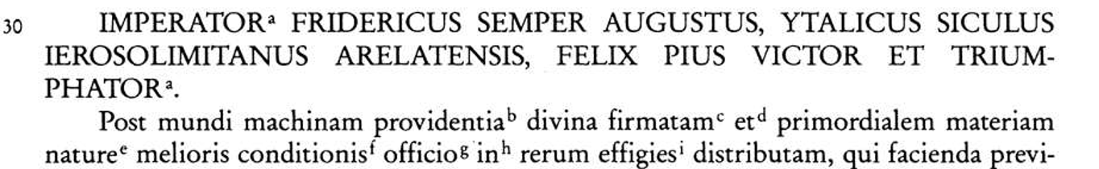
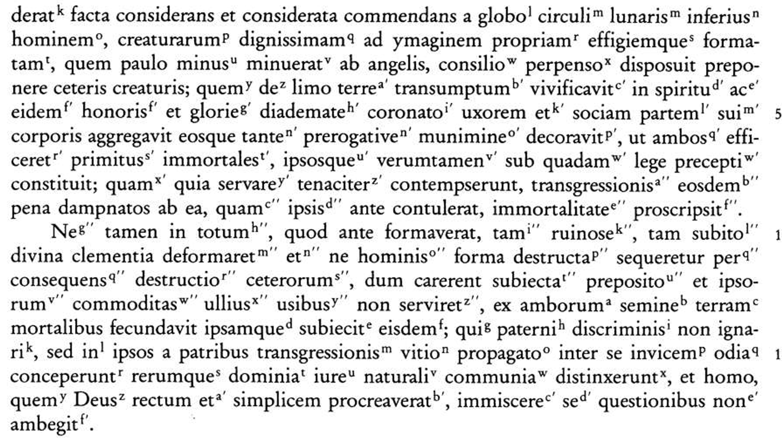


Writing of the Liber Augustalis

Slide 12
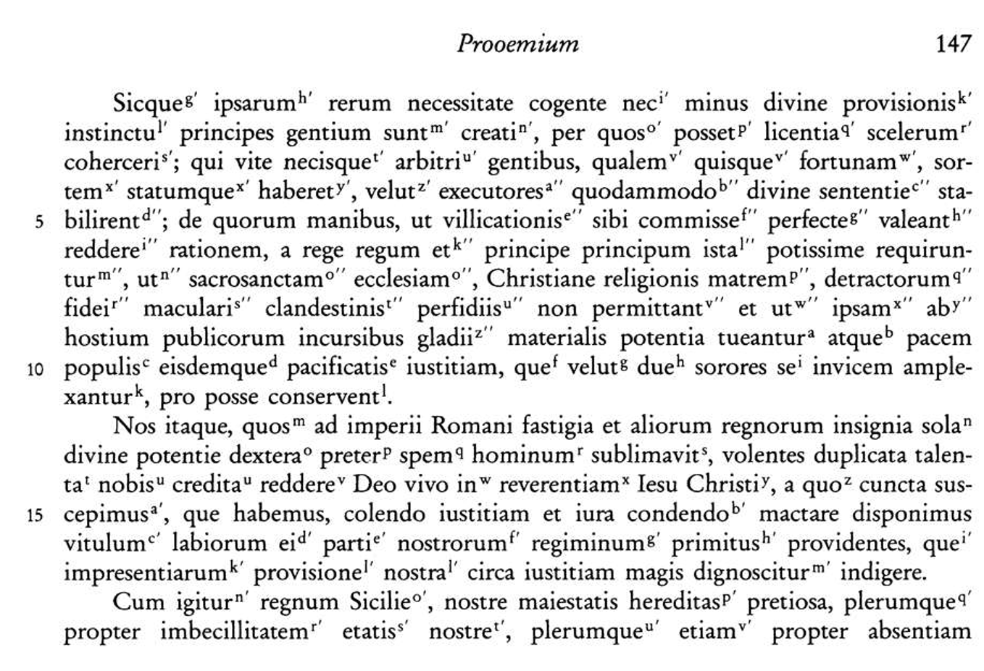


Slide 13
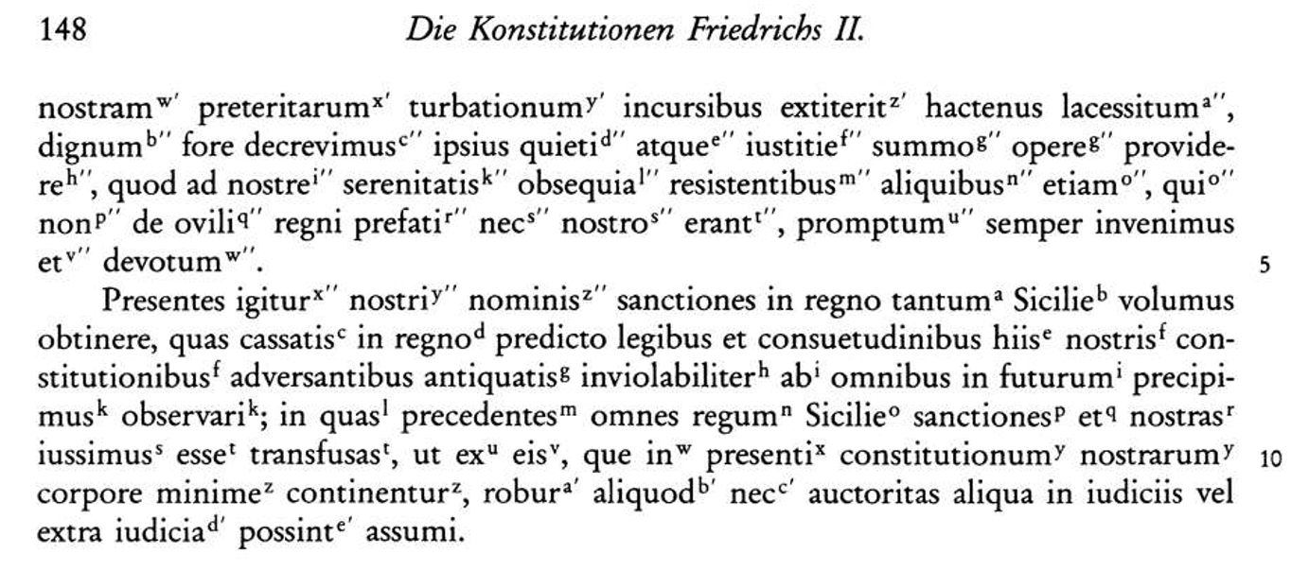

Slide 14
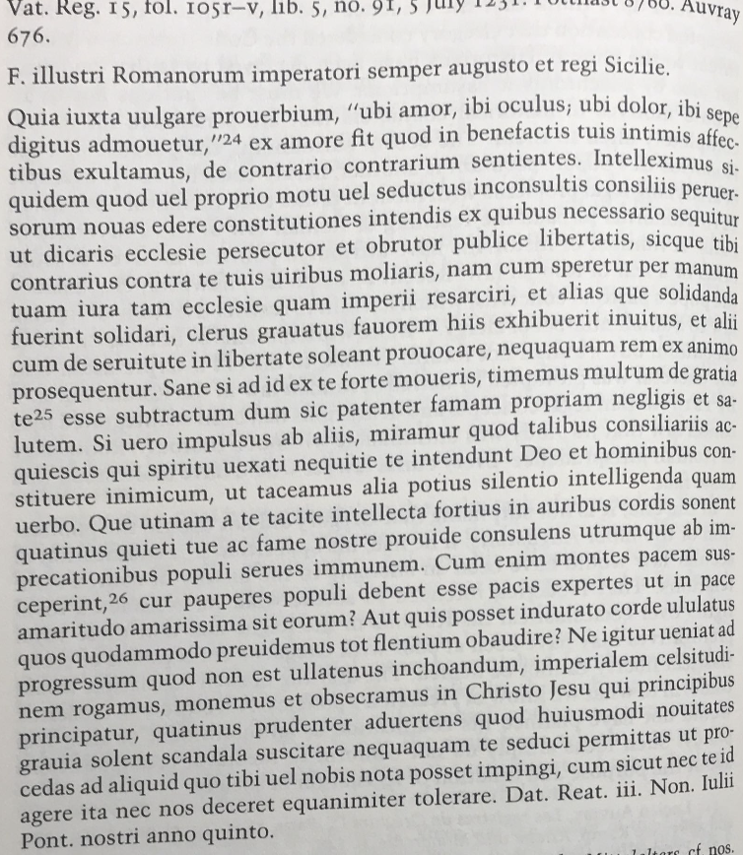
“We heard that you, by your decision or seduced by foolish advice of perverse men, intend to enact new statutes, whence it necessarily follows that you are the persecutor of the church and the destroyer of public liberty". The Pope officially asked sovereign not to adopt new laws “because innovations of this kind usually generate serious scandals” (Pennington 1984: 59).

Slide 15
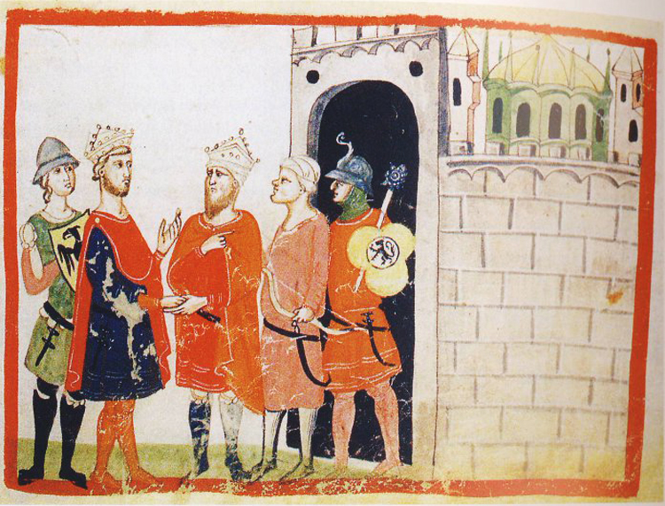
Ascendit de mari:
“A beast full of blasphemous names rises up from the sea. Raging with bear's legs and the jaws of a lion, and in the other limbs in the form of a leopard, it opens its mouth to blaspheme against the divine name, never ceasing to assault with such arrows neither the tabernacle of God nor the saints who dwell in heaven

Slide 16
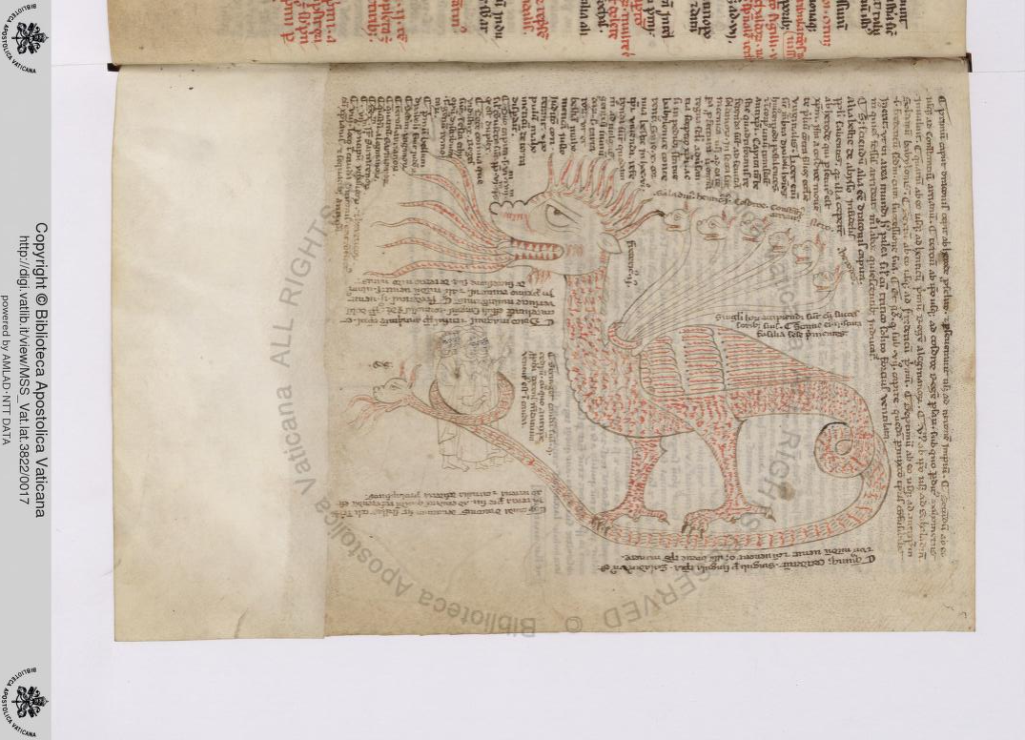
Vatican, Biblioteca Apostolica,
ms. Vat. Lat. 3822, f.5r

Slide 17
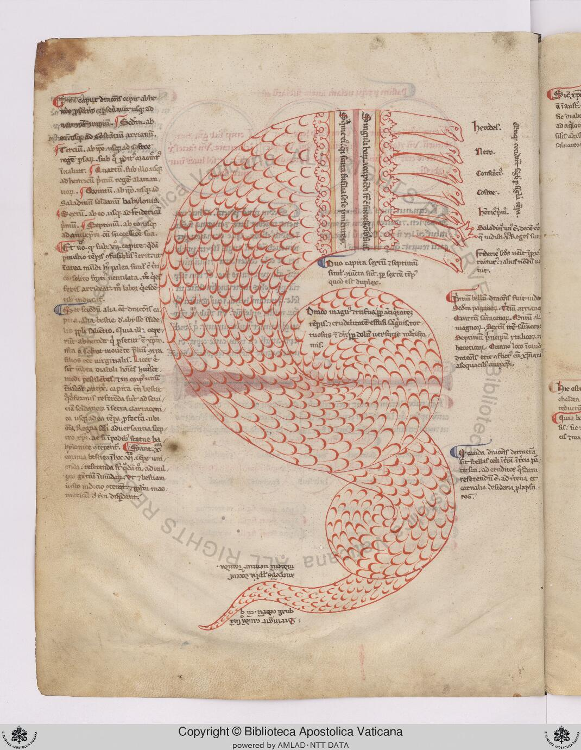

"He who has only the name of pope
has written that we are the beast that rises
from the sea, spotted like a panther.
But we say that it is he the beast of which one reads".
Vatican, Biblioteca Apostolica, ms. Vat. Lat. 4549, f.2v (1255 circa)

Slide 18
“Fiant luminaria in firmamento celi” (Gen. 1,14)
"At the moment of creation God places two lights
in heaven, one larger and one smaller.
The larger one illuminates the day, the smaller one the night.
And so the two lights, to honor their task, look at each other obliquely,
so as not to disturb each other.
And the biggest one sends the light on the smallest one.
Similarly, God has placed two governments (regimes) on earth:
the papacy and the empire:
the first ad cautelam, the second ad tutelam of the human being”.
(http://alim.unisi.it/dl/resource/13041#pb232)
Bea

Slide 19
Structure and tools
The Constitutiones consist of three books (255 chapters)
1st: public law (109 chapters)
2nd: judicial procedure (52 chapters)
3rd: feudal, private and criminal law (94 chapters)

Slide 20
The surviving manuscripts (13th-15th c.)
There are 14 manuscripts of the Liber:
- Original text promulgated at Melfi (5)
- Text supplemented by other Novellae (6)
Greek version (nòmos Basilikòs) (3)
https://digi.vatlib.it/view/MSS_Vat.lat.6770
Città del Vaticano, Biblioteca Apostolica Vaticana,
Vat. Lat. 6770 (XIII sec.) used as the basis of the critical edition.

Slide 21
Stürner's critical edition
W. STÜRNER, Die Konstitutionen Friedrichs II. Für das Königreich Sizilien (Monumenta Germaniae Historica. Constitutiones et acta publica imperatorum et regum, tomus II, supplementum ), Hannover 1996
https://www.dmgh.de/mgh_const_2_suppl/index.htm#page/(III)/mode/1up
The critical edition seeks to reestablish the original form of the text on the basis of the comparative study of each passage of the different existing manuscript or printed witnesses.
This type of edition has a critical apparatus that reports the variants.

Slide 22


