Slide 1
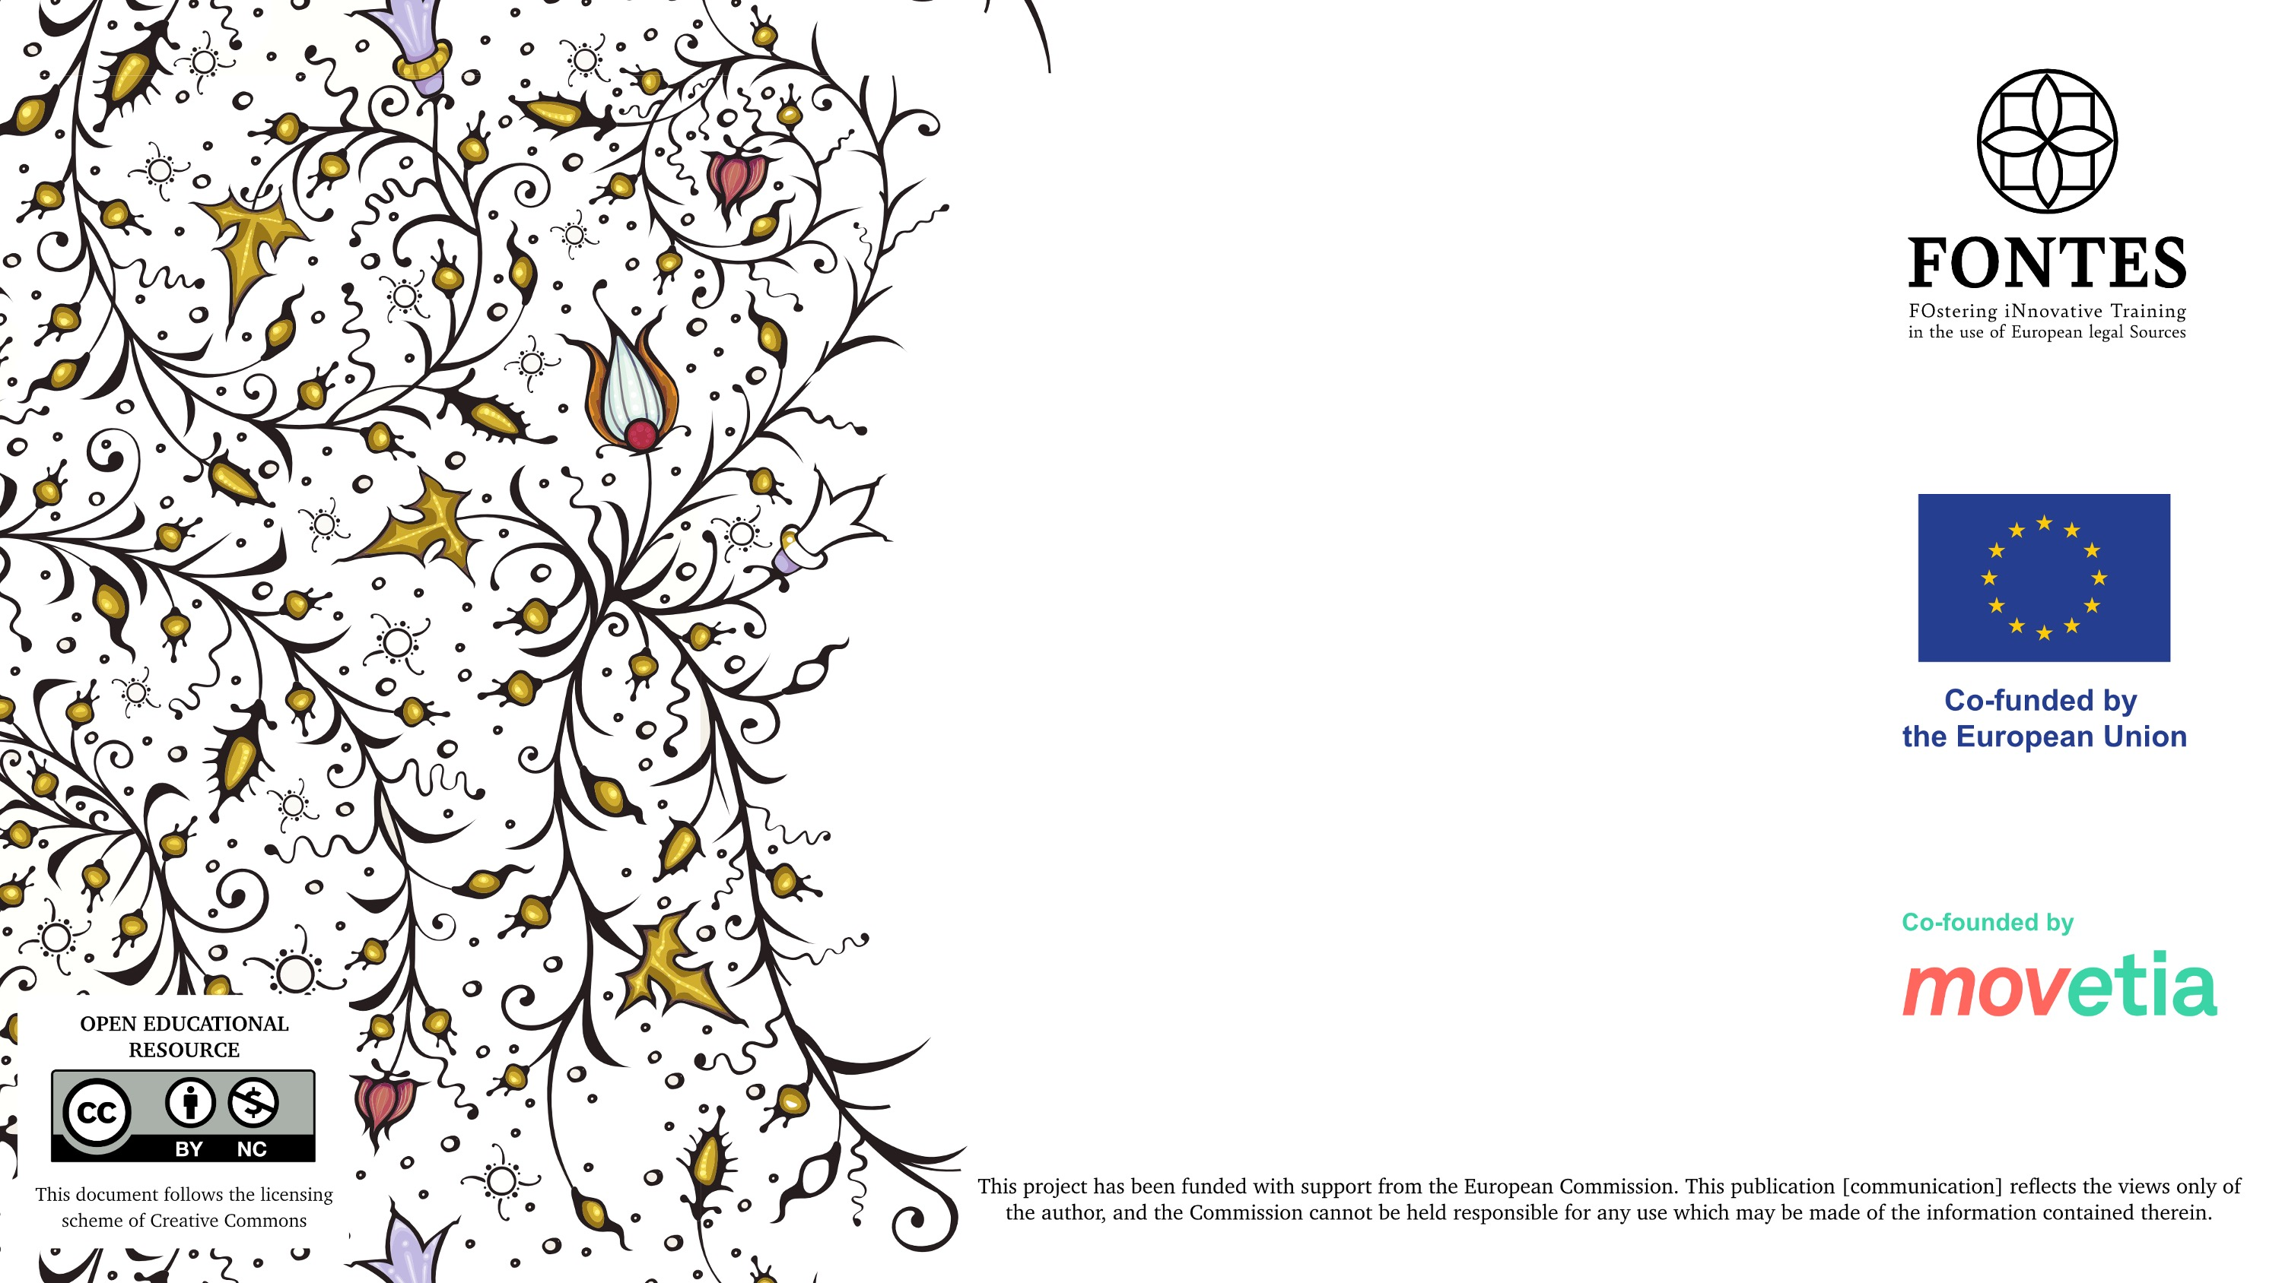
Palaeography (part 1)
Marta Cerrito (Univ. di Palermo)

Slide 2
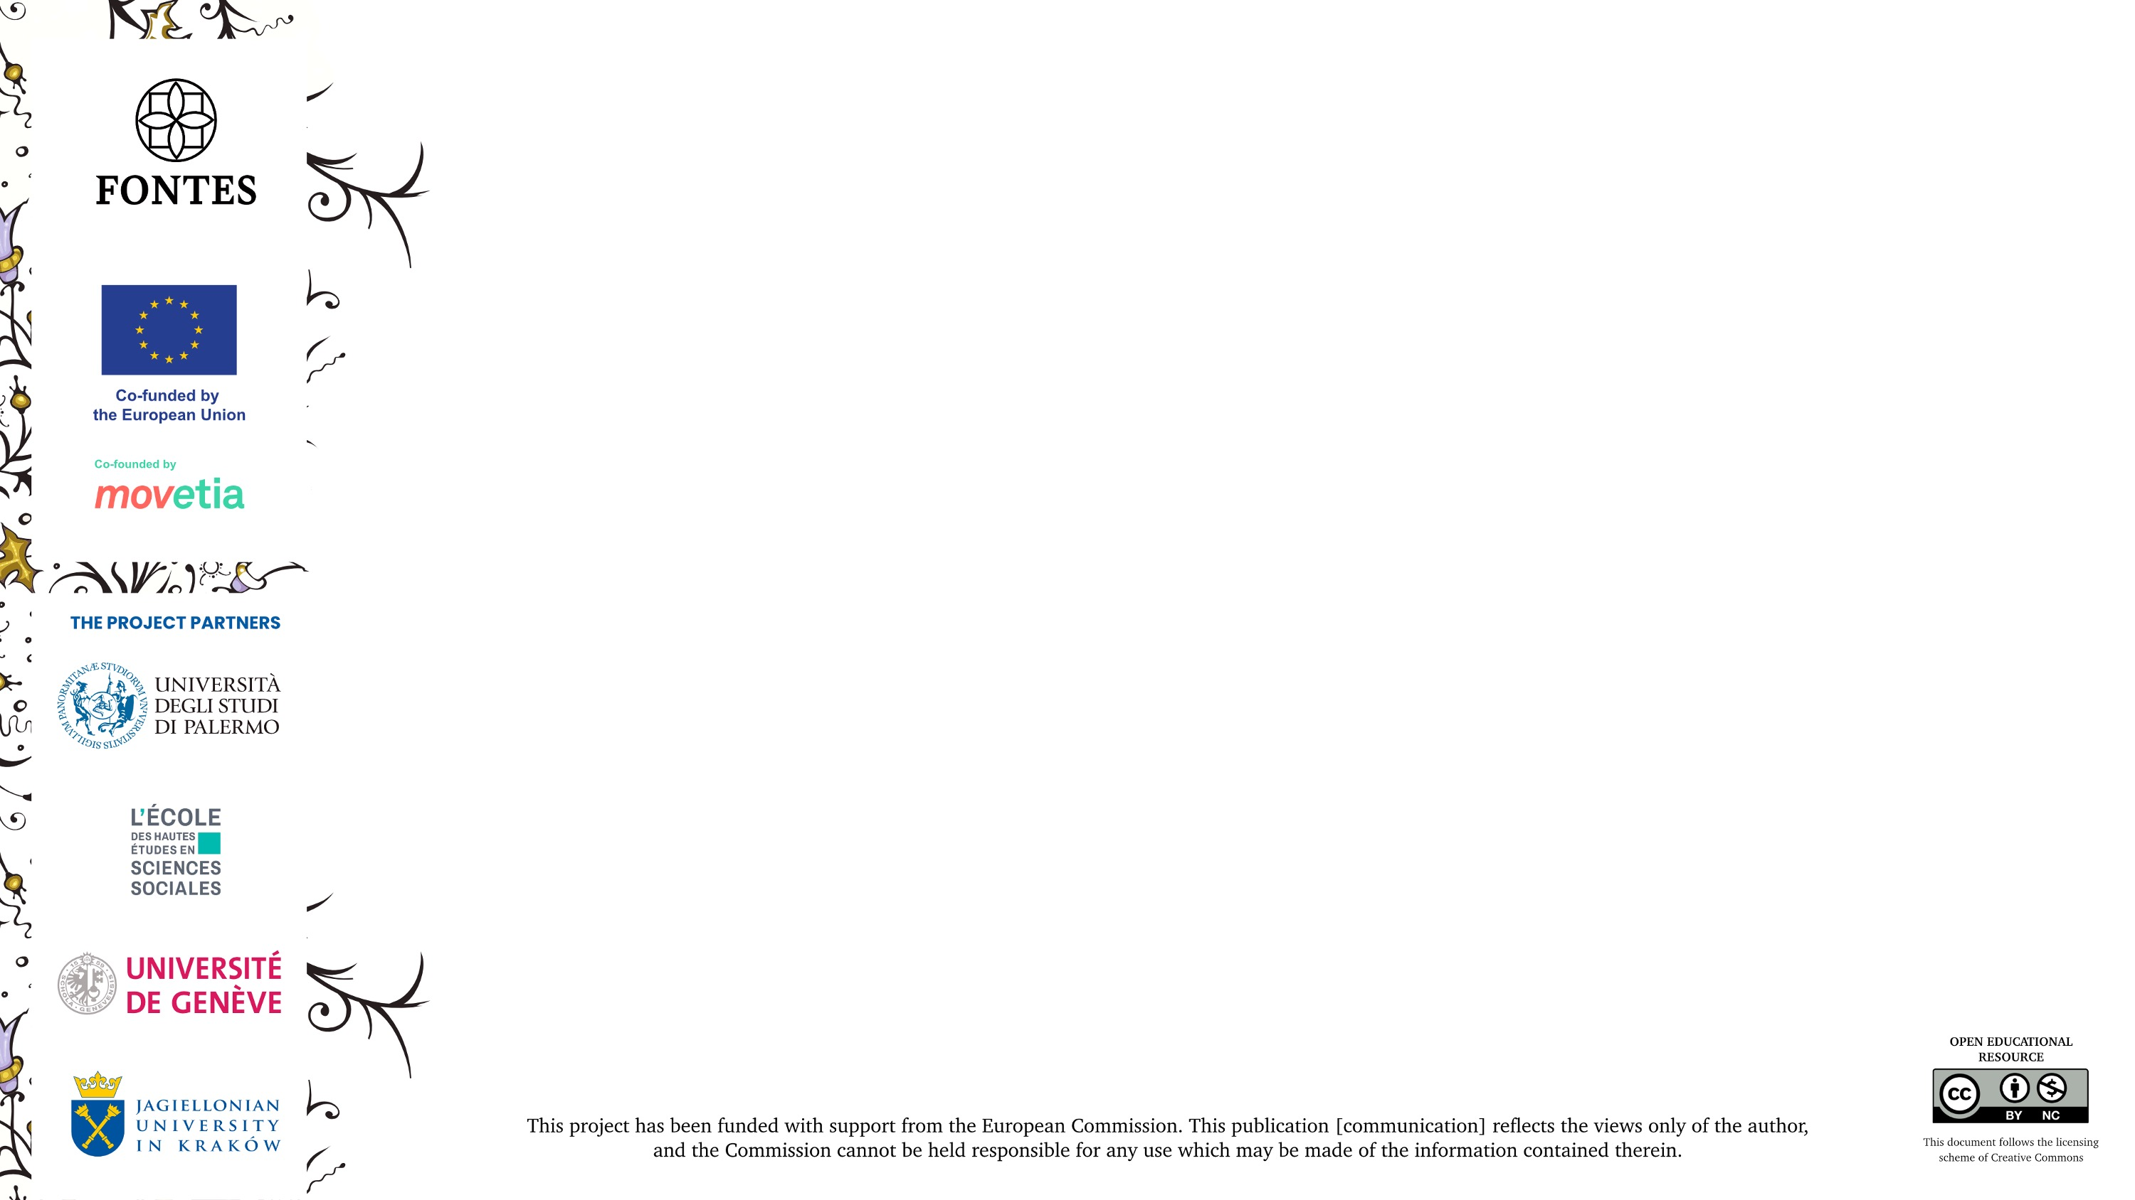
Period of return to a Latin writer unit
Caroline Minuscule (9th century)
Littera Textualis script (12th century)
Humanistic script (14th century)

Slide 3

Period of national writings or “graphic differentiation“
Insular scripts (6th century)
Visigothic script (7th century)
Beneventan script (8th century)

Slide 4
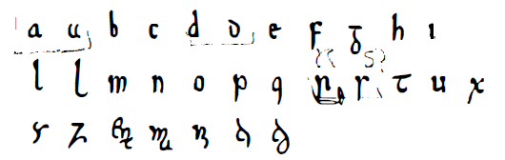
Insular scripts
Insular script is a medieval writing system originating in Ireland and spreading to Anglo-Saxon England and continental Europe under the influence of Irish Christianity. Irish missionaries export this script to continental Europe, where they establish monasteries. The Insular script comprises a diverse family of scripts used for different functions.
Alphabet of Insular Minuscule

Slide 5
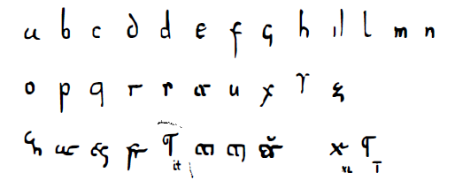
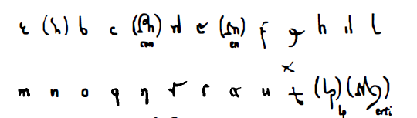
Visigothic script
Visigothic script is a type of medieval writing that originated in the Visigothic kingdom in Hispania. It is also sometimes called Mozarabic or Toletano, because it developed in the last period of the Visigothic Kingdom and continued to be used for centuries after the Arab conquest.
Alphabet of Visigothic Minuscule
Alphabet of Visigothic Cursive

Slide 6
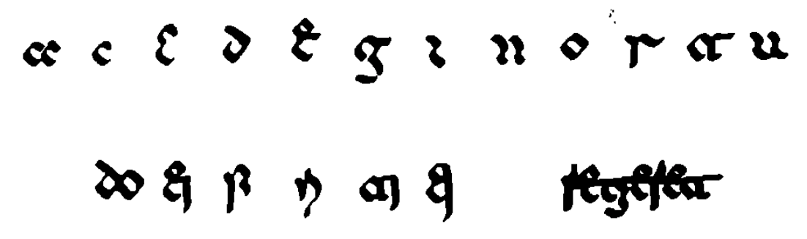
Beneventan script
The Beneventan script is a medieval script originating in the Duchy of Benevento in southern Italy. It was also called Langobard, Longobard, Longobardisca (signifying its origins in the territories ruled by the Lombards).
This script was used from the middle of the 8th century until the 13th century, although examples exist until the 16th century.
Alphabet of Beneventan Minuscule

Slide 7
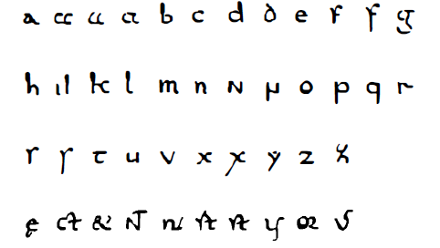
Caroline Minuscule
Caroline (or Carolingian) minuscule is a clear and manageable script, born out of Charlemagne's educational reforms in the second part of the 8th and early 9th century. It was rediscovered and perfected in the Italian Renaissance by the humanists.
Alphabet of Caroline Minuscule

Slide 8
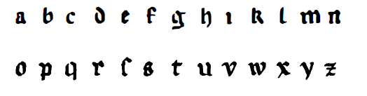
Littera textualis script
The littera textualis script was mainly used for the production of books in the university world. There are the styles born in the universities of Bologna and Paris.
The littera Bononiensis retains the characteristics of the Italian Gothic rotunda. The littera Parisiensis is smaller, less rounded and more irregular.
Alphabet of littera textualis Minuscule

Slide 9

Humanistic script
The humanist script was the spelling of the Latin alphabet typical of the humanist period and was the result of a conscious elaboration by the intellectuals of the 14th and 15th centuries in reaction to the Gothic script.
Alphabet of Humanistic Minuscule

Slide 10
Abbreviations
Truncation: A word is abbreviated by truncation when only the first part of the word is actually written out, while an abbreviation mark replaces the missing final letters.
Contraction: A word which has middle letters missed out is called a contraction.
Abbreviation marks significant in themselves
Abbreviation marks significant in context
Superscript letters

Slide 11
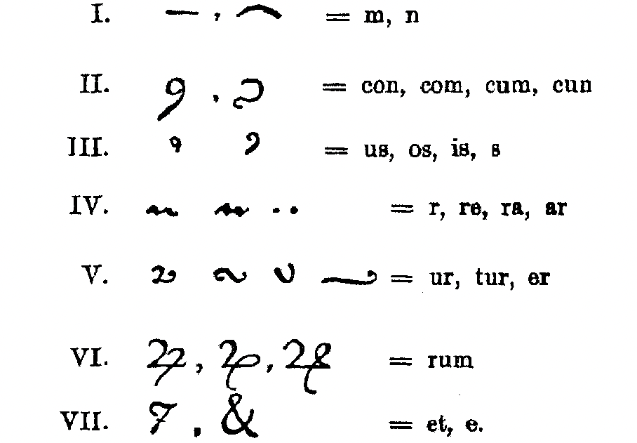
Abbreviation marks significant in themselves

Slide 12

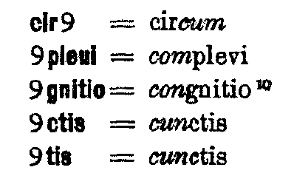
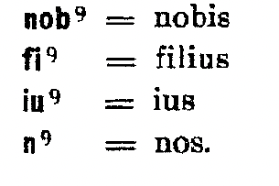

Slide 13
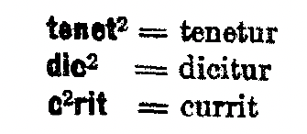
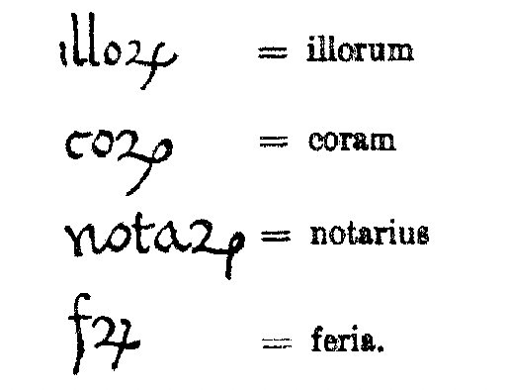

Slide 14
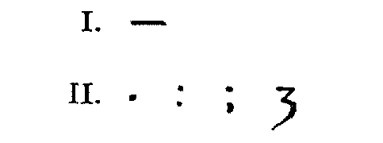
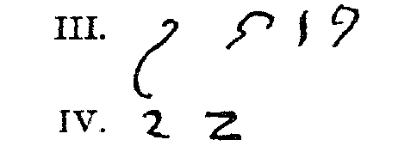
Abbreviation marks significant in context

Slide 15
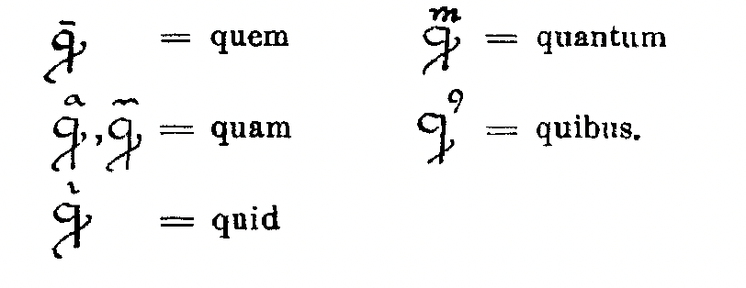
Specificities of the letter “q”

Slide 16
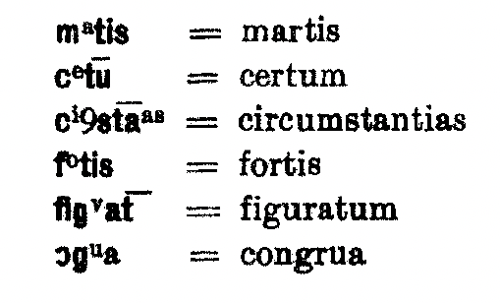
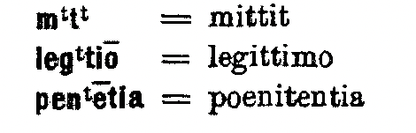
Superscript letters

Slide 17


