Slide 1
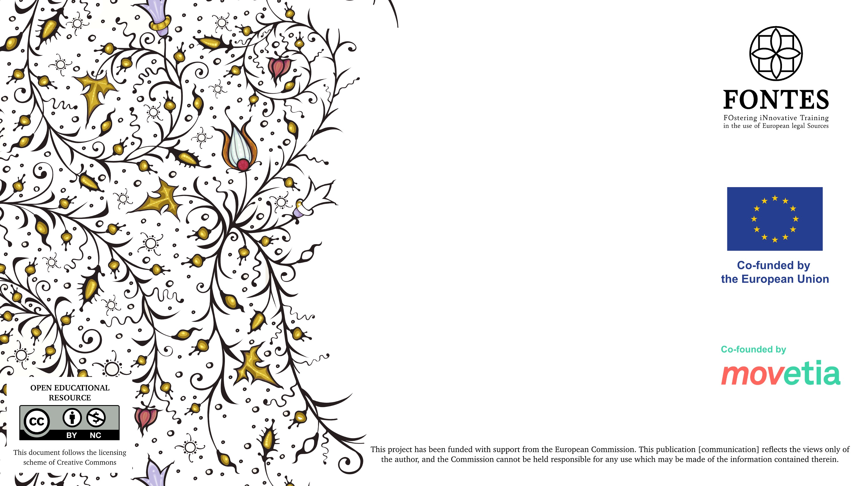
Legal Historical Sources on the Internet
          Workshop, Paris 7-10 February 2023
          Kacper Górski (Jagiellonian University in Kraków)
          E-mail: kacper.gorski@uj.edu.pl

Slide 2
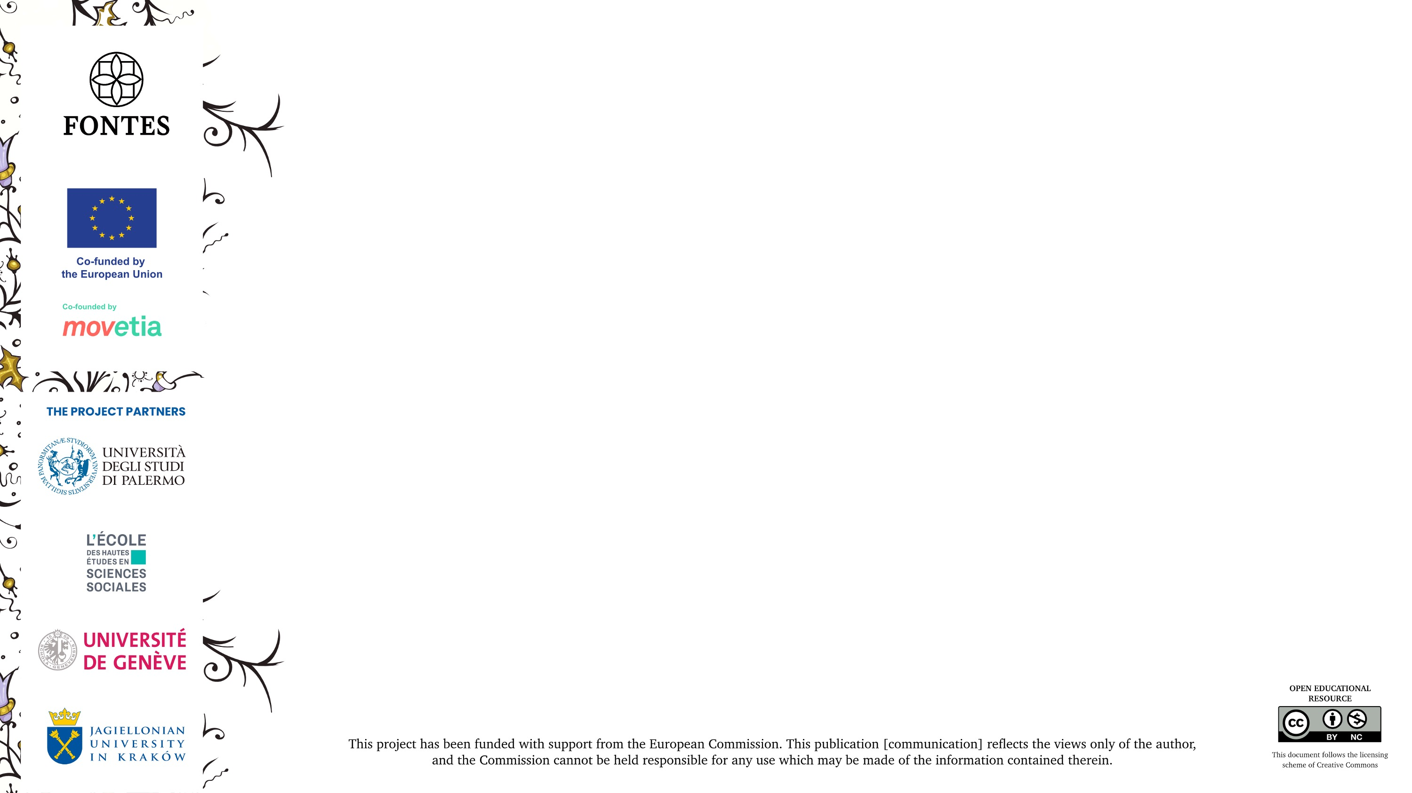
Contents
Internet bases:
  Digital libraries
  Digital archives
Other tools:
  AI-powered text transcription
  On-line Latin dictionaries and glossaries
  Latin grammar tools

Slide 3
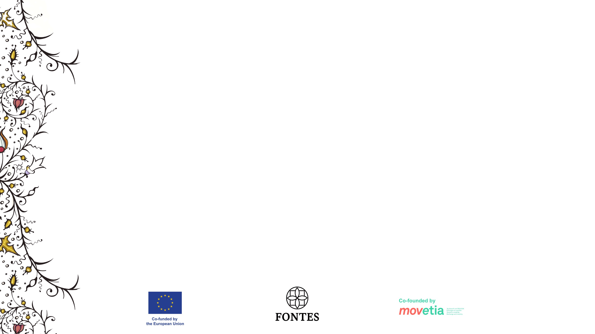
Digital Libraries
Google Books - https://books.google.com
Internet Archive - https://archive.org
HathiTrust - https://www.hathitrust.org
Europeana - https://www.europeana.eu
Gallica - https://gallica.bnf.fr
German Digital Library (Deutsche Digitale Bibliothek) - https://www.deutsche-digitale-bibliothek.de
Federacja Bibliotek Cyfrowych (Federation of Digital Libraries) - https://fbc.pionier.net.pl

Slide 4
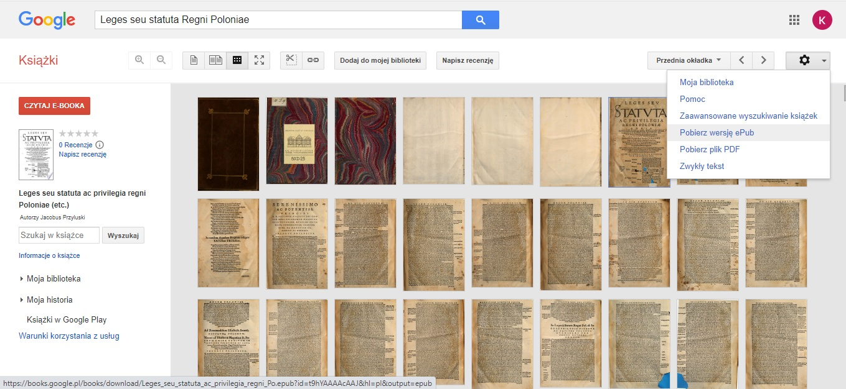

Slide 5
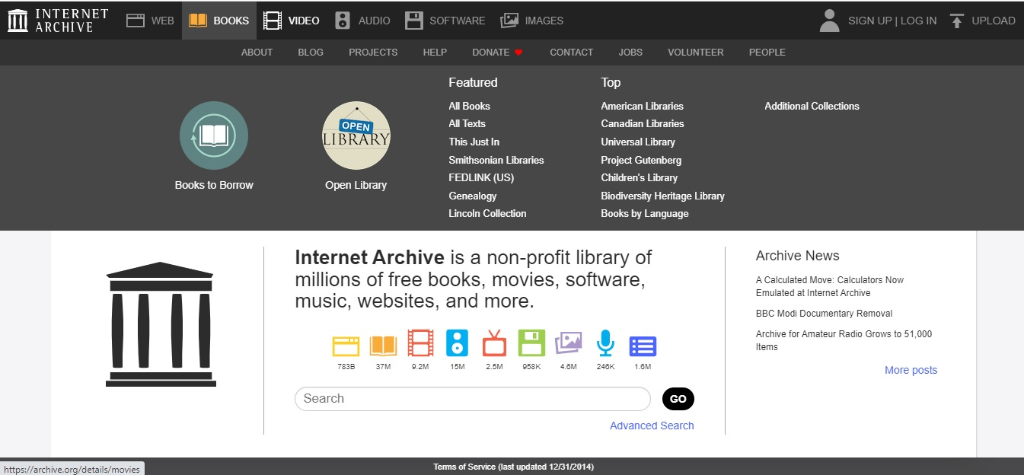

Slide 6
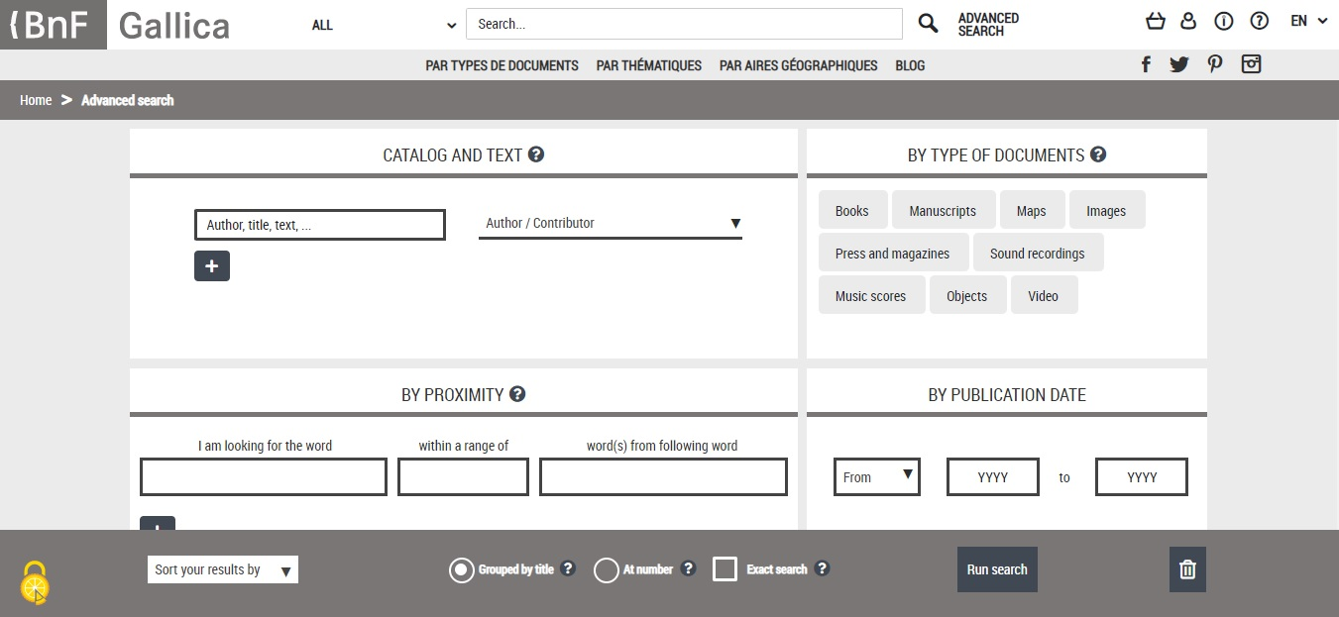

Slide 7
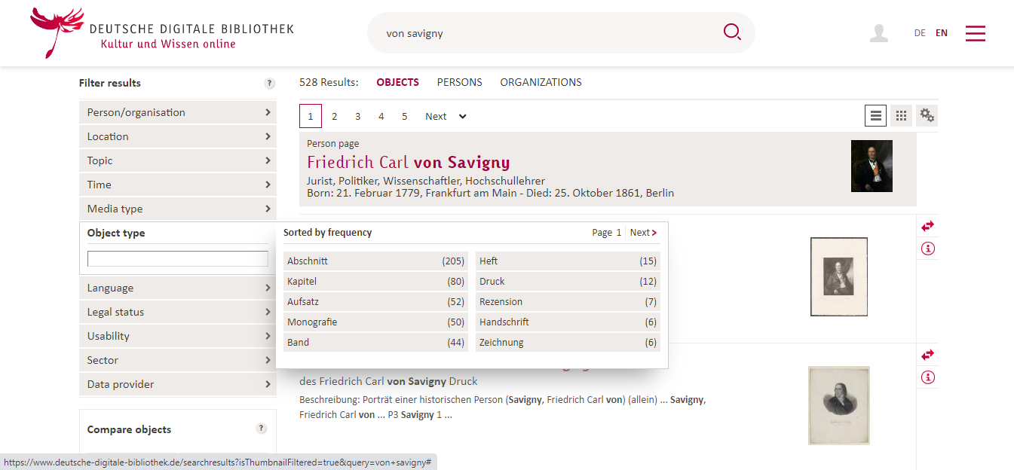

Slide 8
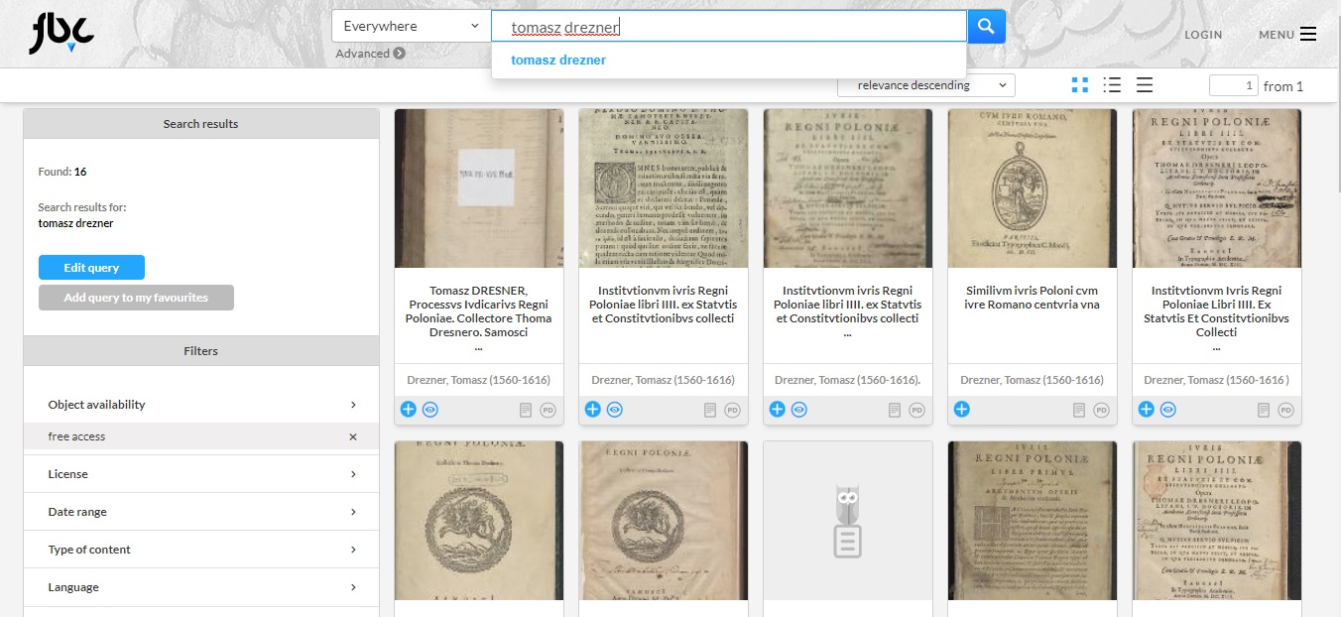

Slide 9
Digital Collections of Legal Sources
The Avalon Project - https://avalon.law.yale.edu
Monumenta Germaniae Historica - https://www.dmgh.de
Collection of Swiss Law Sources (Sammlung Schweizerischer Rechtsquellen) - https://editio.ssrq-online.ch/
IURA. Sources of Law from the Past (IURA. Źródła prawa dawnego) - https://www.iura.uj.edu.pl/

Slide 10
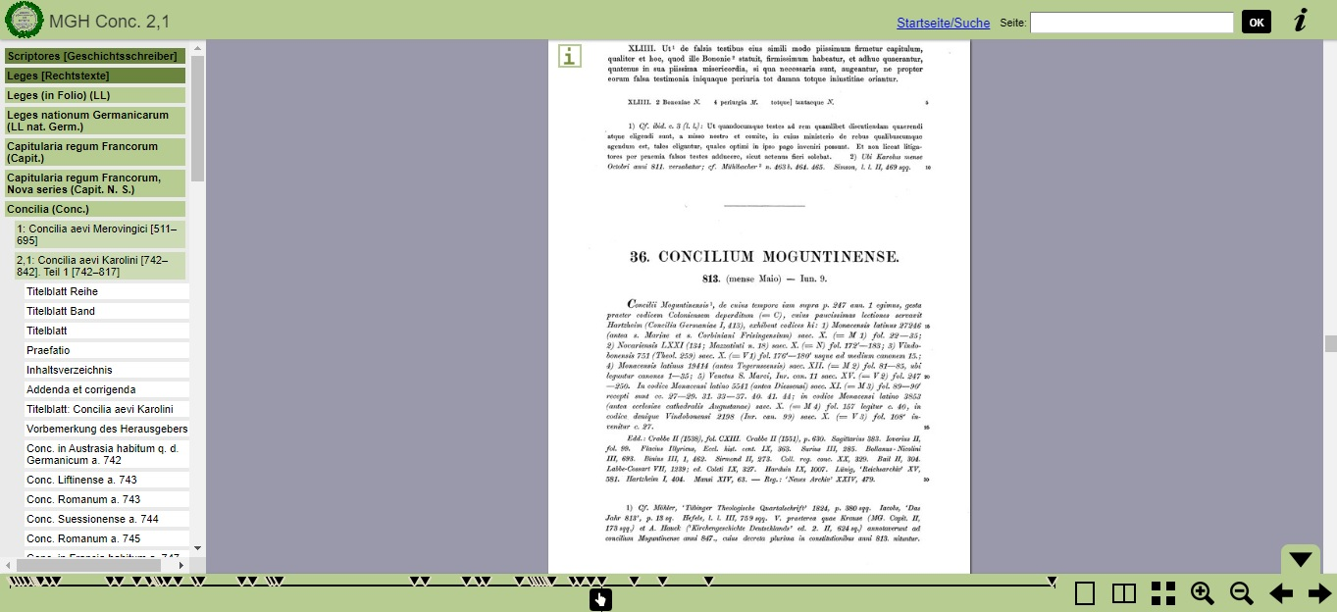

Slide 11
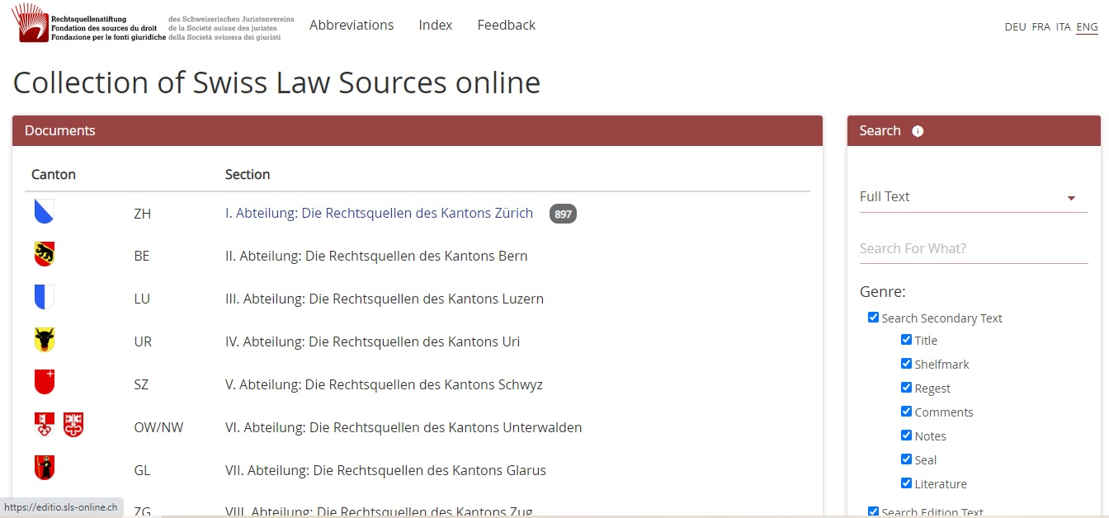

Slide 12
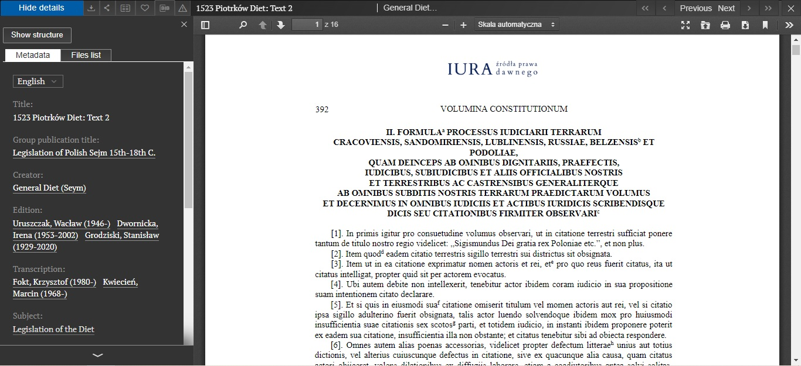

Slide 13
Digital Archives
Search the Archives (Szukajwarchiwach) - https://www.szukajwarchiwach.gov.pl
Virtual Manuscript Library of Switzerland - https://www.e-codices.unifr.ch
e-manuscripta - https://www.e-manuscripta.ch
Archivportal - https://www.archivportal-d.de
The National Archives - https://www.nationalarchives.gov.uk

Slide 14
Digital Archives
6. France Archives - https://francearchives.gouv.fr
7. Vatican Digital Library - https://digi.vatlib.it
8. Italian National Archive System - https://san.beniculturali.it
Inventories: https://inventari.san.beniculturali.it/inventari
9. Archives Portal Europe - https://www.archivesportaleurope.net

Slide 15
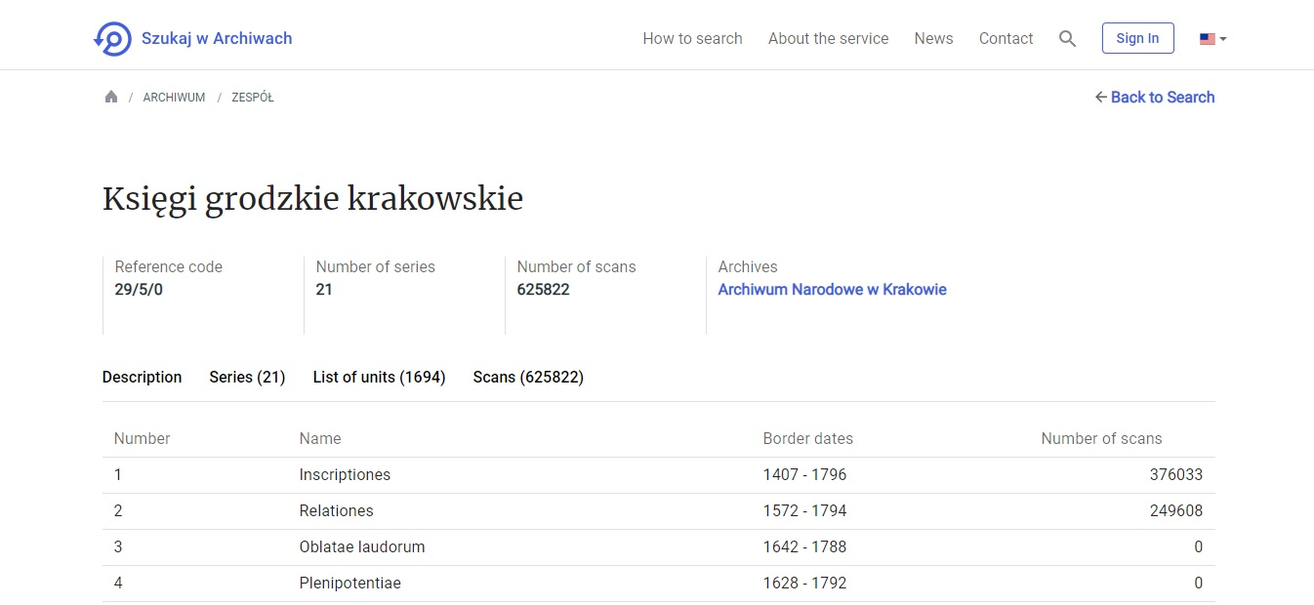

Slide 16
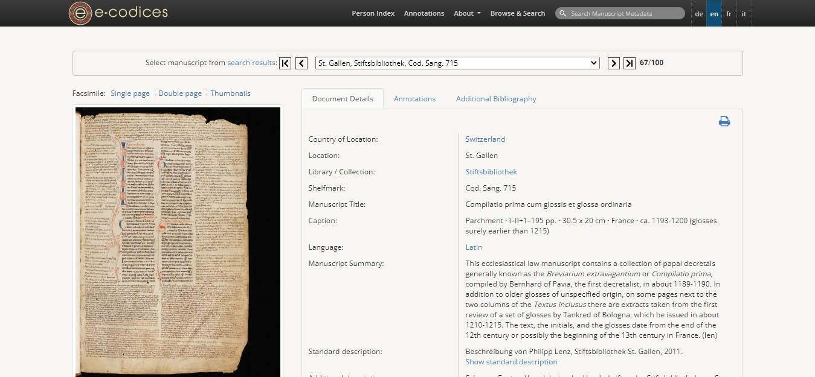

Slide 17
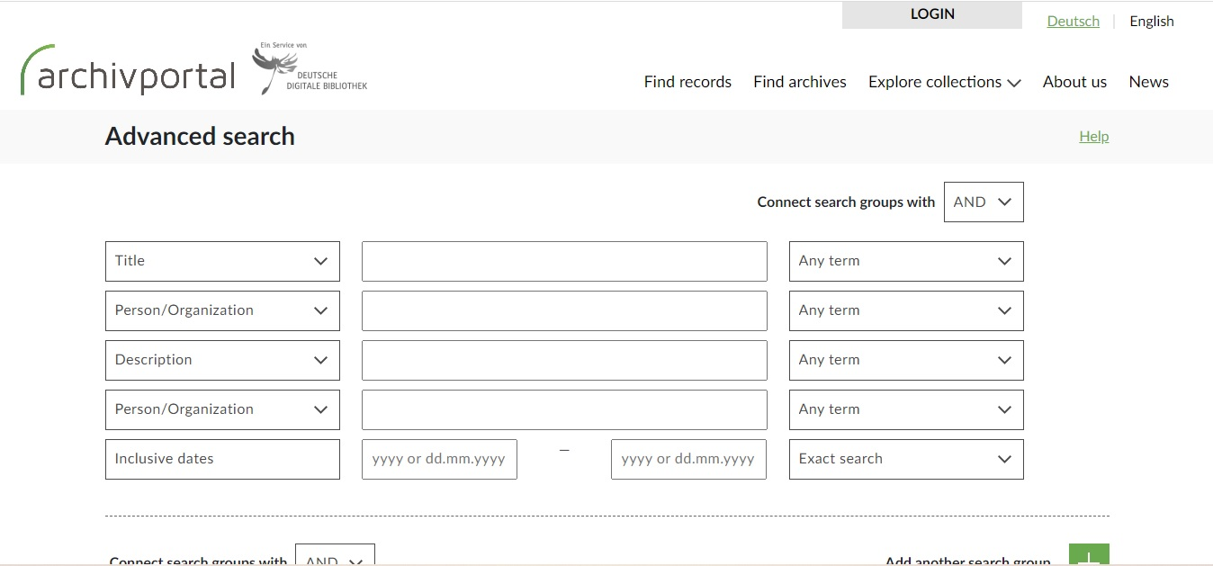

Slide 18
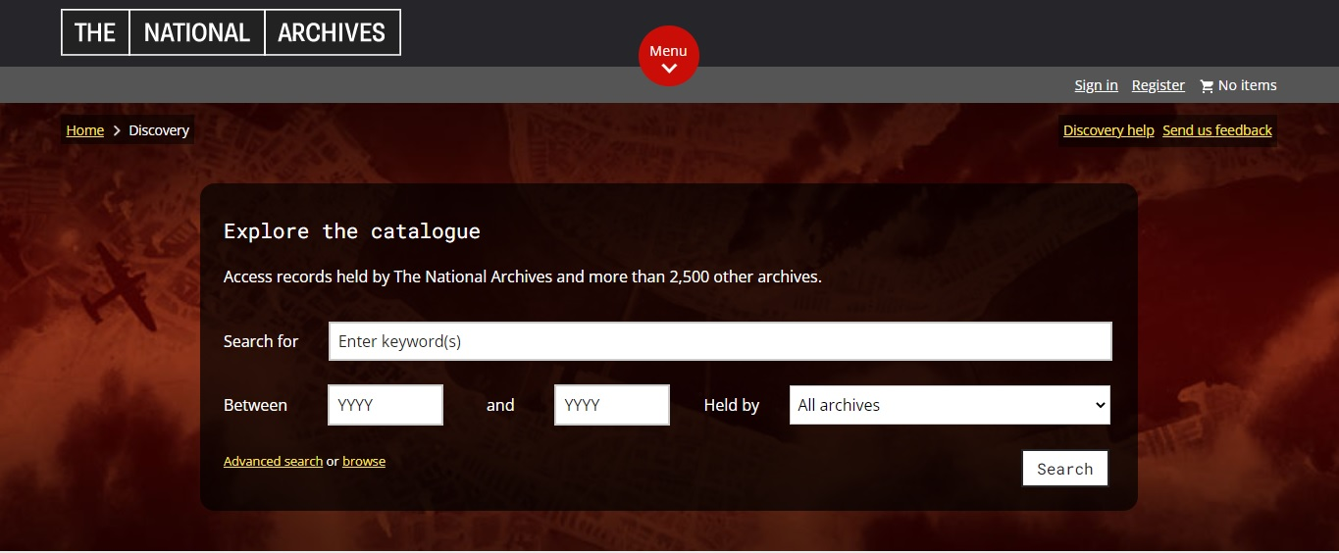

Slide 19
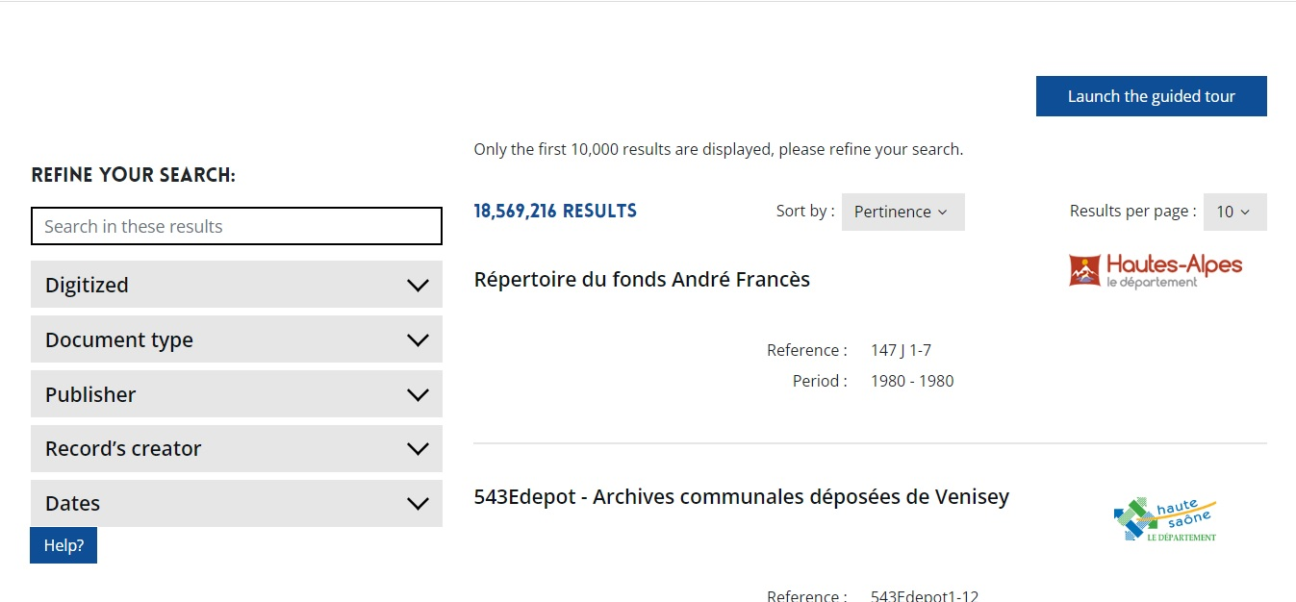

Slide 20
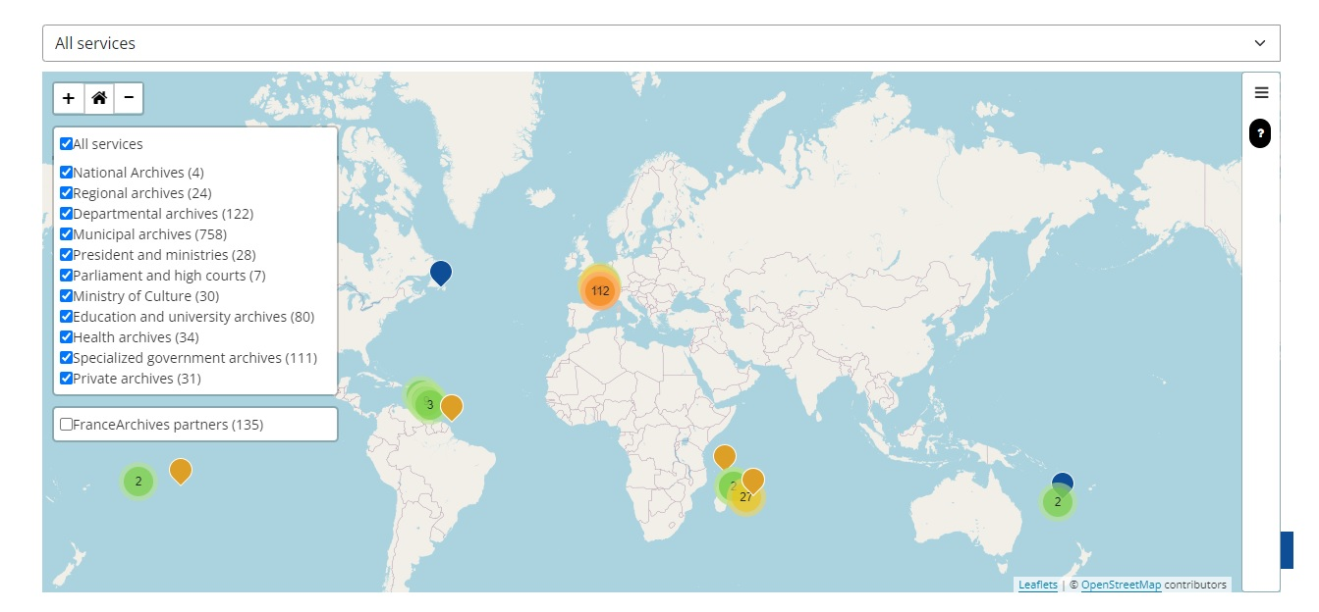

Slide 21
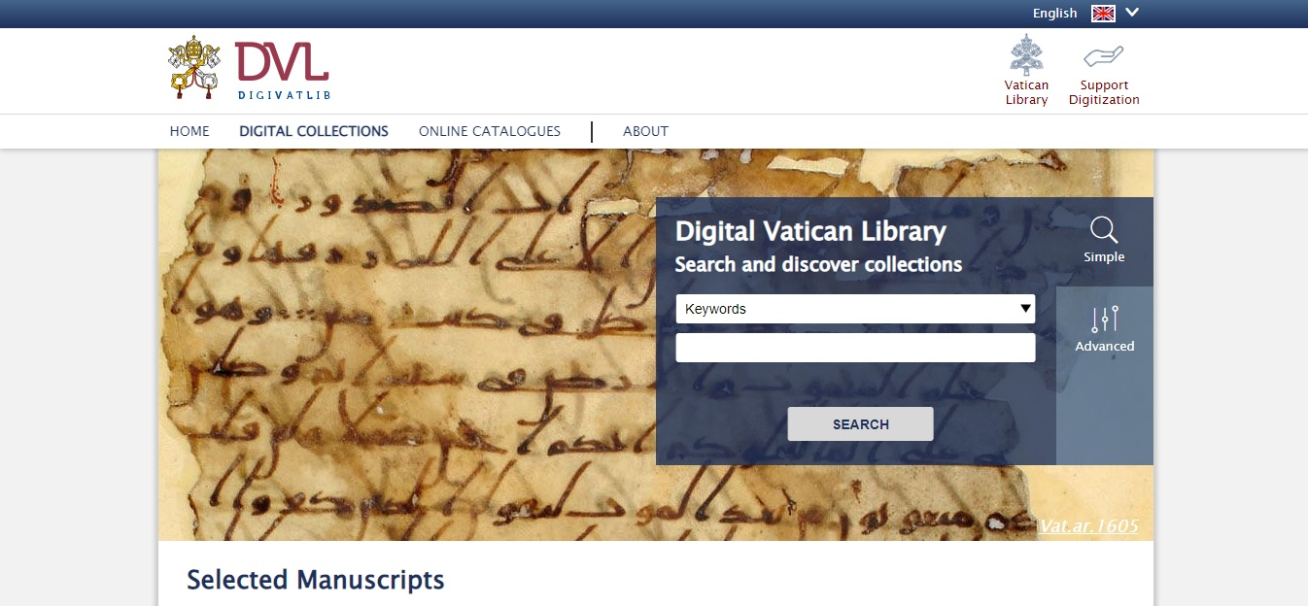

Slide 22
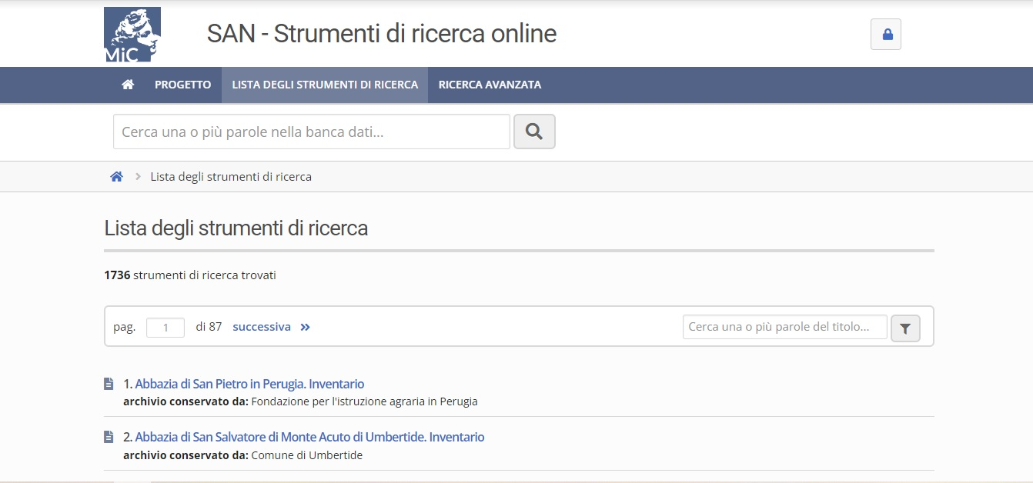

Slide 23
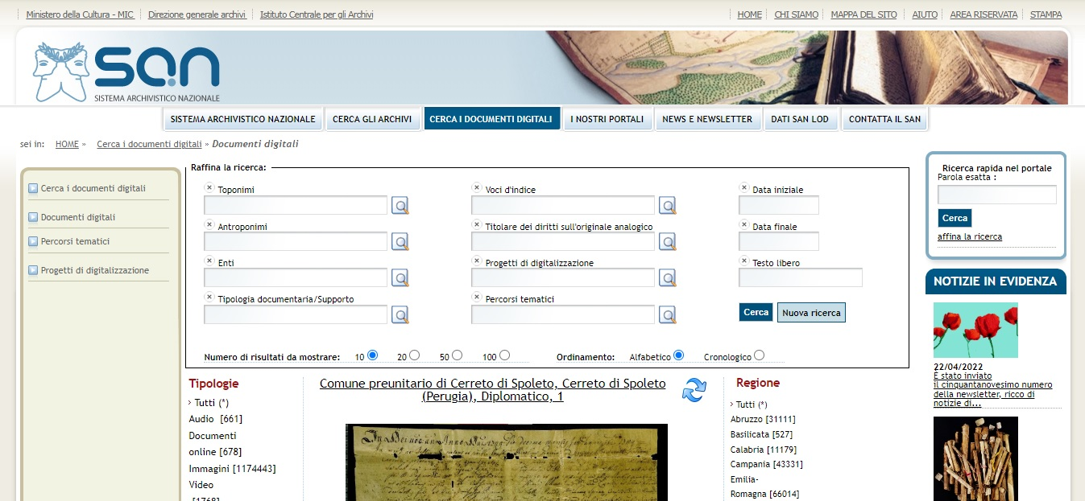

Slide 24
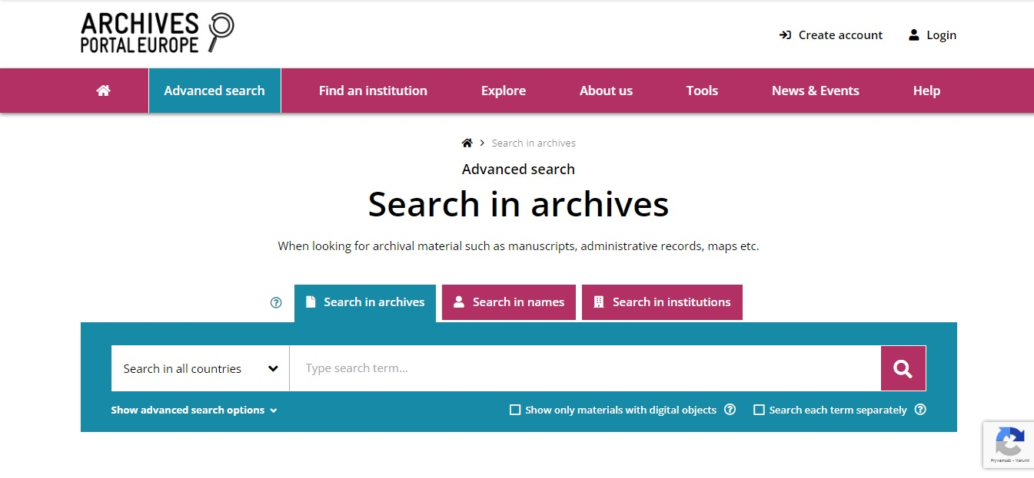

Slide 25
Transkribus – Text Transcription and Text Recognition
Layout Analysis – automatic segmenting of text (printed or handwritten) – lines and regions (paragraphs) → manual transcription (free)
Handwritten Text Recognition (HTR) – automatic recognition of text (printed or handwritten) based on ready or self-trained model of recognition (behind the paywall)

Slide 26
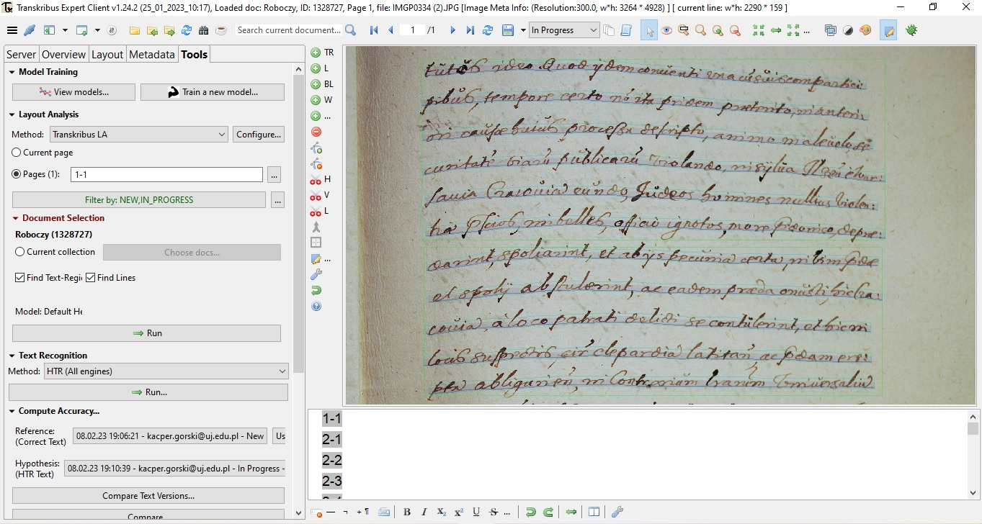

Slide 27
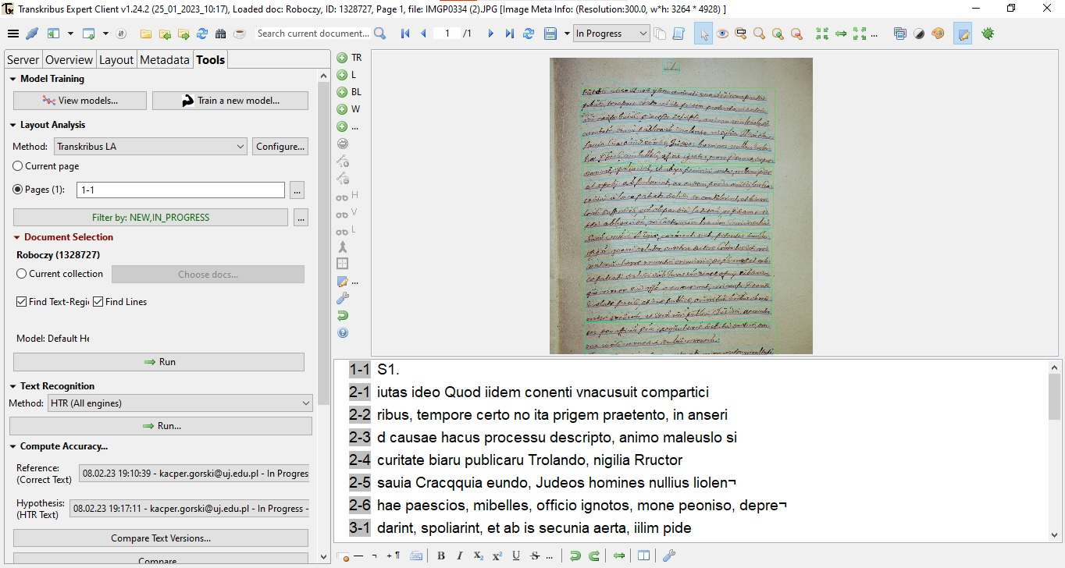

Slide 28
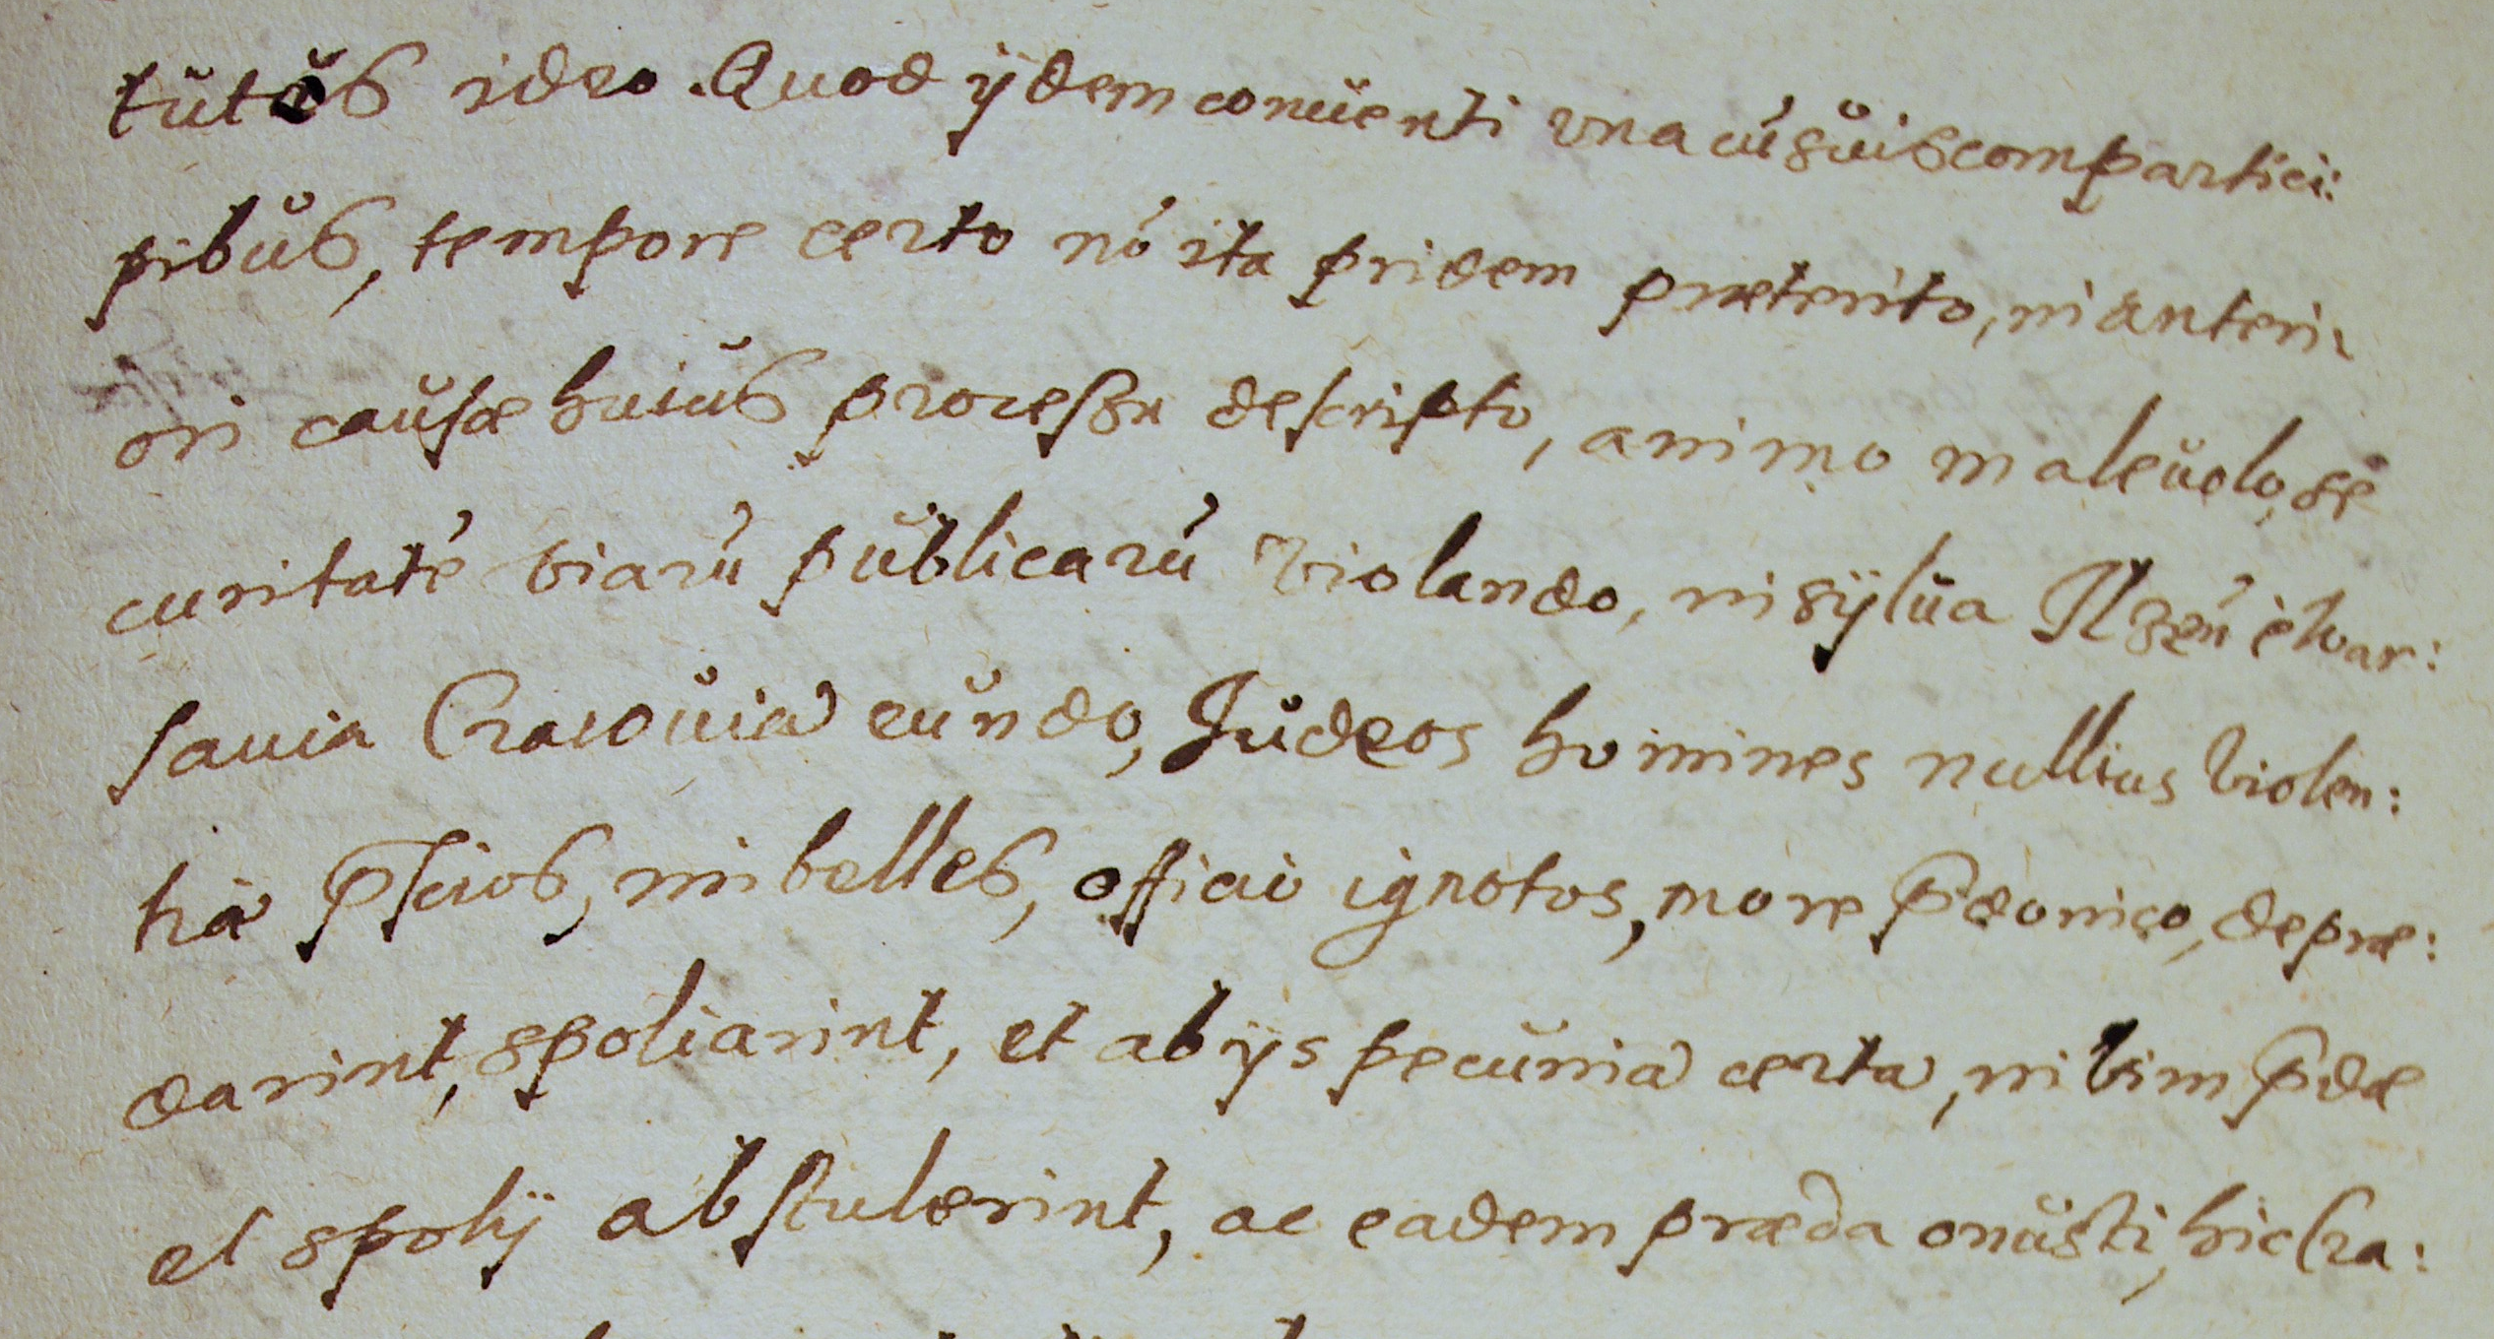
TRANSCRIPTION BY TRANSKRIBUS:
iutas ideo Quod iidem conenti vnacusuit compartici
ribus, tempore certo no ita prigem praetento, in anseri
d causae hacus processu descripto, animo maleuslo si
curitate biaru publicaru Trolando, nigilia Rructor
sauia Cracqquia eundo, Judeos homines nullius liolen¬
hae paescios, mibelles, officio ignotos, mone peoniso, depre¬
darint, spoliarint, et ab is secunia aerta, iilim pide
et spolii abstulerint, ac eadem praedi onusti sic lra¬
CORRECT TRANSCRIPTION:
[...]tutos ideo, Quod iidem conuenti vna cu[m] suis compartici:
pibus, tempore certo no[n] ita pridem praeterito, in anteri:
ori causae huius procesu descripto, animo maleuolo se:
curitate[m] viaru[m] publicaru[m] violando, in sylua Ilzen[si] e War:
sauia Cracouiam eundo, Judeos homines nullius violen:
tiae p[rae]scios, imbelles, officio ignotos, more p[rae]donico, deprae:
darint, spoliarint, et ab iis pecuniam certam, in vim p[rae]dae
et spolii abstulerint, ac eadem praeda onusti, hic Cra:[...]
Source: own photography of MS Castrensia Cracoviensia 1101, p. 51 (National Archives in Kraków)

Slide 29
Online Latin Dictionaries and Glossaries (General, Ancient)
Lexicon Totius Latinitatis by Egidio Forcellini - http://www.lexica.linguax.com/forc.php
A Latin Dictionary by Ch. Lewis and Ch. Short - https://artflsrv03.uchicago.edu/philologic4/LewisShort521
Dictionnaire Illustré Latin-Français by Félix Gaffiot - https://gaffiot.fr
Thesaurus Linguae Latinae - https://publikationen.badw.de/de/thesaurus/lemmata

Slide 30
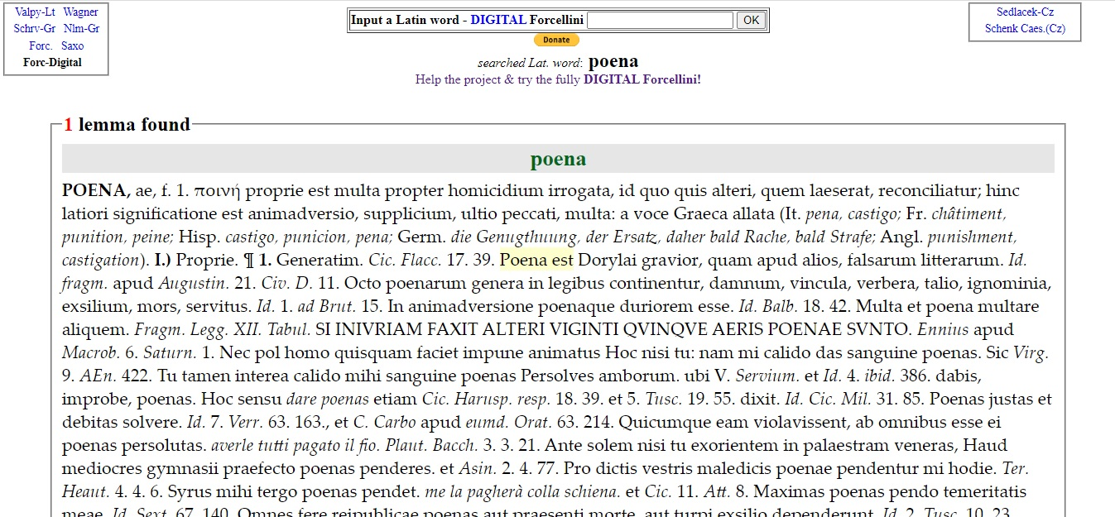

Slide 31
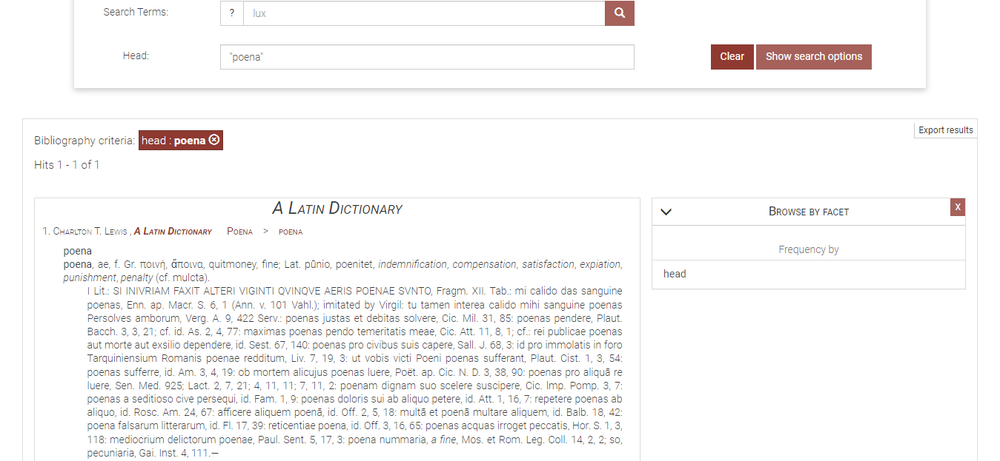

Slide 32
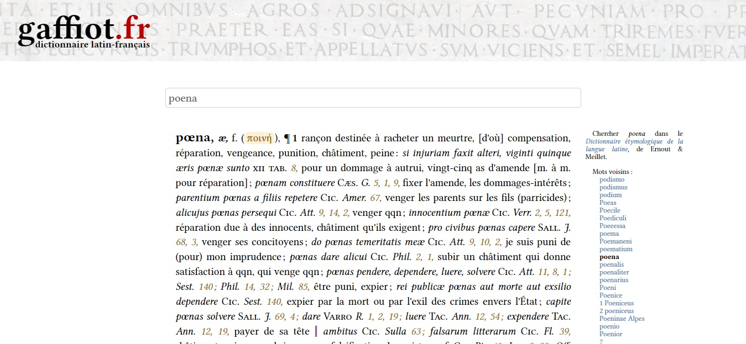

Slide 33
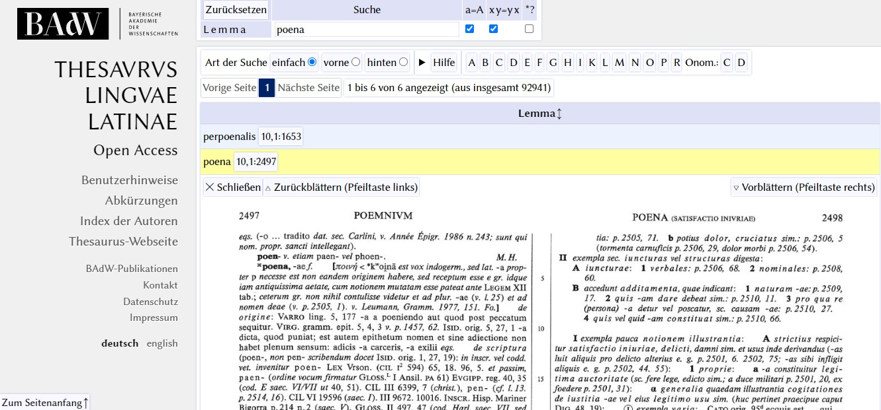

Slide 34
Online Latin Dictionaries and Glossaries (Medieval and Early Modern)
Glossarium ad scriptores mediae et infimae latinitatis by Ch. du Fresne, sieur du Cange (DuCange) - http://ducange.enc.sorbonne.fr
Dictionary of Medieval Latin from British Sources (DMLBS) - http://www.dmlbs.ox.ac.uk
Lexicon Mediae et Infimae Latinitatis Polonorum (Słownik łaciny średniowiecznej w Polsce) - https://elexicon.scriptores.pl/pl
Latinititatis Medii Aevi Lexicon Bohemorum - http://lb.ics.cas.cz/#cs
Mittellateinische Wörterbuch (MLW) - https://mlw.badw.de/en/mlw-digital/mlw-open-access.html
Latinitatis italicae medii aevi lexicon
Novum Glossarium Mediae Latinitatis (NGML) - https://glossaria.eu/ngml

Slide 35
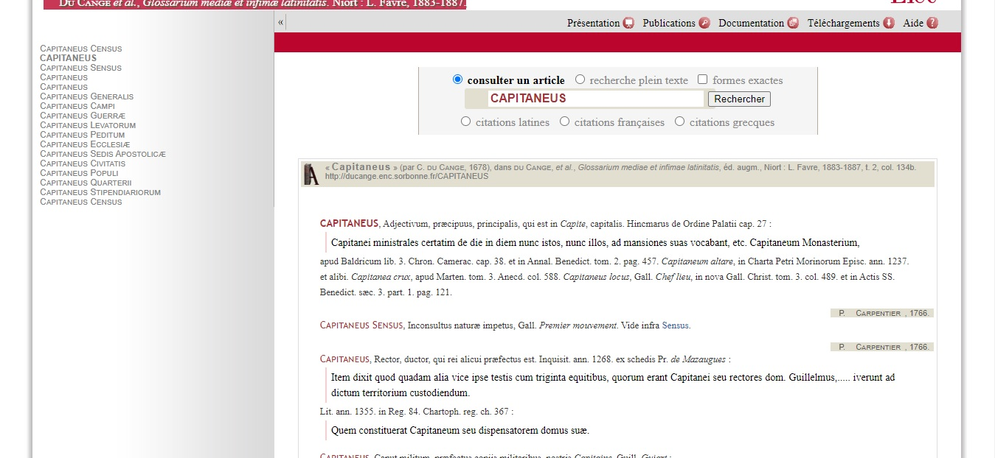

Slide 36
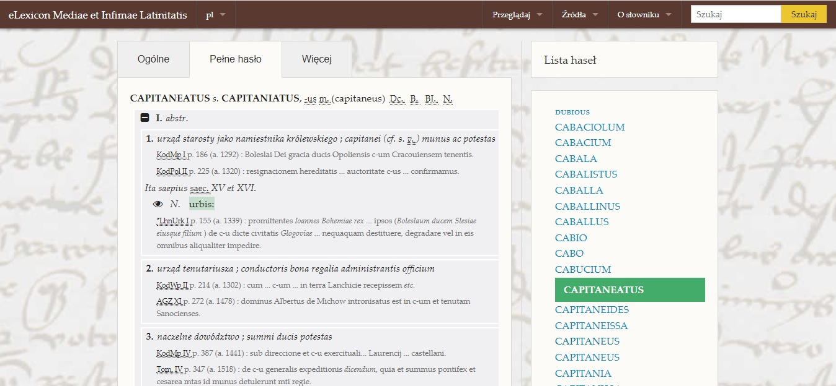

Slide 37
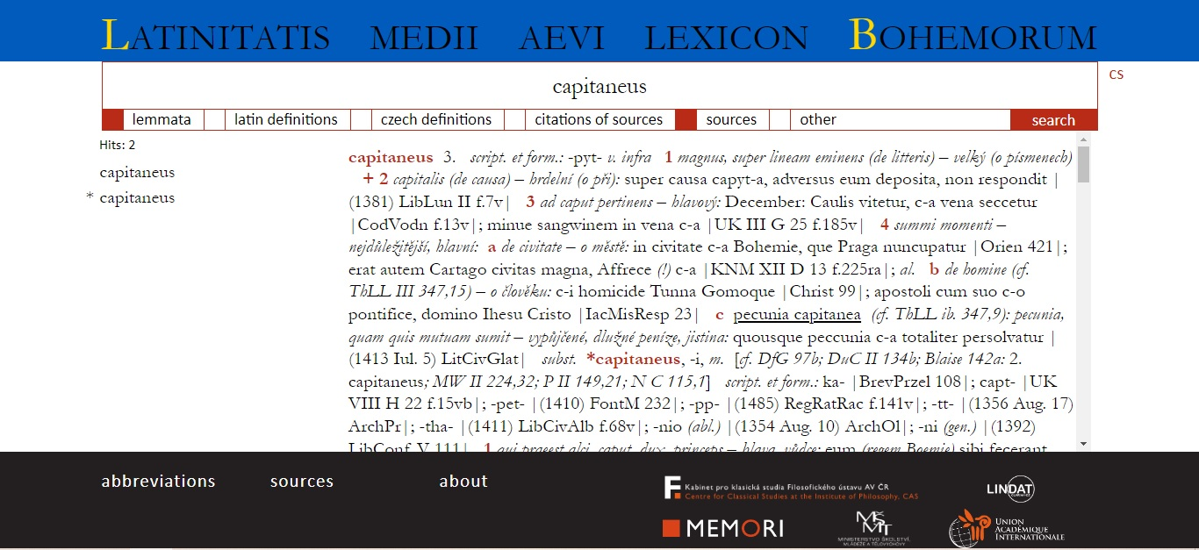

Slide 38
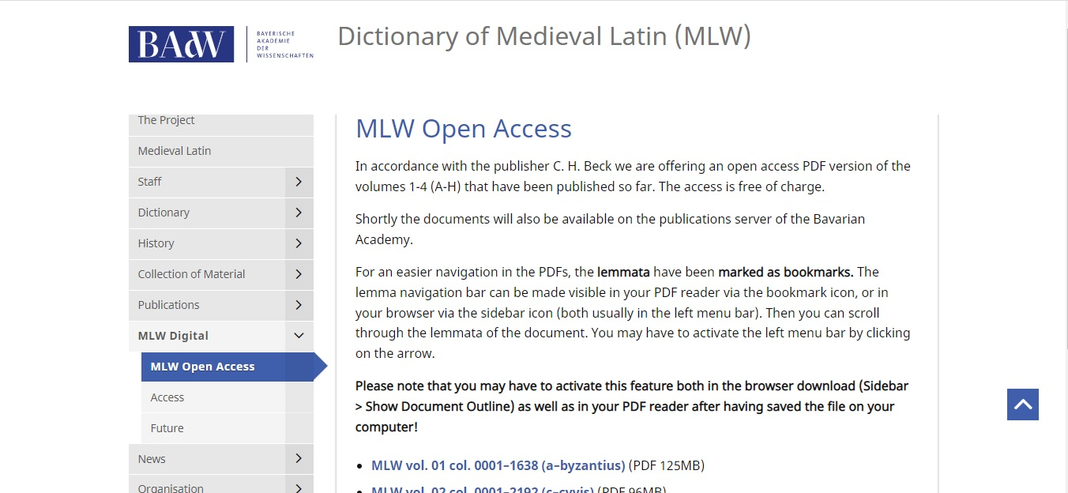

Slide 39
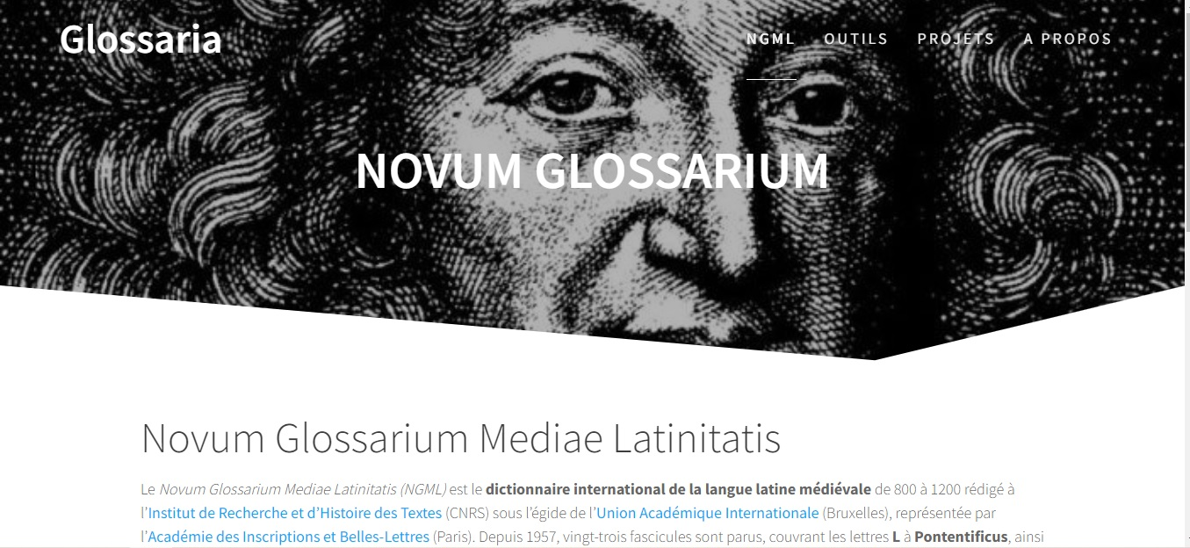

Slide 40
Online Latin Meta-Dictionaries
Logeion (ΛΟΓΕΙΟΝ) – https://logeion.uchicago.edu
contains:
  A Latin Dictionary by Lewis and Short (L&S);
  Dictionary of Medieval Latin from British Sources (DMLBS);
  Glossarium ad scriptores mediae et infimae latinitatis by du Cange (DuCange);
  Dictionnaire Illustré Latin-Français by Gaffiot (Le Gaffiot);
  Woordenboek Latijn/Nederlands edited by Harm Pinkster (LaNe).

Slide 41
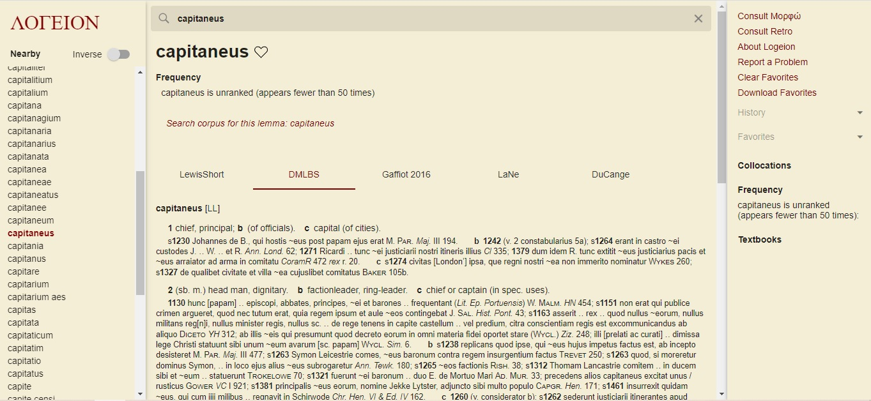

Slide 42
Online Latin Meta-Dictionaries
Database of Latin Dictionaries (DLD) – through Brepols
contains:
concerning classical Latin: Forcellini’s Lexicon Totius Latinitatis, Lewis and Short Latin Dictionary, Le Gaffiot;
concerning patristic age: Dictionnaire latin-français des auteurs chrétiens by Albert Blaise, A Glossary of Later Latin to 600 A.D. by Alexander Souter;
concerning medieval and early modern Latin: Lexicon latinitatis medii aeui by Albert Blaise, Du Canges’ Glossarium mediae et infimae latinitatis, national dictionaries of medieval Latin from 20th century: Italian Latinitatis italicae medii aevi lexicon, Hungarian Glossarium mediae et infimae Latinitatis regni Hungariae by Antonius Bartal (1901) , Spanish Lexicon Latinitatis Medii Aevi Regni Legionis (s. VIII-1230) imperfectum (2010) , British Dictionary of Medieval Latin from British Sources (see above) and Czech Latinitatis medii aevi Lexicon Bohemorum (see above);
many others thematic and medieval dictionaries.

Slide 43
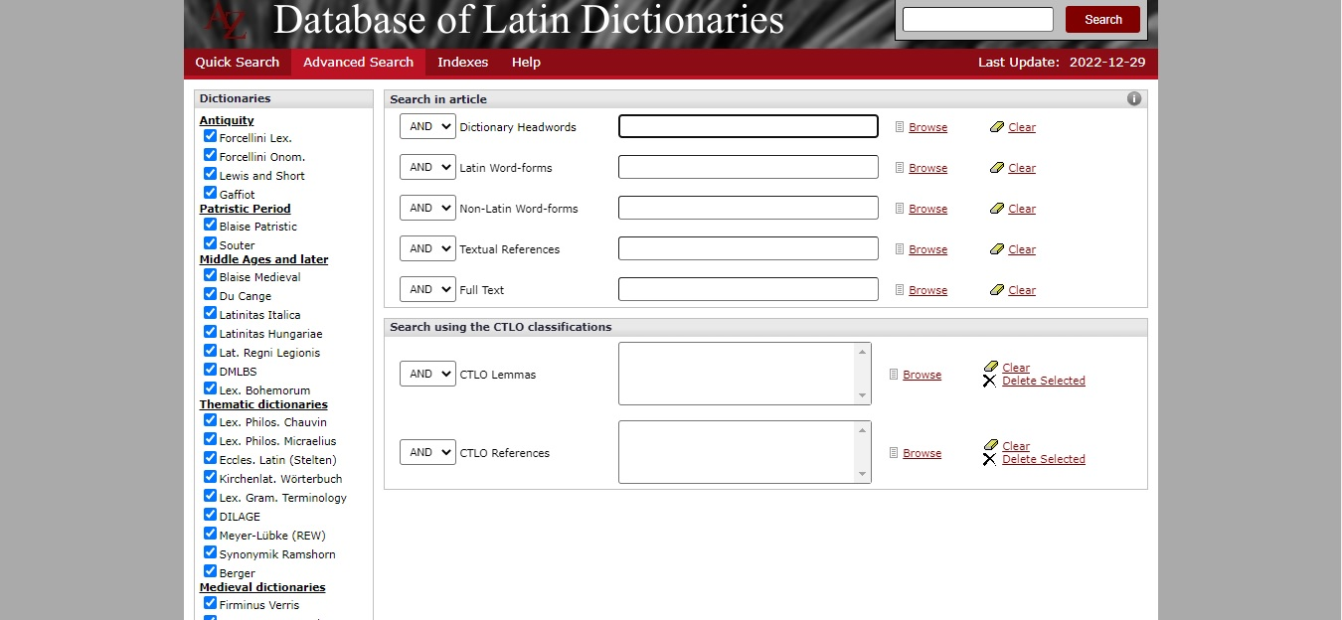

Slide 44
Grammar Tool
Whitaker’s WORDS – a Latin translation software
more than 39 000 entries
offers grammatical analysis of a typed word in terms of part of speech, gender, case, number, comparison, numeral sort, tense, number of conjugation, voice, mood, pronoun type.
Legible Latin – user-friendly Whitaker’s WORDS
downloadable from https://www.softpedia.com/get/Others/Home-Education/Legible-Latin.shtml#sgal_4

Slide 45
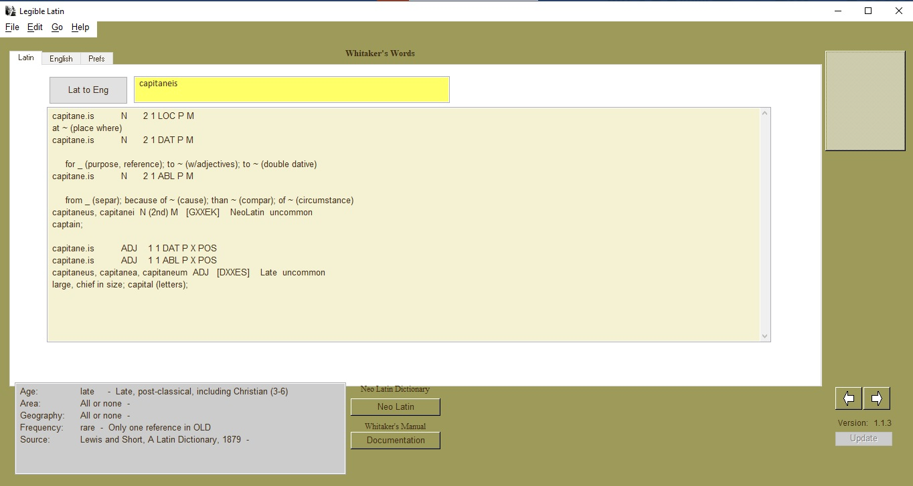

Slide 46
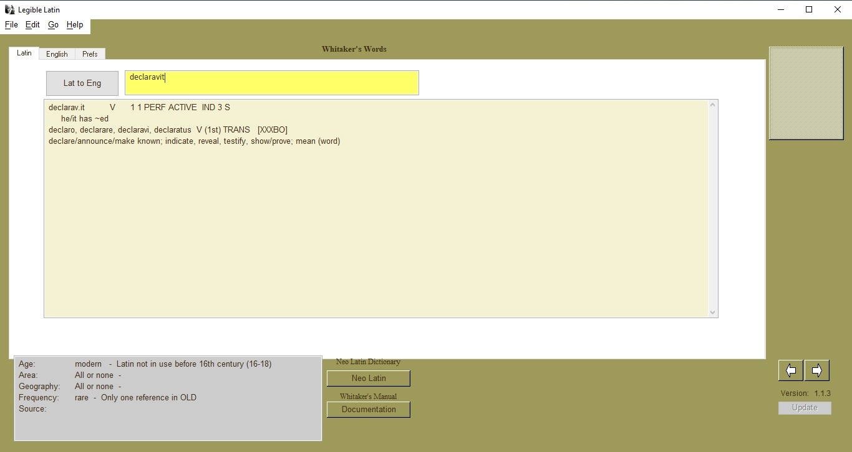

Slide 47
Thank you for your attention!
          Workshop, Paris 7-10 February 2023
          Kacper Górski (Jagiellonian University in Kraków)
          E-mail: kacper.gorski@uj.edu.pl

