Slide 1

          DIGITAL TOOLS IN LEGAL HISTORY
            Workshop, Paris 7. – 10. February 2023
            Maciej Mikuła (Jagiellonian University in Kraków)
            maciej.mikula@uj.edu.pl

Slide 2

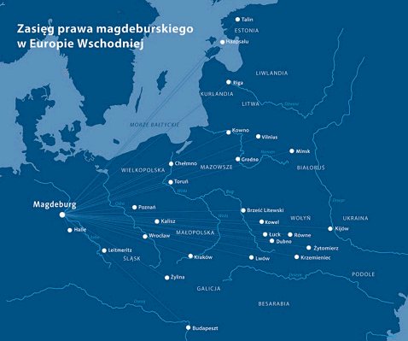
  Source: https://nadmiastem.wordpress.com/category/uncategorized/ (2017-05-03; 15:11)

Slide 3

DICTIONARIES ONLINE
DuCange: http://ducange.enc.sorbonne.fr
Gaffiot: https://www.lexilogos.com/latin/gaffiot.php
Słownik łaciny średniowiecznej: https://elexicon.scriptores.pl
Logeion: https://logeion.uchicago.edu

Slide 4
Five sets: provisions of Ius municipale Magdeburgense
Set I [Manuscript of Gniezno Archidioecesian Archives, Shelfmark 104, 1359]
Set II [Manuscript of State Archives in Przemyśl, Shelfmark 428, 1473-1474]
Set III [Manuscript of Kórnik Library, Shelfmark 800, post 1472]
Set IV [Commune incliti Poloniae Regni…, Iohannes Lascius, 1506]
Set V [Ius municipale Magdeburgense…, Nicolaus Iaskier, 1535]

Slide 5
Set I [Manuscript of Gniezno Archidioecesian Archives, Shelfmark 104, 1359]
[17] De dono in infirmitate donato.
∙XVII∙ Nemo masculus, ├necª┤ nec ulla mulier possunt in lecto egritudinis de suis bonis alicui ultra tres solidos dare absque heredum consensu seu voluntate.
[66] De hereditate, que mortuo domino permanet sine successore.
[fol. 106v] ∙LXVI∙ Quod si hereditas mortaliola [s] absque heredibus inventa seu reperta fuerit, regie cedet maiestati.
https://iura.uj.edu.pl/dlibra/publication/605/edition/191/content?ref=struct
https://iura.uj.edu.pl/dlibra/publication/669/edition/250/content?ref=struct

Slide 6
Set II [Manuscript of State Archives in Przemyśl, Shelfmark 428, 1473-1474]
[17] De dono in infirmitate donato. C[apitulum] XXI
Nemo masculus, nec ulla mulier possunt in lecto egritudinis de suis bonis alicui ultra tres solidos dare absque heredum consensu seu voluntate etc.
[69] De hereditate, que mortuo domino permanet et sine successore. Capitulum LXIX
Si hereditas mortaliola absque heredibus inventa seu reperta fuerit ita, quod nullus se ad hanc trahet infra annum et diem, hoc inquit cedit regie maiestati, nisi legale impedimentum inpedierit.
https://iura.uj.edu.pl/dlibra/publication/1139/edition/512/content?ref=struct
https://iura.uj.edu.pl/dlibra/publication/1412/edition/744/content?ref=struct

Slide 7
Set III [Manuscript of Kórnik Library, Shelfmark 800, post 1472]
[17] De dono in egritudinis lecto. XVII
Nemo masculus nec nulla mulier possunt in lecto [s. 110] egritudinis de suis bonis alicui ultra tres solidos dare absque heredum consensu seu voluntate, nec uxor sine viri consensu.
[64] De obmortua hereditate. LXVI
Si hereditas obmoriatur, ita quod nullus se trahat ad hanc infra annum et diem, hoc [s] nu[m]quam cedit regie mai[e]stati.
https://iura.uj.edu.pl/dlibra/publication/2385/edition/1681/content?ref=struct
https://iura.uj.edu.pl/dlibra/publication/2374/edition/1670/content?ref=struct

Slide 8
Set IV [Commune incliti Poloniae Regni…, Iohannes Lascius, 1506]
[19] De legationibus seu donis in lecto egritudinis.
Nemo masculus, nec ulla mulier possunt in loco egritudinis de bonis suis alicui ultra tres solidos dare absque heredum consensu seu voluntate, nec mulier sine consensu mariti.
[73] De hereditate lege caduca ad regiam maiestatem devolvenda.
Si hereditas absque successoribus relinquitur, ita quod nullus se trahat ad eadem infra annum et die, hoc pertinet ad regiam maiestatem.
https://iura.uj.edu.pl/dlibra/publication/2385/edition/1681/content?ref=struct
https://iura.uj.edu.pl/dlibra/publication/2374/edition/1670/content?ref=struct

Slide 9
Set V [Ius municipale Magdeburgense…, Nicolaus Iaskier, 1535]
Articulus LIX. De haereditate relicta nullo haerede extante.
Si haereditas relinquatur vacuaa, hoc est, non extante haerede, et ad quam se nullus trahit in anno et die, illa ad regalem pertinet maiestatem.
Articulus LXV. De dono in lecto egritudinis.
Nemo masculus neque ulla foemina possunt in lecto egritudinis de bonis suis alicui quicquam dare ultra tres solidosa absque heredum consensu. Nec mulierb quicquam dare potest sine consensu mariti.
Glosa
Testis autem ad ordinationem testamentalem esse non debet mulier, puer annos non habens[…], ut Insti[tutione] de testamen[ti] ordi[natione].

Slide 10
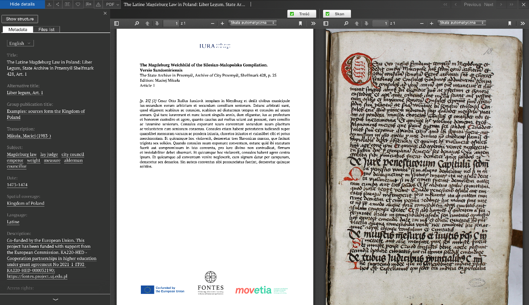
Three issues
  - spreading of legal texts
  - dynamic of normative texts
  - changes of text meaning
  How digital tools can help?
  Source: https://iura.uj.edu.pl/dlibra/publication/2940/edition/2229/content?ref=struct (2023-02-03; 15:11)

Slide 11
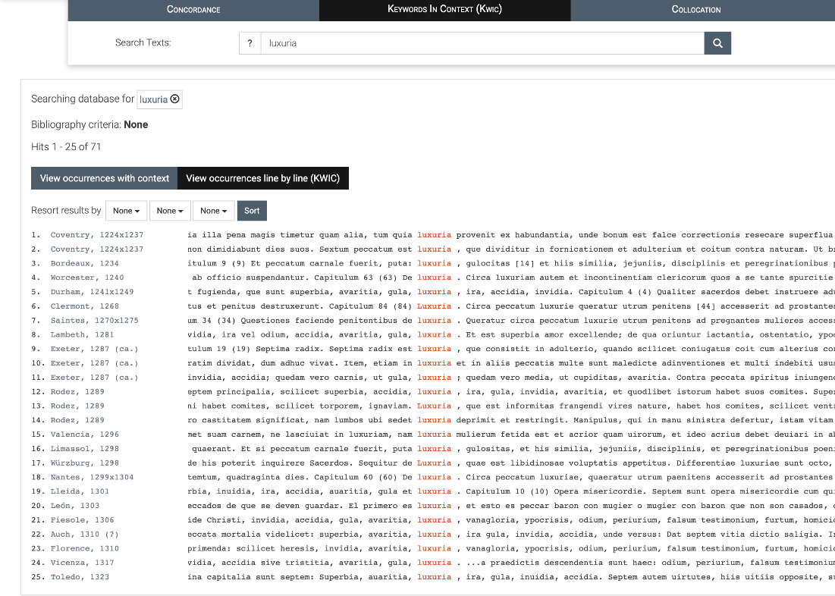
Spread of legal text [1]
Corpus Synodalium
https://corpus-synodalium.com/
Search for: luxuria
Source: https://corpus-synodalium.com/philologic/corpus/query?report=kwic&method=proxy&q=luxuria&start=0&end=0&direction=&metadata_sorting_field= (2023-02-03)

Slide 12
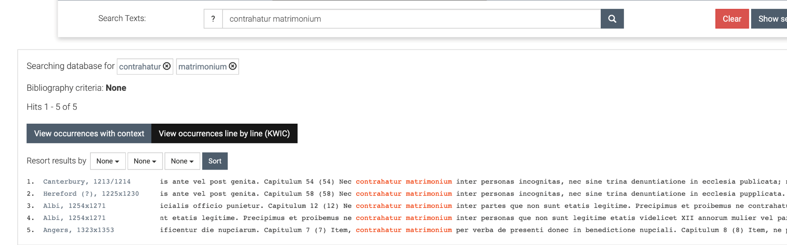
Spread of legal text [2]
Corpus Synodalium; Search for: contrahatur matrimonium
Source: https://corpus-synodalium.com/philologic/corpus/query?report=kwic&method=proxy&q=contrahatur%20matrimonium&start=0&end=0&direction=&metadata_sorting_field= (2023-02-03)

Slide 13
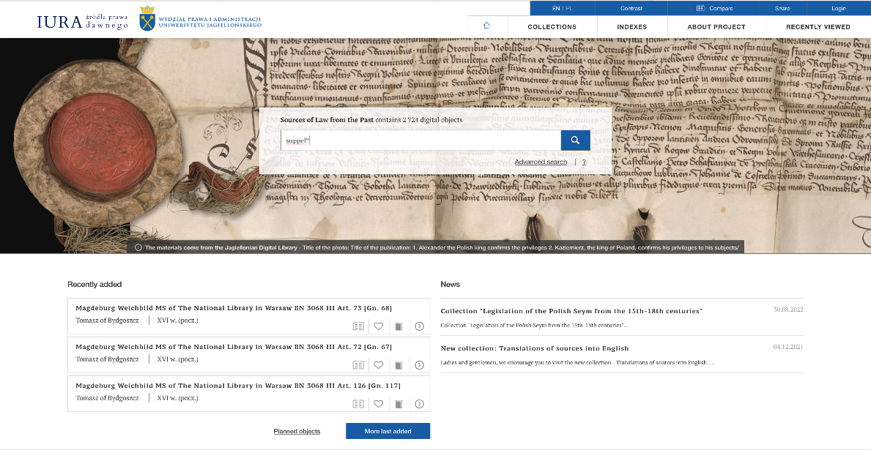
Spread of legal text [3]
IURA.
Sources of Law from the past
https://iura.uj.edu.pl/dlibra
Search for: suppel*
[suppellectilia]
Sources for two following pages (2023-02-03):
https://iura.uj.edu.pl/dlibra/publication/3312/edition/2542/content?q=suppel%20&ref=aHR0cHM6Ly9pdXJhLnVqLmVkdS5wbC9kbGlicmEvcmVzdWx0cz9xPXN1cHBlbComYWN0aW9uPVNpbXBsZVNlYXJjaEFjdGlvbiZ0eXBlPS02JnA9MCZxZjE9RGF0ZV9yYW5nZSUzQTEzNjAwMTAxJTdFMTQxMDEyMzE
https://iura.uj.edu.pl/dlibra/publication/3509/edition/2738/content?q=suppel%20&ref=aHR0cHM6Ly9pdXJhLnVqLmVkdS5wbC9kbGlicmEvcmVzdWx0cz9xPXN1cHBlbComYWN0aW9uPVNpbXBsZVNlYXJjaEFjdGlvbiZ0eXBlPS02JnA9NQ

Slide 14
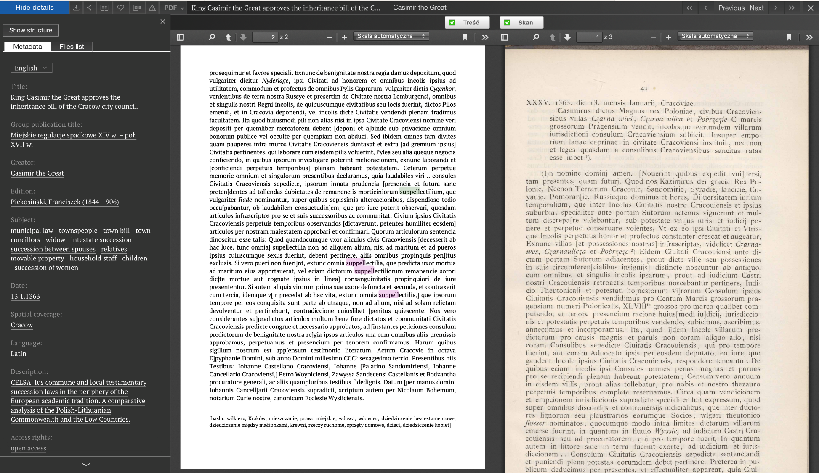


Slide 15
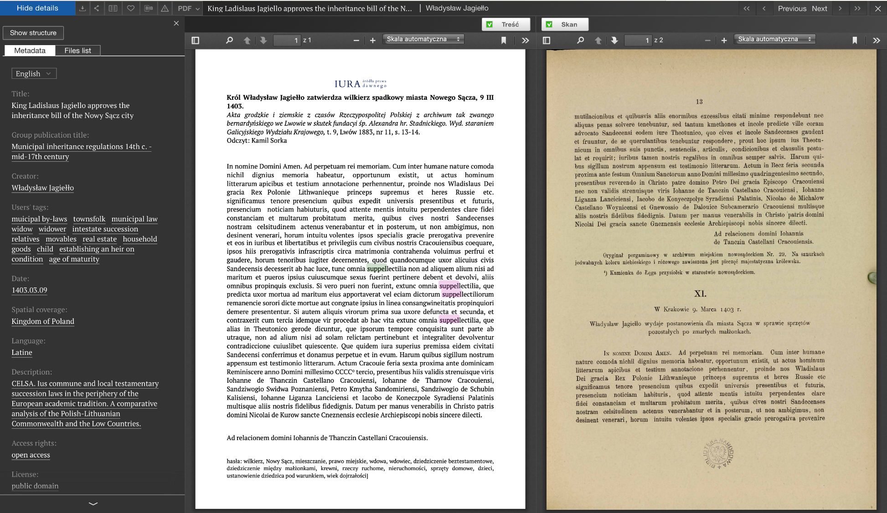

Slide 16
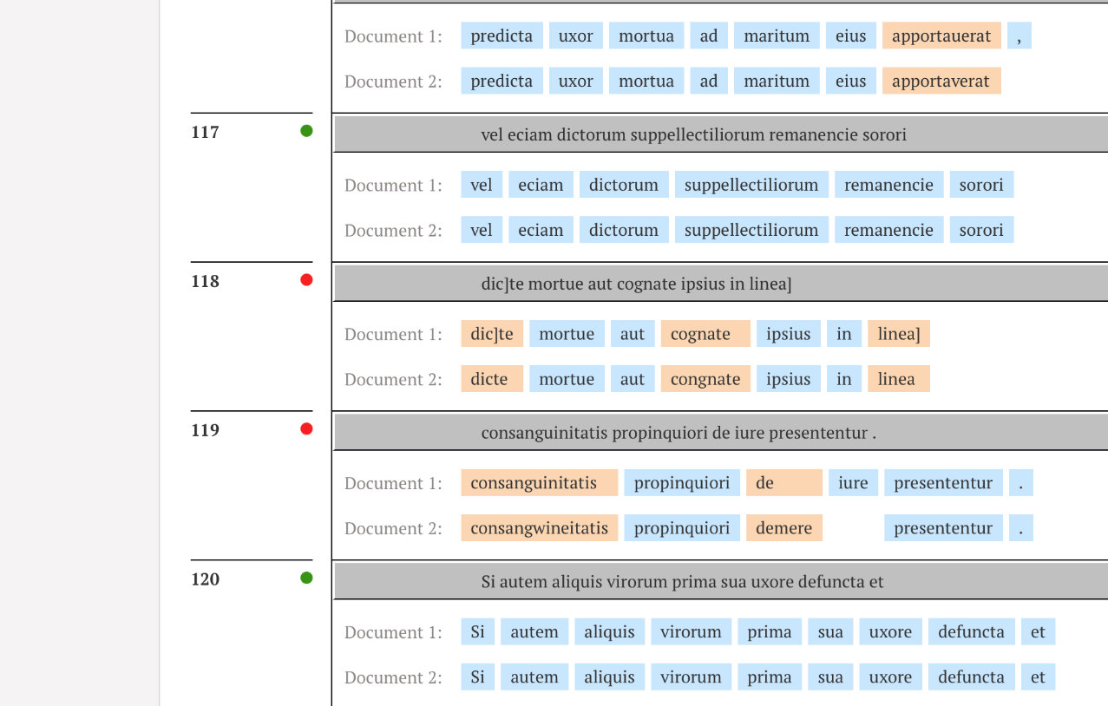

Slide 17
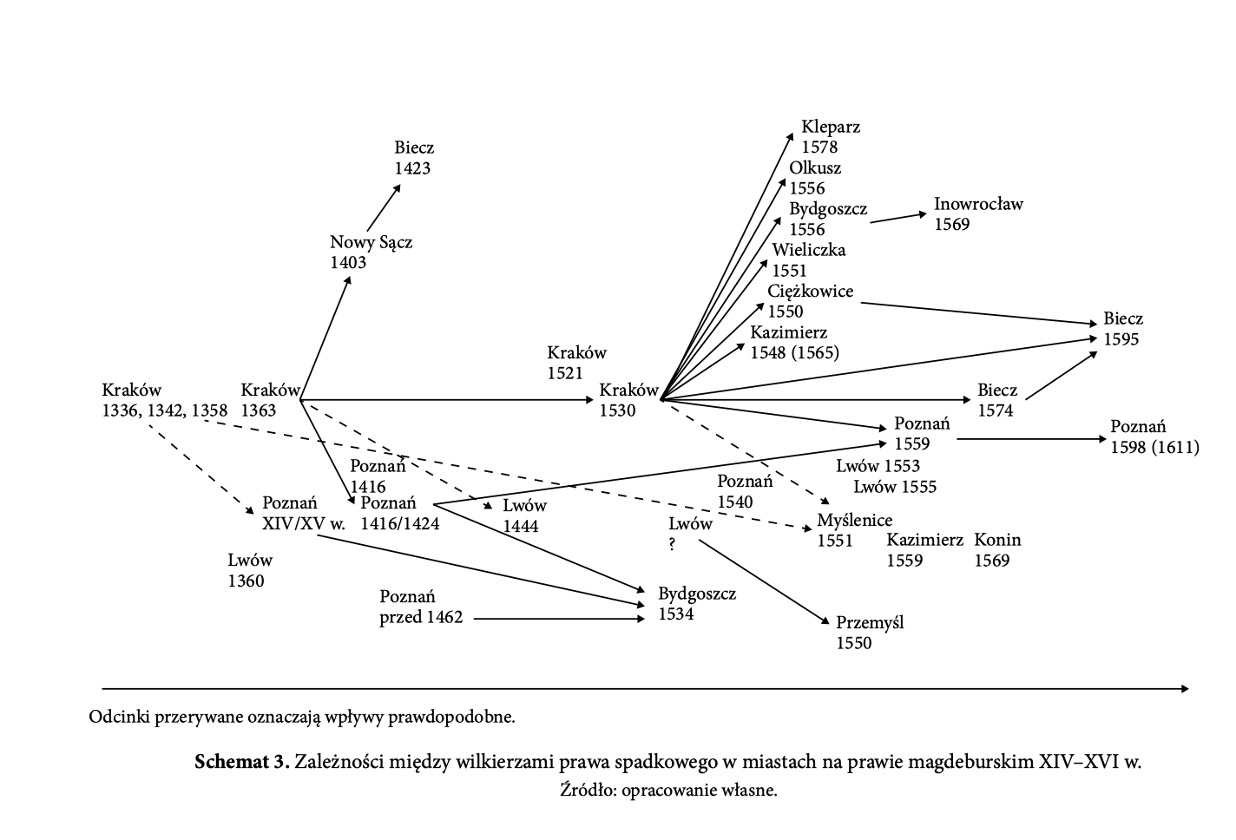
Source: M. Mikuła, Prawodawstwo monarsze i sejmowe dla małopolskich miast królewskich (1386-1572). Studium z dziejów rządów prawa w Polsce, Kraków: Wydawnictwo Uniwersytetu Jagiellońskiego, 2014

Slide 18
  Dynamic of medieval normative texts [1]
Many versions of the same provision!
Contemporary continental law: legislation → law in force → application of law
Middle Ages: application of the modified legal text → modified law in force → in practice, each extant text may have had an identical legal value
- Before digitalization: How to edit legal sources? All texts in extenso? Critical edition – one text and a huge of number of variants in footnotes?

Slide 19
  Dynamic of medieval normative texts [2]
https://tei-c.org/activities/projects/
„Bibliotheca legum. A Database on Carolingian Secular Law Texts” (http://www.leges.uni-koeln.de/en/)
“Aberdeen Registers Online: 1398-1511” (https://www.abdn.ac.uk/riiss/projects/aberdeen-registers-online-213.php).
„Swiss Law Sources Online”. (https://editio.ssrq-online.ch/NE/4/1.37-1.html)

Slide 20
  Dynamic of medieval normative texts [3]
IURA
[https://iura.uj.edu.pl/dlibra/publication/3516/edition/2743/content?ref=struct]
Donatio in lecto egritudinis
https://iura.uj.edu.pl/dlibra/publication/2374/edition/1670/content?ref=desc
https://iura.uj.edu.pl/dlibra/publication/1139/edition/512/content?ref=desc

Slide 21
  Changes of text meaning
Hyper Machiavelli project: new translations, new meanings
Digital tools are not ideal. How to describe resources in Semantic Web?
The need of consequent and coherent description of resources
Thesauri

Slide 22
Thank you for your attention!
            Workshop, Paris 7. – 10. February 2023
            Maciej Mikuła (Jagiellonian University in Kraków)
            maciej.mikula@uj.edu.pl

