Slide 1

Canon law: 1. DECRETUM GRATIANI
Gratian: Concordia discordantium canonum (DECRETUM)
1st part: 101 distinctiones
  D. c.
    D.1, c.1
    D.1, c. Humanum genus
2nd part: 36 Causae
  Causa 23: 8 quaestiones
  Causa 33: Tractactus de Poenitentia
  C.23, q.4, c.17
  C.23, q. Quomodo mali, c. Infidelium
    (“Infidelium colloquia et convivia non sunt evitanda”)

Slide 2
Canon law: 2. DECRETUM GRATIANI
dictum ante:
  “C.23, q.4, d.a.1” (or “a.1”)
dictum post
  “C.1, q.1, c.43”
    Grat. (post) Si qui episcopi
3rd part of Decretum: De consecratione

Slide 3
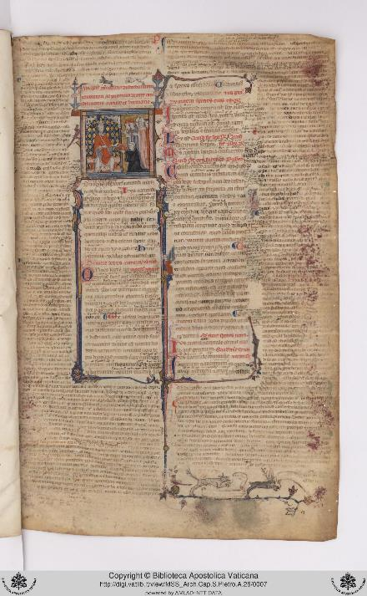
Decretum, manuscript (source: BAV) - 1

Slide 4
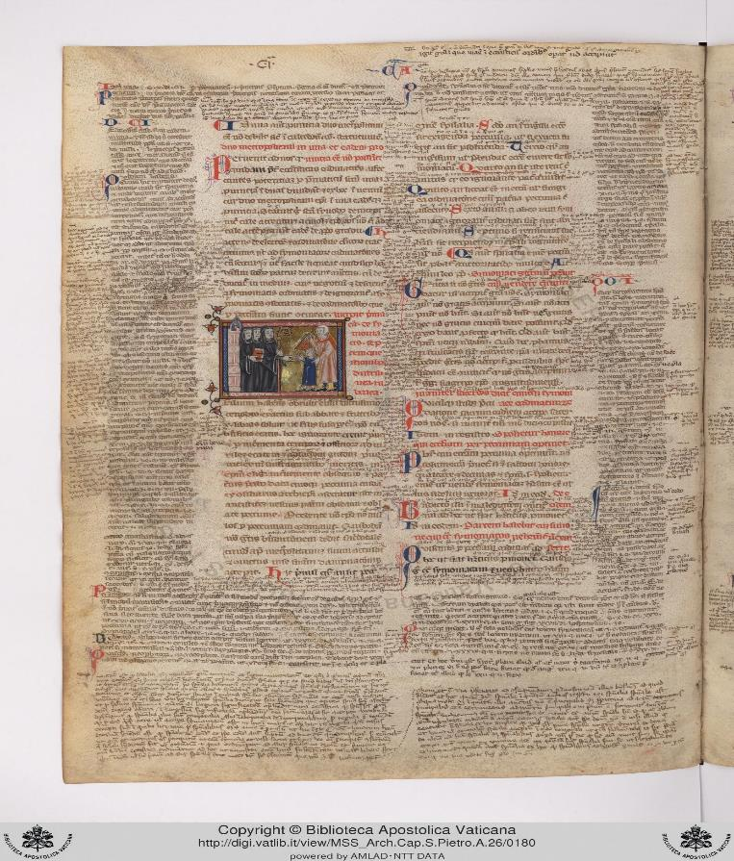
Decretum, manuscript (source: BAV) - 2

Slide 5
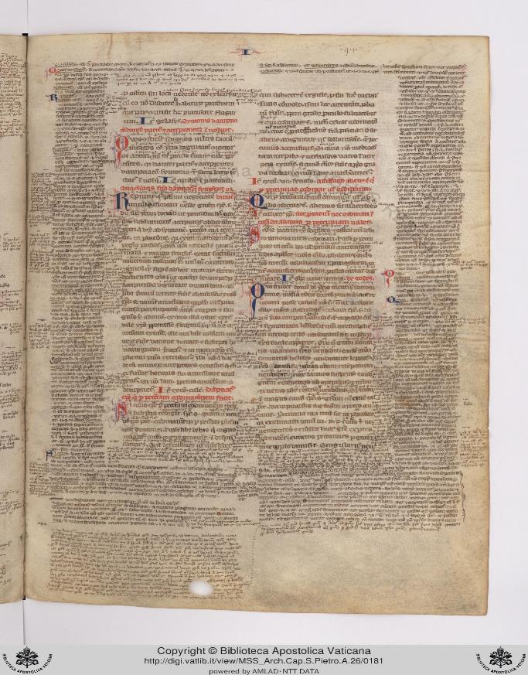
Decretum, manuscript (source: BAV) - 3

Slide 6
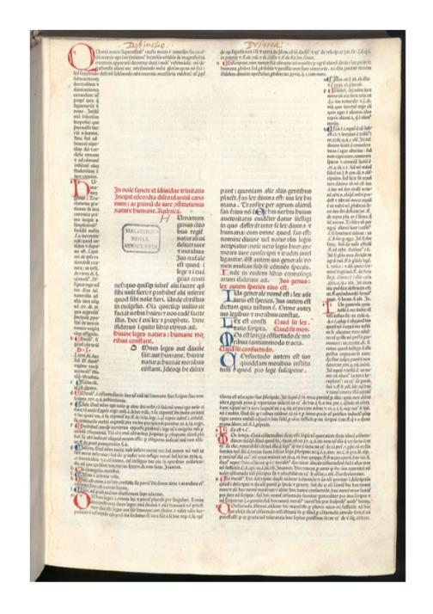
Decretum – printed (source: Munich Digitalisierungs Zentrum) - 1

Slide 7
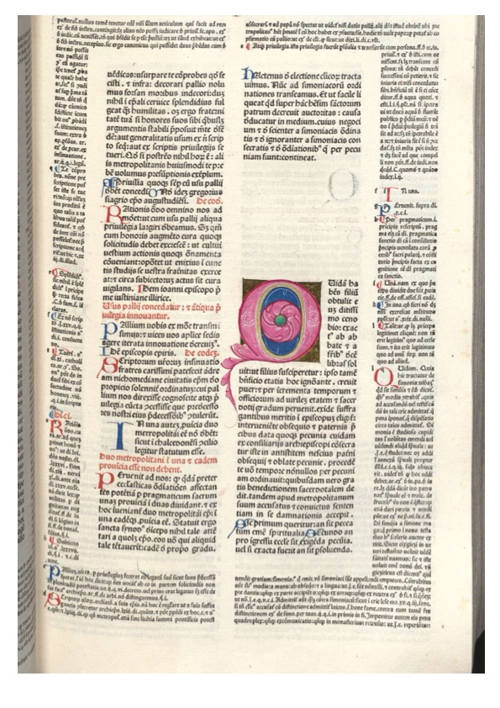
Decretum – printed (source: Munich Digitalisierungs Zentrum) - 2

Slide 8
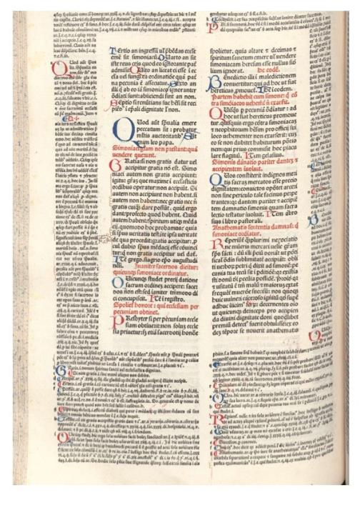
Decretum – printed (source: Munich Digitalisierungs Zentrum) - 3

Slide 9
Decretum: critical edition
Emil Friedberg (1879)
https://geschichte.digitale-sammlungen.de/decretum-gratiani//text/

Slide 10
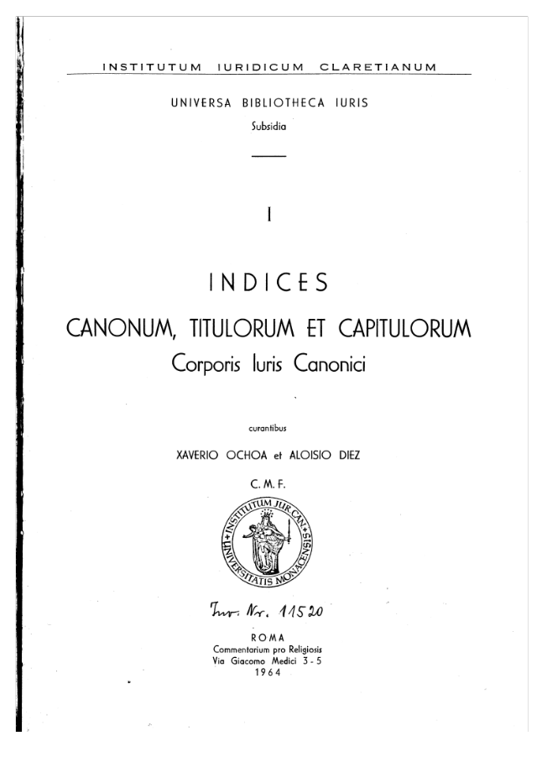
Decretum: Reference 1

Slide 11
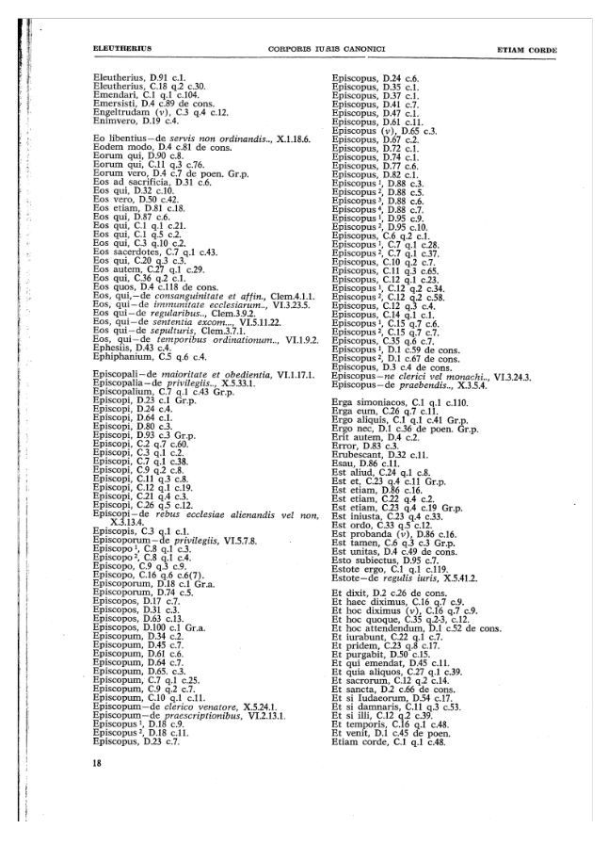
Decretum: Reference 2

Slide 12
Liber Extra - 1
Sources and ecclesiastical offices
Procedure
Clergy, properties and benefices of the clergy
Marriage
Criminal law
https://www.hs-augsburg.de/~harsch/Chronologia/Lspost13/GregoriusIX/gre_0000.html#1

Slide 13
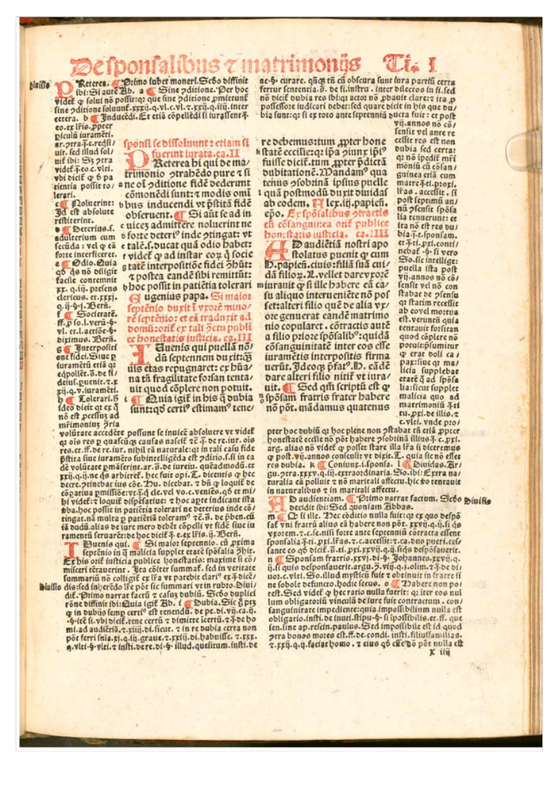
Liber Extra 2 – X.3.2 / X.3, § Praeterea hi

Slide 14
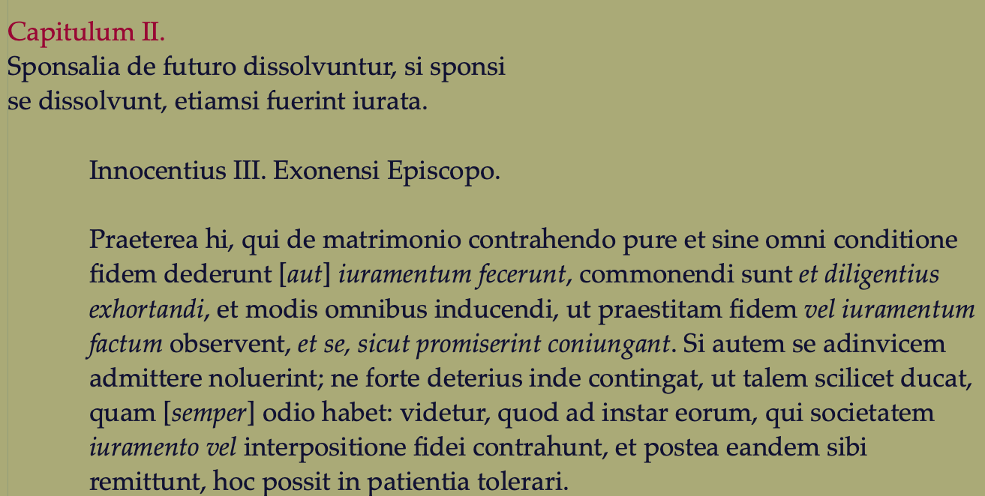
Liber Extra - 3

Slide 15
NORMATIVE LOCAL SOURCES

Slide 16
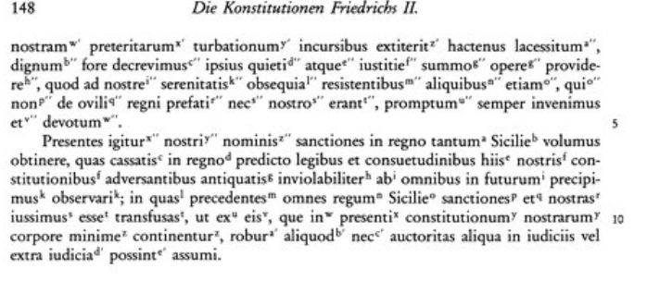
The kingdom of Sicily (1130-1860)
Liber Augustalis (1231-1248) by Frederick II, Emperor of S.R.E. and king of Sicily

Slide 17

https://www.dmgh.de/mgh_const_2_suppl/index.htm#page/(III)/mode/1up

Slide 18
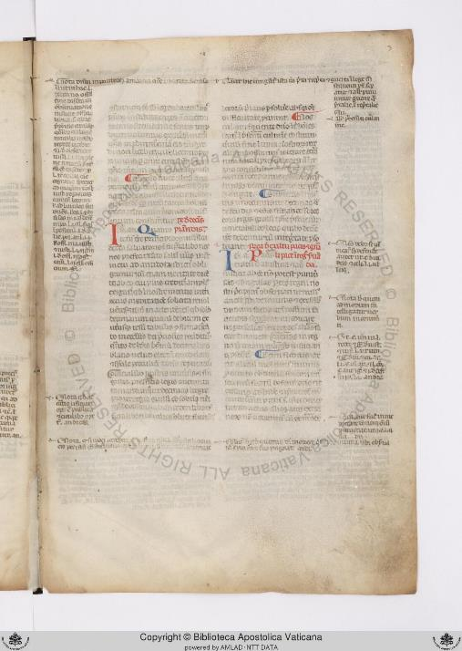
Vat.lat. 6770, f.3r https://digi.vatlib.it/view/MSS_Vat.lat.6770

Slide 19
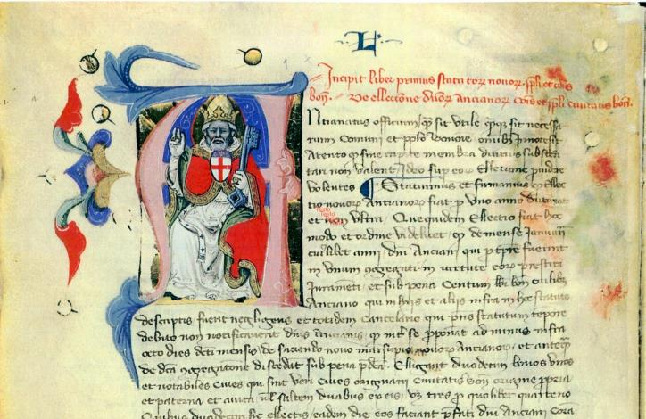
City Statutes - BOLOGNA 1376 source: A.L. Trombetti Budriesi, Gli statuti di Bologna e la normativa statutaria dell’Emilia Romagna tra XII e XVI secolo, available online: https://doi.org/10.4000/mefrm.2396

Slide 20
DOCTRINAL SOURCES

Slide 21
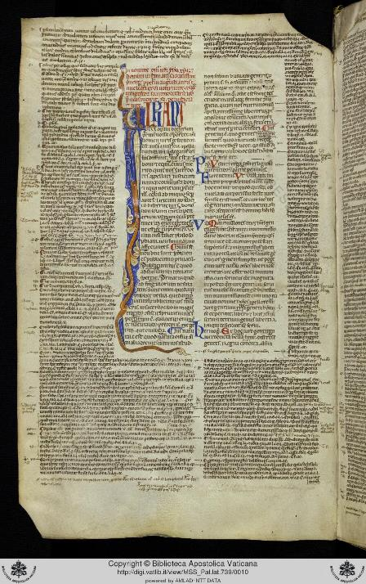
GLOSS a) Gloss on the C. Iur. Civilis: Vetus 1 (BAV)

Slide 22
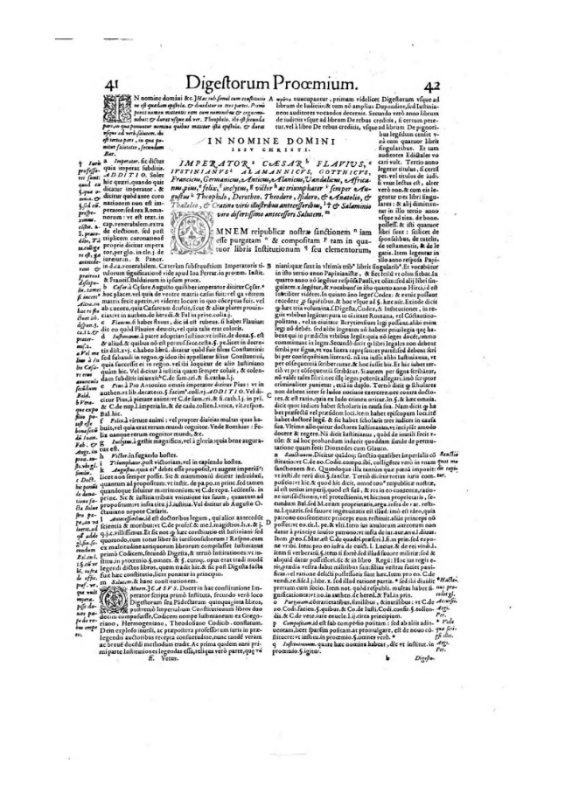
Gloss on the Vetus - 2 (MDZ)

Slide 23
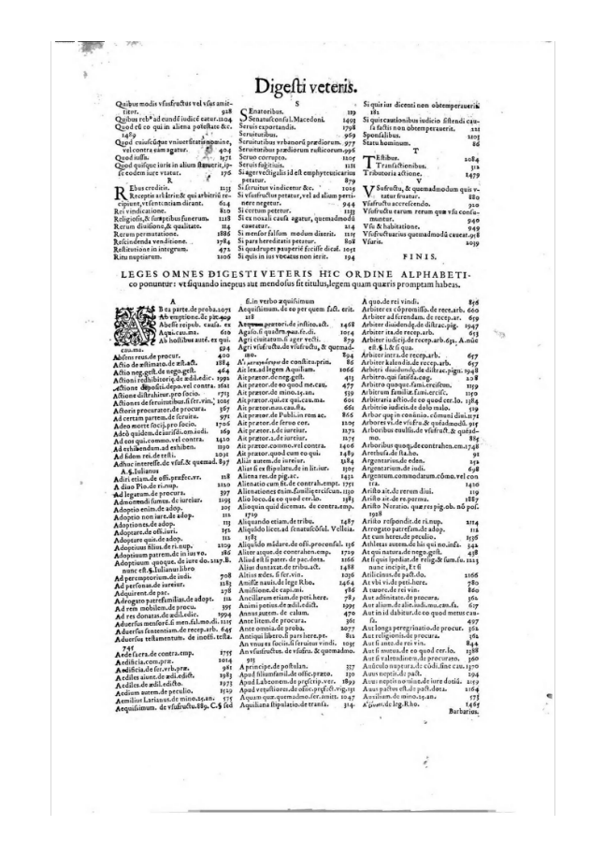
Gloss on Vetus – 3 (MDZ)

