Slide 1

Gloss on the Decretum - 2 (MDZ)

Slide 2
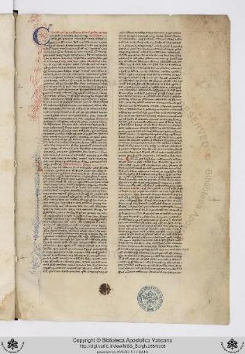
SUMMAE – Azo, Summa Codicis 1 (BAV)

Slide 3
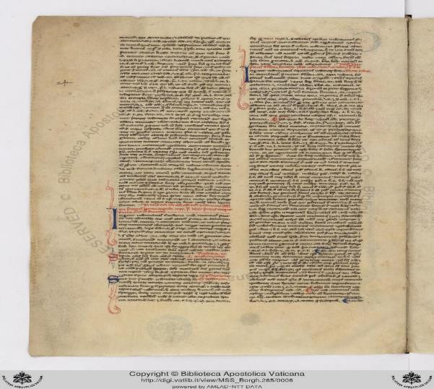
Azo, Summa Codicis 2 (BAV)

Slide 4
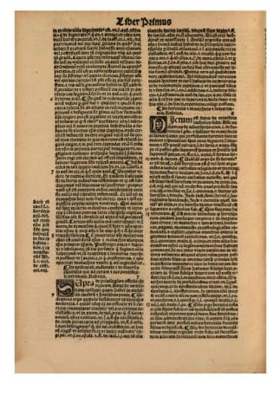
Azo, Summa Codicis 3 (MDZ)

Slide 5
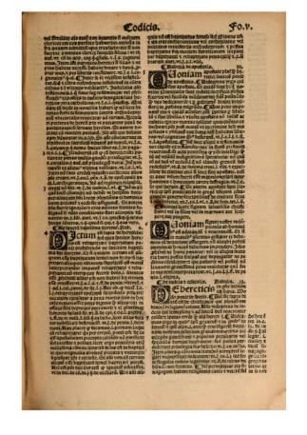
Azo, Summa Codicis 4 (MDZ)

Slide 6
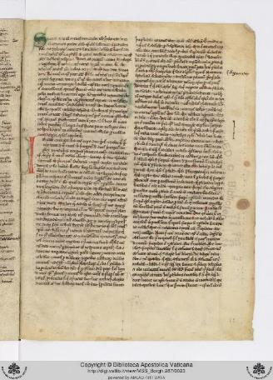
Summa Decreti, Stephen of Tournai - 1 (BAV)

Slide 7
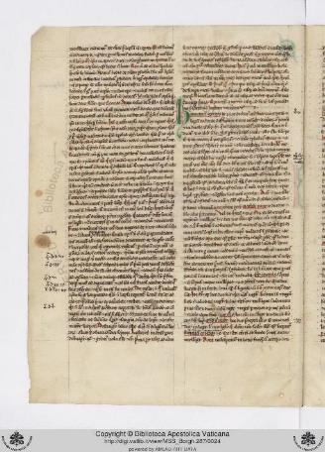
Summa Decreti, Stephen of Tournai - 2 (BAV)

Slide 8
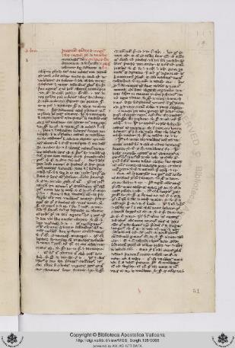
QUAESTIO - quaestiones de facto - 1 (Pillius, BAV)

Slide 9
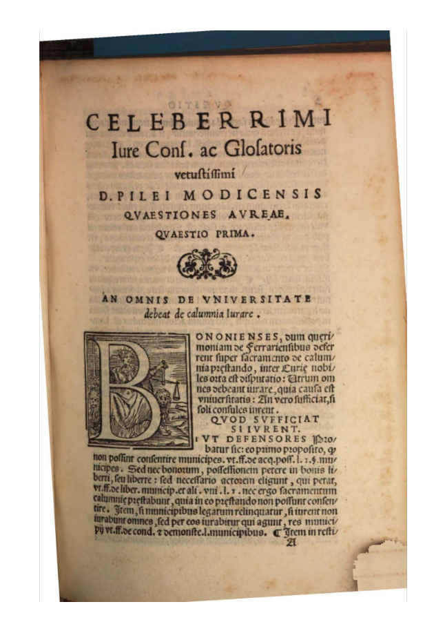
QUAESTIO - quaestiones de facto - 2 (Pillius, MDZ)

Slide 10
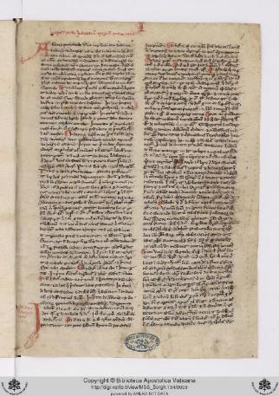
Ordo iudiciarius – Tancred of Bologna (BAV)

Slide 11

Thank you!!
All images, which have been used here solely for educational purposes, are subject to copyright.

